Slide 1




19th December 2025
A VERY Merry Christmas from all at Cavalry…

Slide 2

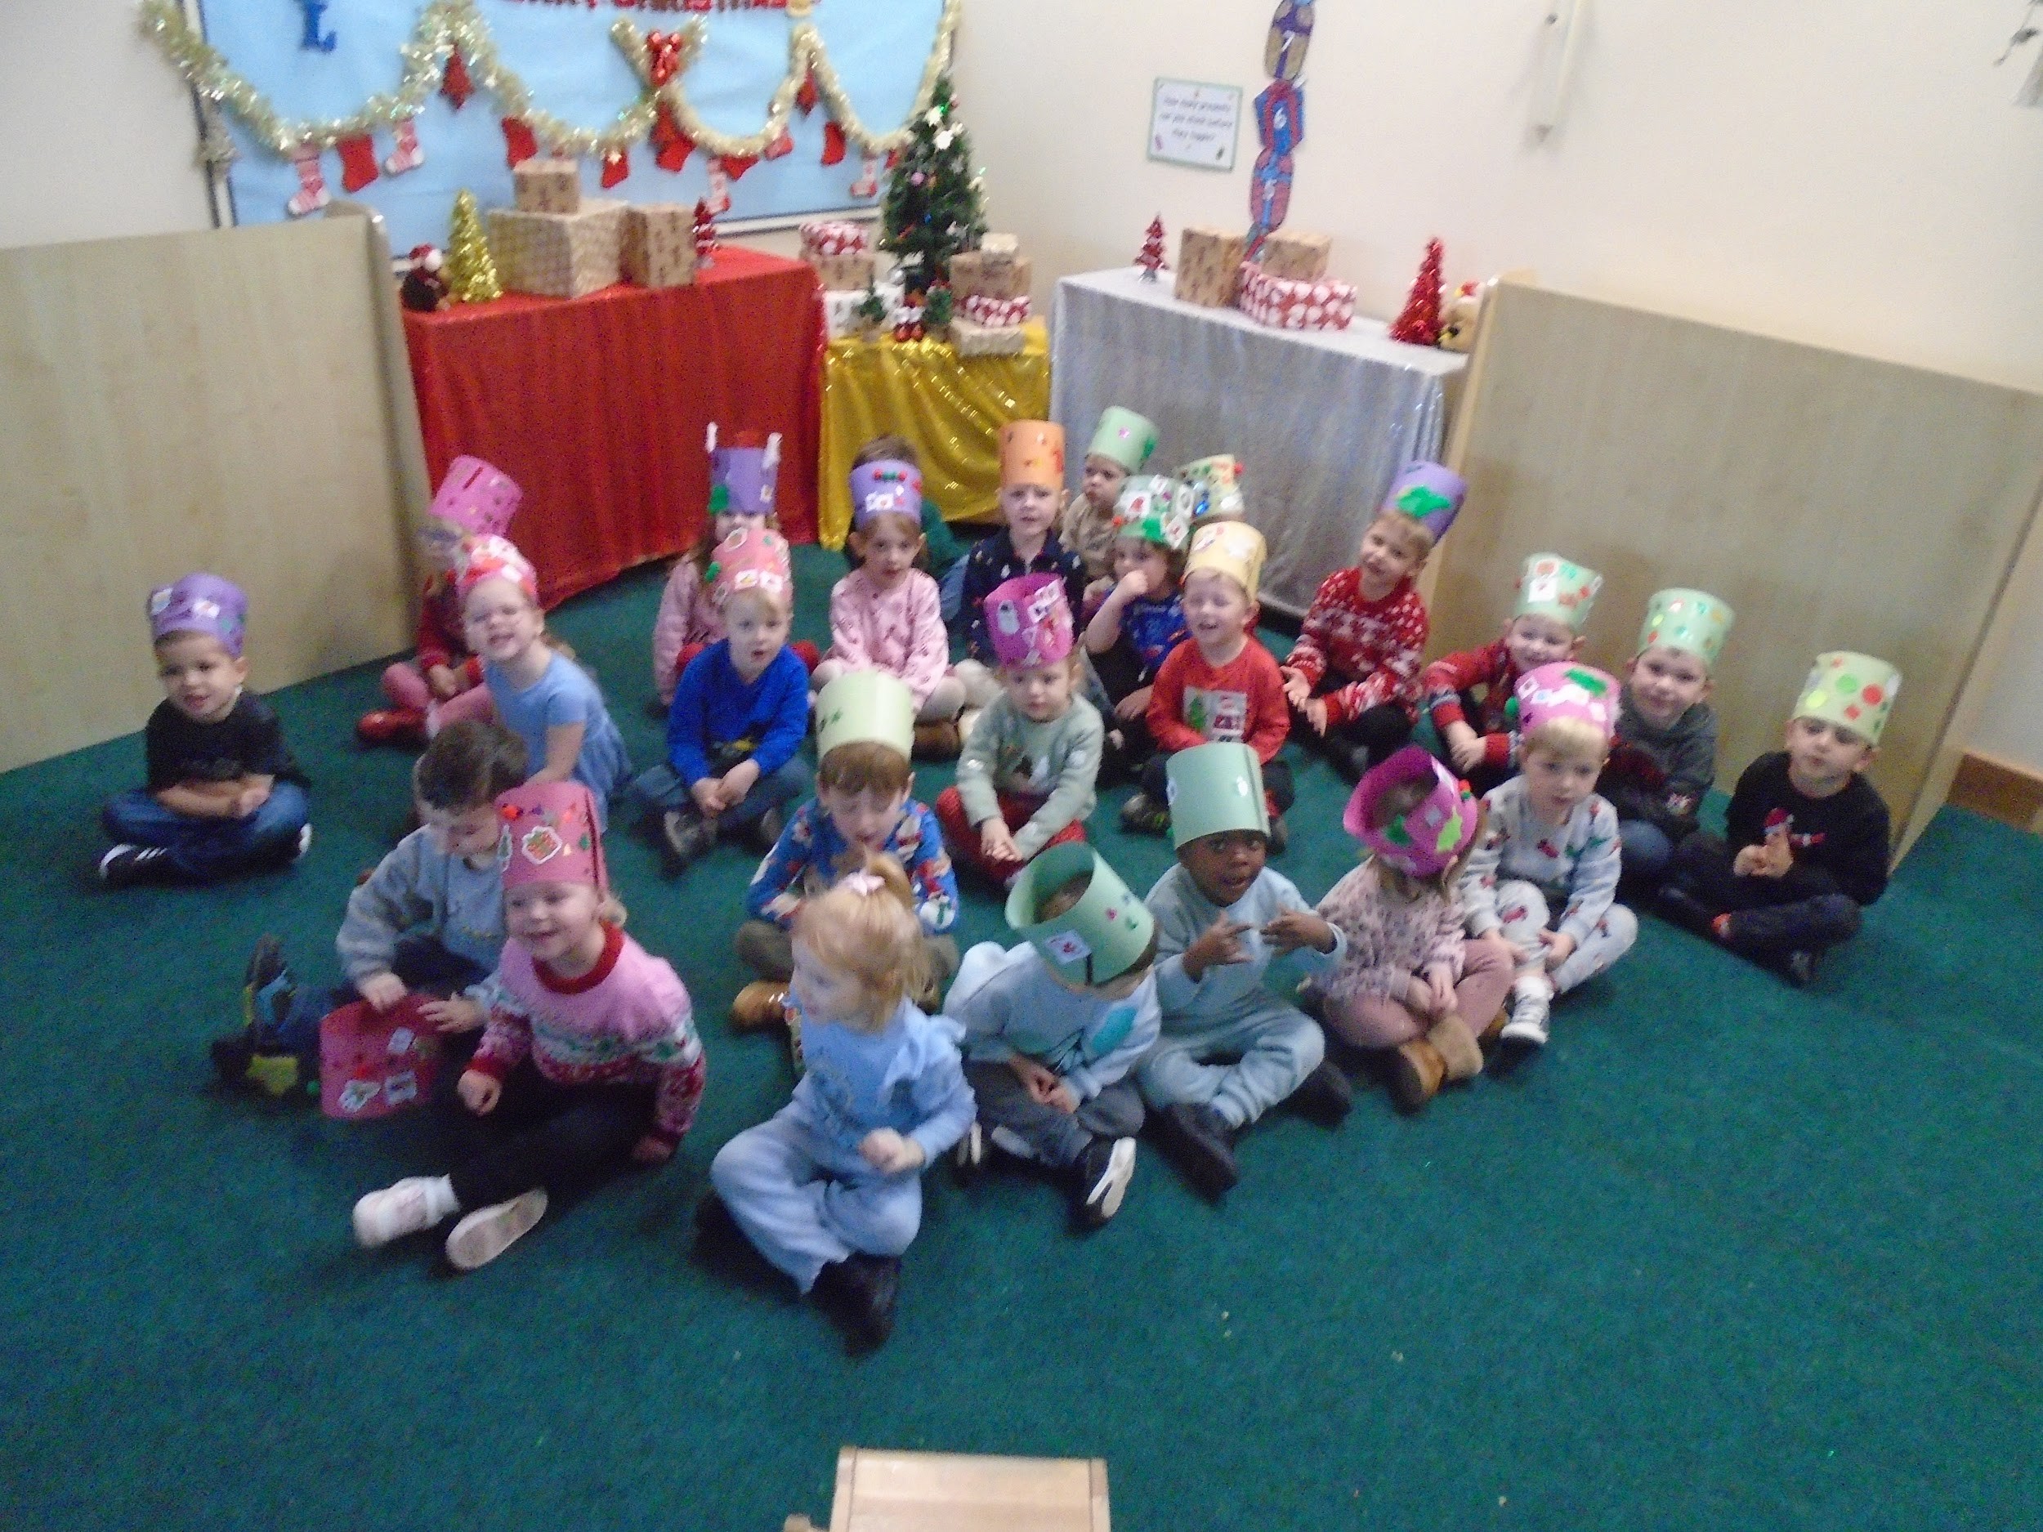
Nursery Christmas Sing Song!
We are incredibly proud of the children who performed for our Nursery families in our Christmas sing song this week. The children loved having our spectators join in with singing and actions to a collaborative rendition of Jingle Bell Rock!

Slide 3
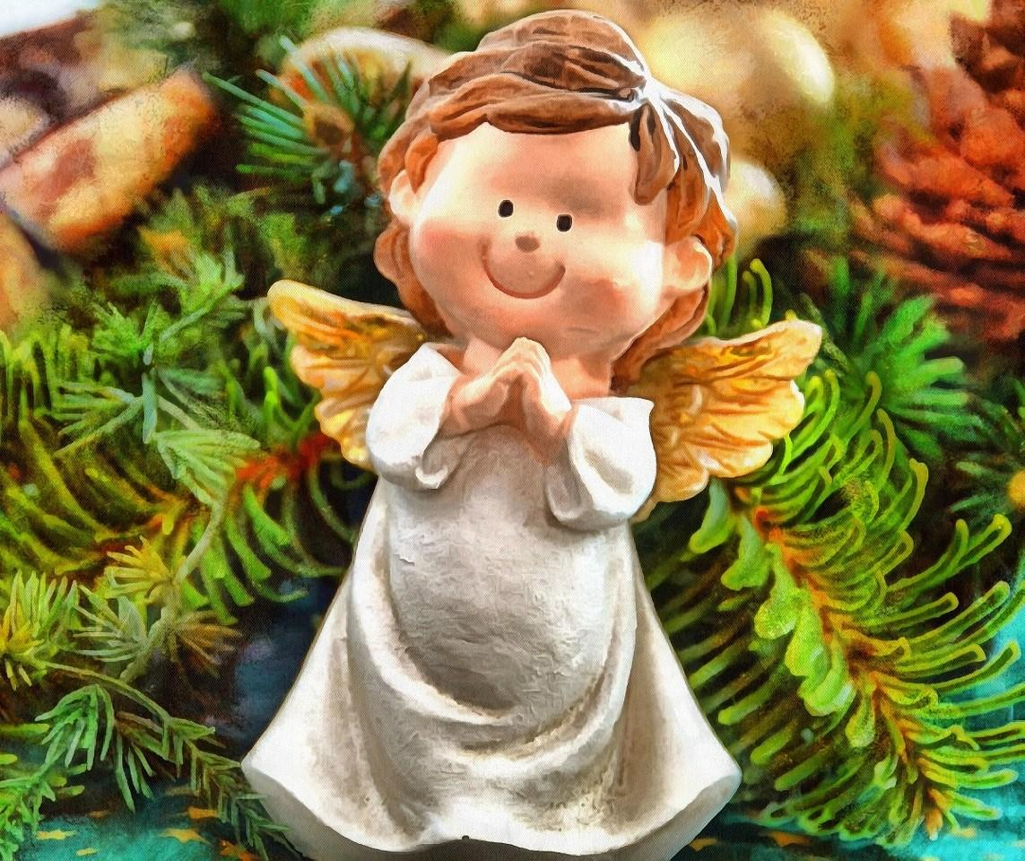
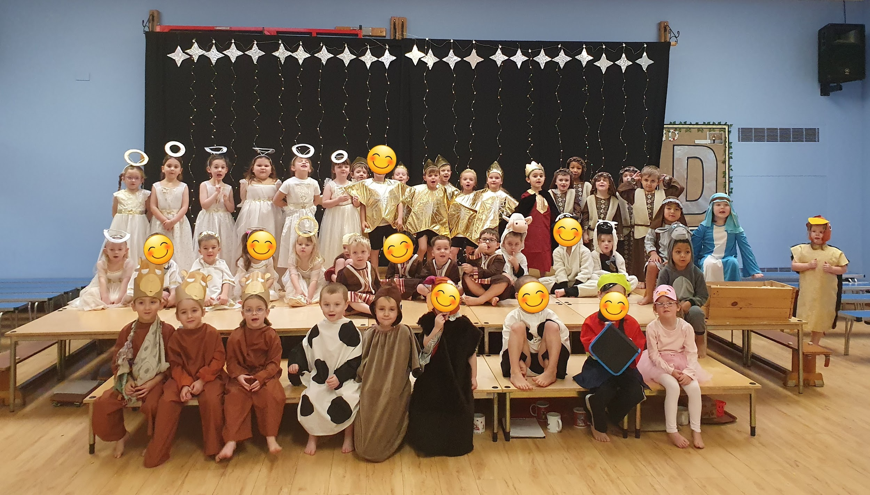
Reception’s Angel Express
This week the Reception children performed brilliantly to tell the story of the ‘Angel Express’, a story about a group of angels who hear news of baby Jesus and who want to sing a song for Him.
The children sang so beautifully and the acting was wonderful… we couldn’t be more proud of them!

Slide 4
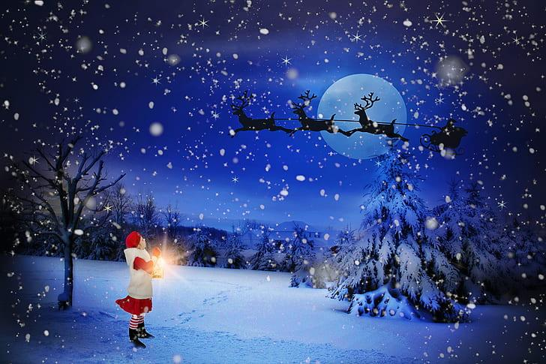
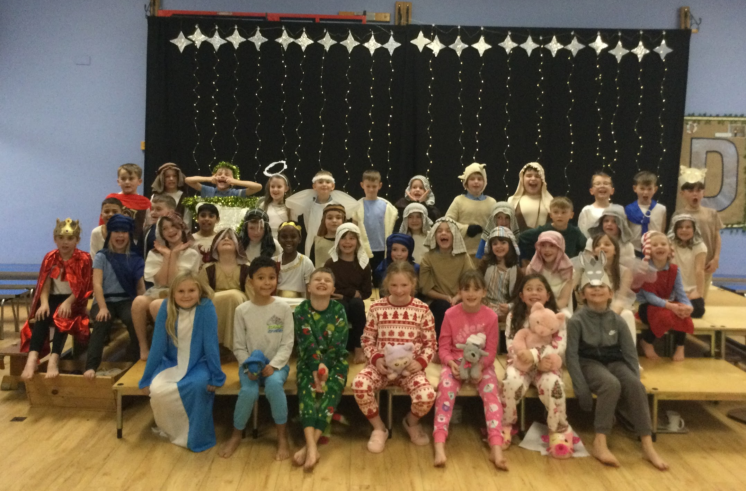
Year 1, 2 and 3 - A King is Born
Years 1, 2 and 3 worked super hard on their Nativity production this year, with the Year 3 children doing an outstanding job of retelling the story of how ‘A King is Born’.
A loving mum told her children all about how Mary and Joseph travelled A long, long way to Bethlehem where it was a Squash and a Squeeze to get in anywhere! Meanwhile, out on the hills angels were delivering some Joyful News to some shepherds, who then rushed to a tiny stable that was found under a Great Big Star. Later that evening, Three Kings also noticed the star and decided to follow it. Together, in that stable, they witnessed the birth of a very special baby who we give Thanks and Praise to until this day.

Slide 5

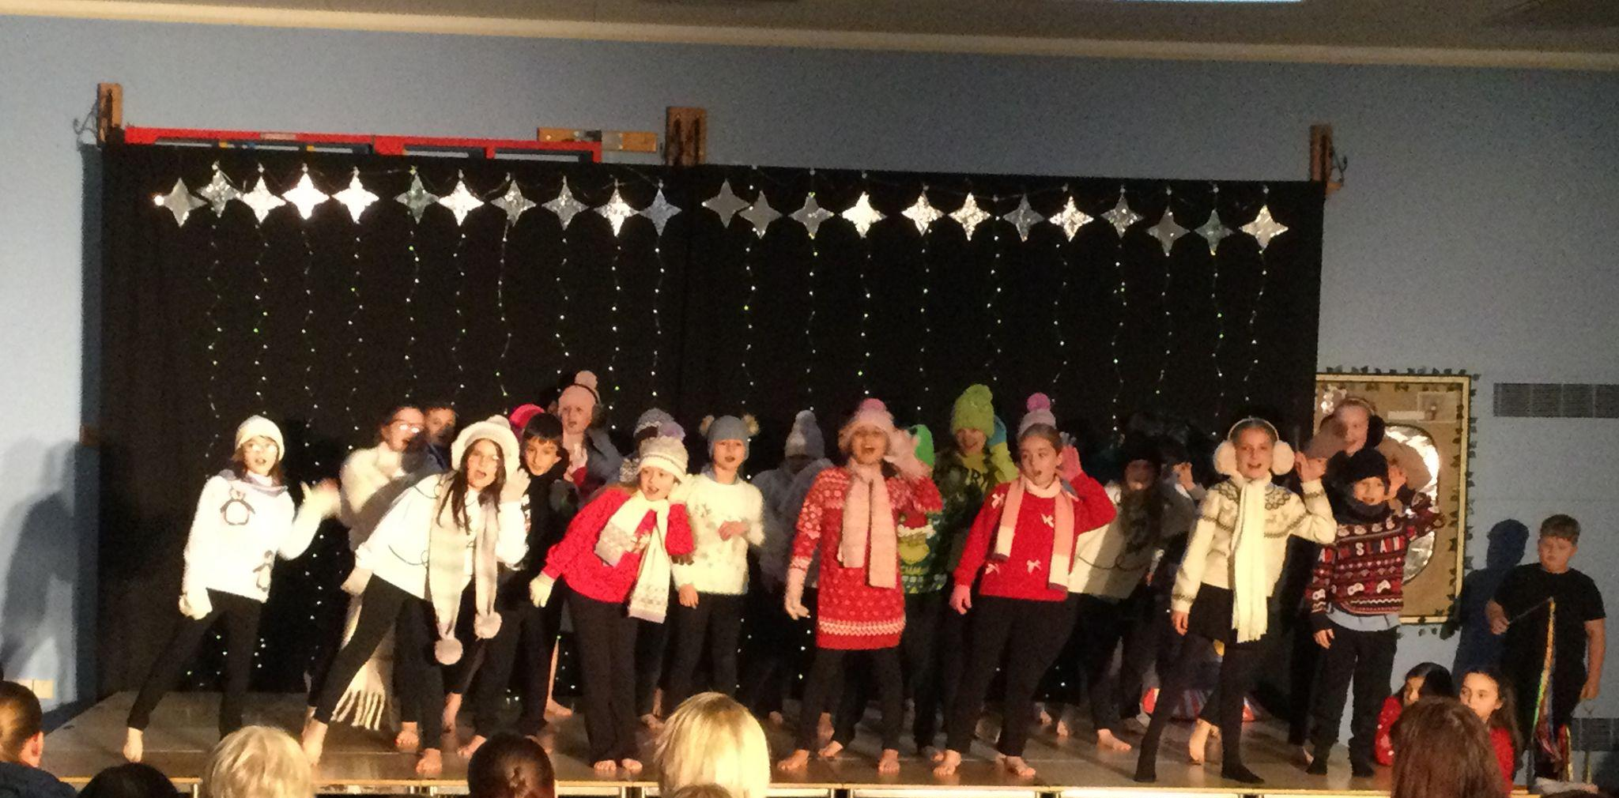
Years 4, 5 and 6 - The Christmas Express
Year 4, 5 and 6 performed ‘The Christmas Express’ telling the story of a magical train which travels around the world on Christmas Eve. We visited Christmas in Mexico, India, France and Norway before ending up back in our home country of England.
The children all did an amazing job of singing and dancing, showcasing our musical talents at Cavalry. We are all very proud of their fantastic performances!

Slide 6







Word Wizard Winners:
Year 3 - Class 7 (14,117)
Year 4 - Class 9 ( 204,230)
Year 5 - Class 12 (193,294)
Year 6 - Class 14 (875,969)
Mrs Edwards recommends
Fred would like to wish all the children a very Merry Christmas and remind them to keep practicing their phonics and to keep reading over the holidays!
The Snowman: Inspired by the original story by Raymond Briggs. A wonderful read to snuggle up and enjoy as a family before bedtime.
Mr Webb recommends The Wild Robot Escapes. The exciting sequel to The Wild Robot. After successfully saving the island and its inhabitants at great personal cost, Roz (the wild robot) finds herself working on a farm with a new family. It doesn't take long before the call of home and the sense of responsibility she feels to the farm lead her to take action. This book is for children around 8 and up. There's adventure, favourite characters and new settings.

Slide 7

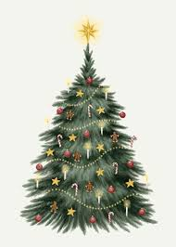

A Christmas message from
Mrs Edwards…
Dear Families,
We’ve nearly reached the last moment of the school year!
The tinsel is tangled, the glitter won’t cease,
We’re finally ready for silence and peace!
We’ve had so much sparkle, we’ve quite lost the plot,
From Nativity plays to the tunes that were hot.
Your children were stars, even when bits got sticky,
With costumes and lines that were wonderfully tricky.
You opened your wallets, your purses, and hearts,
To support all our school in so many great parts.
The generous collections were splendid to view.
The money raised is wonderful,
So thank you, thank you!
We are aiming for 97% attendance.
This week, our classes with the highest attendance are…
KS1 - Class 5 94.89%
KS2 - Class 14 98.33%
WELL DONE

Slide 8


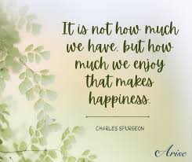
Last day of term Friday 19th Dec 2025
Training Days Mon 5th January 2026
Back to School Tuesday 6th January
Clubs start w/c 12th January
Safer Internet Day 10th February
Half term 16-20th February
Many more dates have been added to the school website so please check regularly for spring and summer dates.

Slide 9
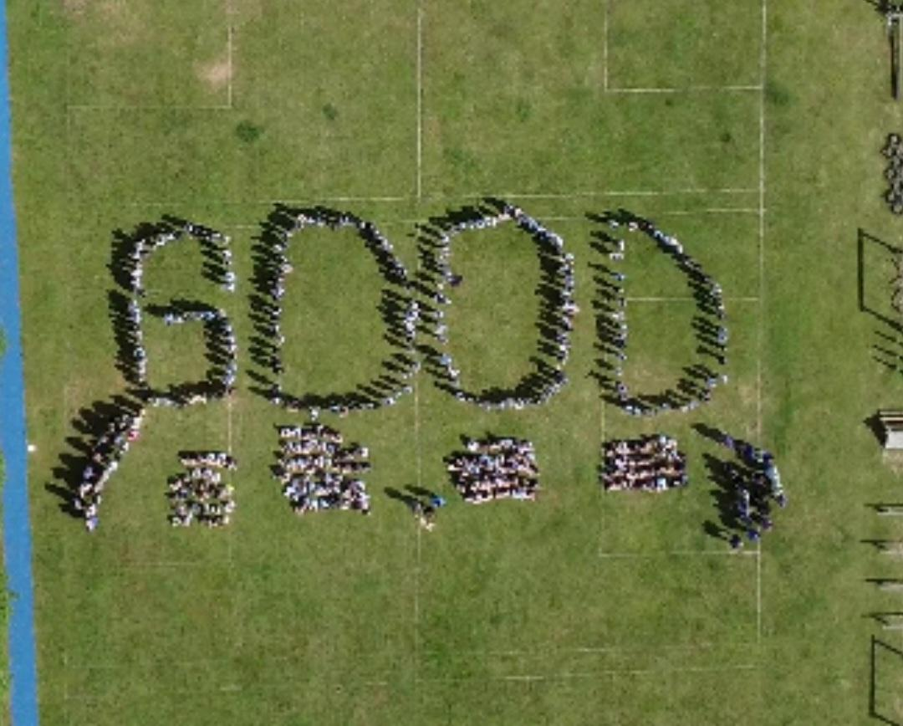

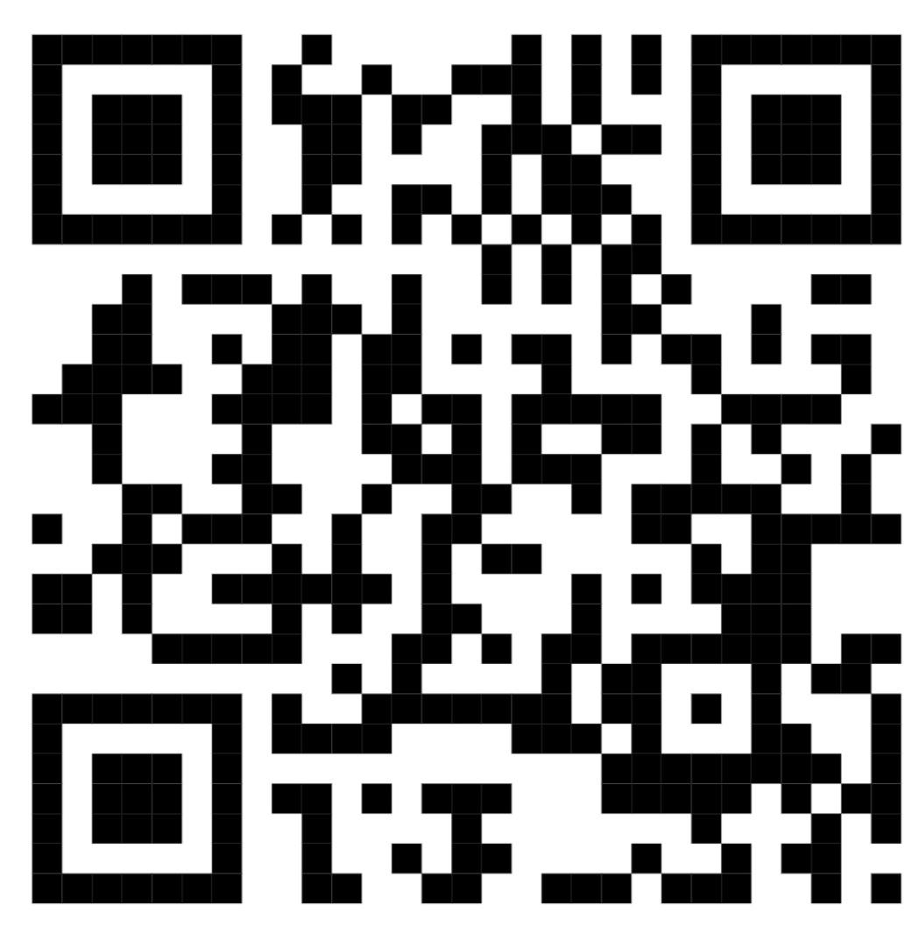
Cavalry Website
Contact us:
Cavalry Primary School
Cavalry Drive
March
Cambridgeshire
PE15 9EQ
office@cavalryprimary.org
Tel: 01354 652814

