Slide 1

Newsletter 16/10/26
Next week at a glance…
It’s a 4 day week for our pupils…
The end of term is
THURSDAY 22nd October due to a training day on the Friday for our staff
Swimming
Thursday
Don’t forget your swimming kit!
Visit to the residents of Aria Court
Tuesday 20th
Please bring a coat and sensible footwear!
Whole school
Year 4
The Green Team
Reception 2027
If you or someone you know has a child starting Reception in September 2027, our open morning is on Wednesday 21st at 9am

Slide 2
Up and coming events…
Whole school
Halloween Discos Thursday 22nd October Reception and KS1 (Years 1 & 2) 5 - 6pm Key Stage 2 (Years 3,4,5,6) 6.15-7.15pm | Children should be brought to the main entrance at the front of school to be dropped off. The children receive a drink and a packet of sweets during the disco (dietary requirements catered for) included in the price of their ticket. Collection is from the classroom doors following the one way system, including Reception who are collected from their cloakroom door on this occasion. Fancy dress is optional. Explain to your child that it can be quite noisy if they haven’t attended before. Please show consideration for local residents when parking.
End of term THURSDAY 22nd October | We will be having a Trust-wide training day on Friday 23rd October so school and Nursery will be closed on this day. We reopen on Monday 2nd November.

Slide 3

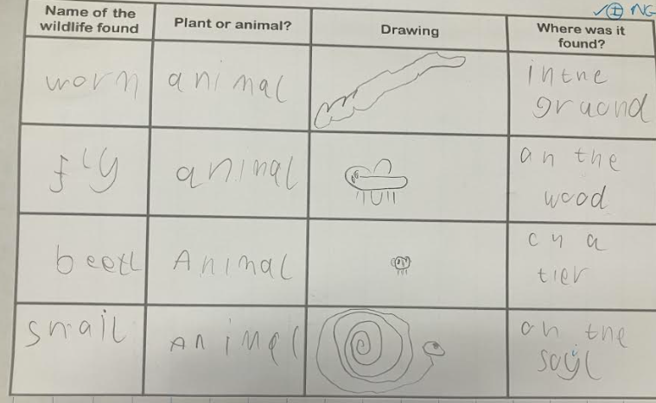
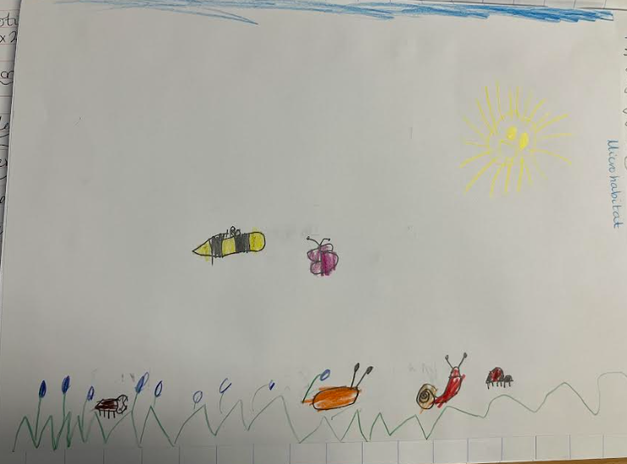
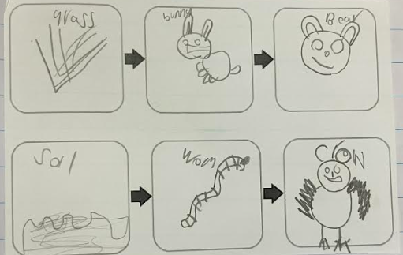
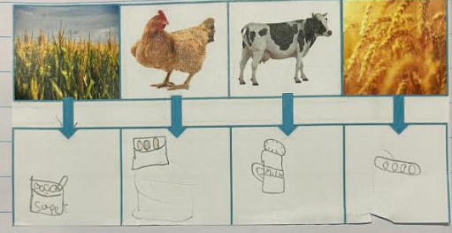
Year 2
In our Science lessons, we have been learning about animals and their habitats. We have been for a minibeast hunt outside and investigated food chains.

Slide 4
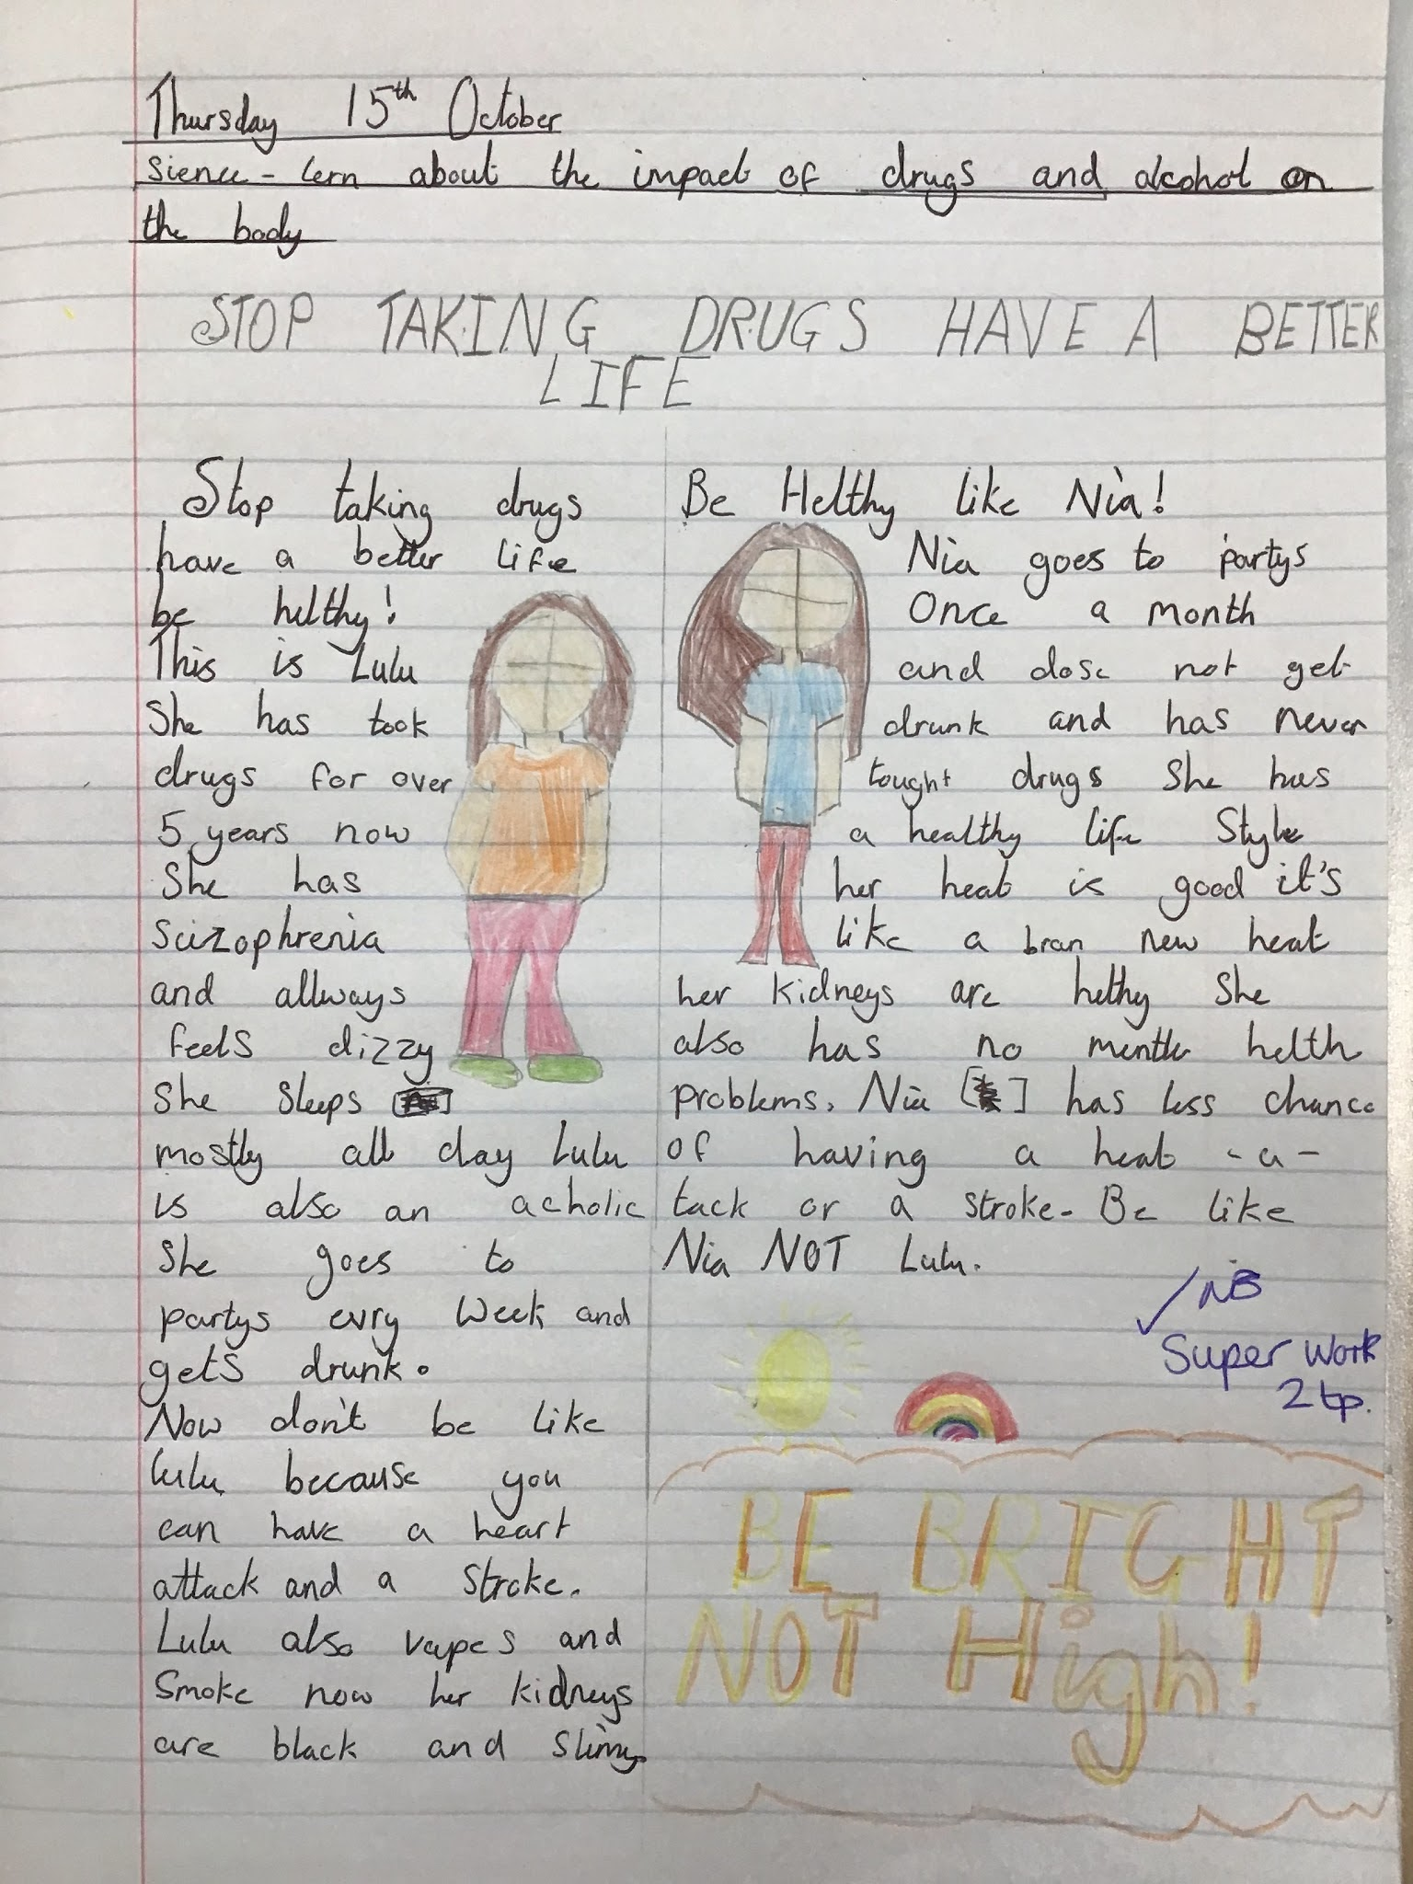
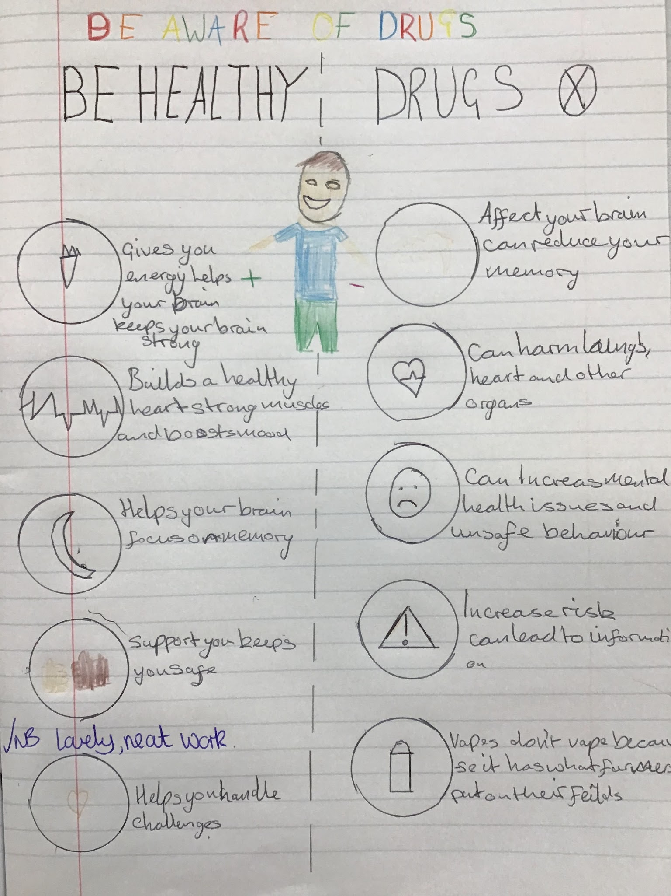
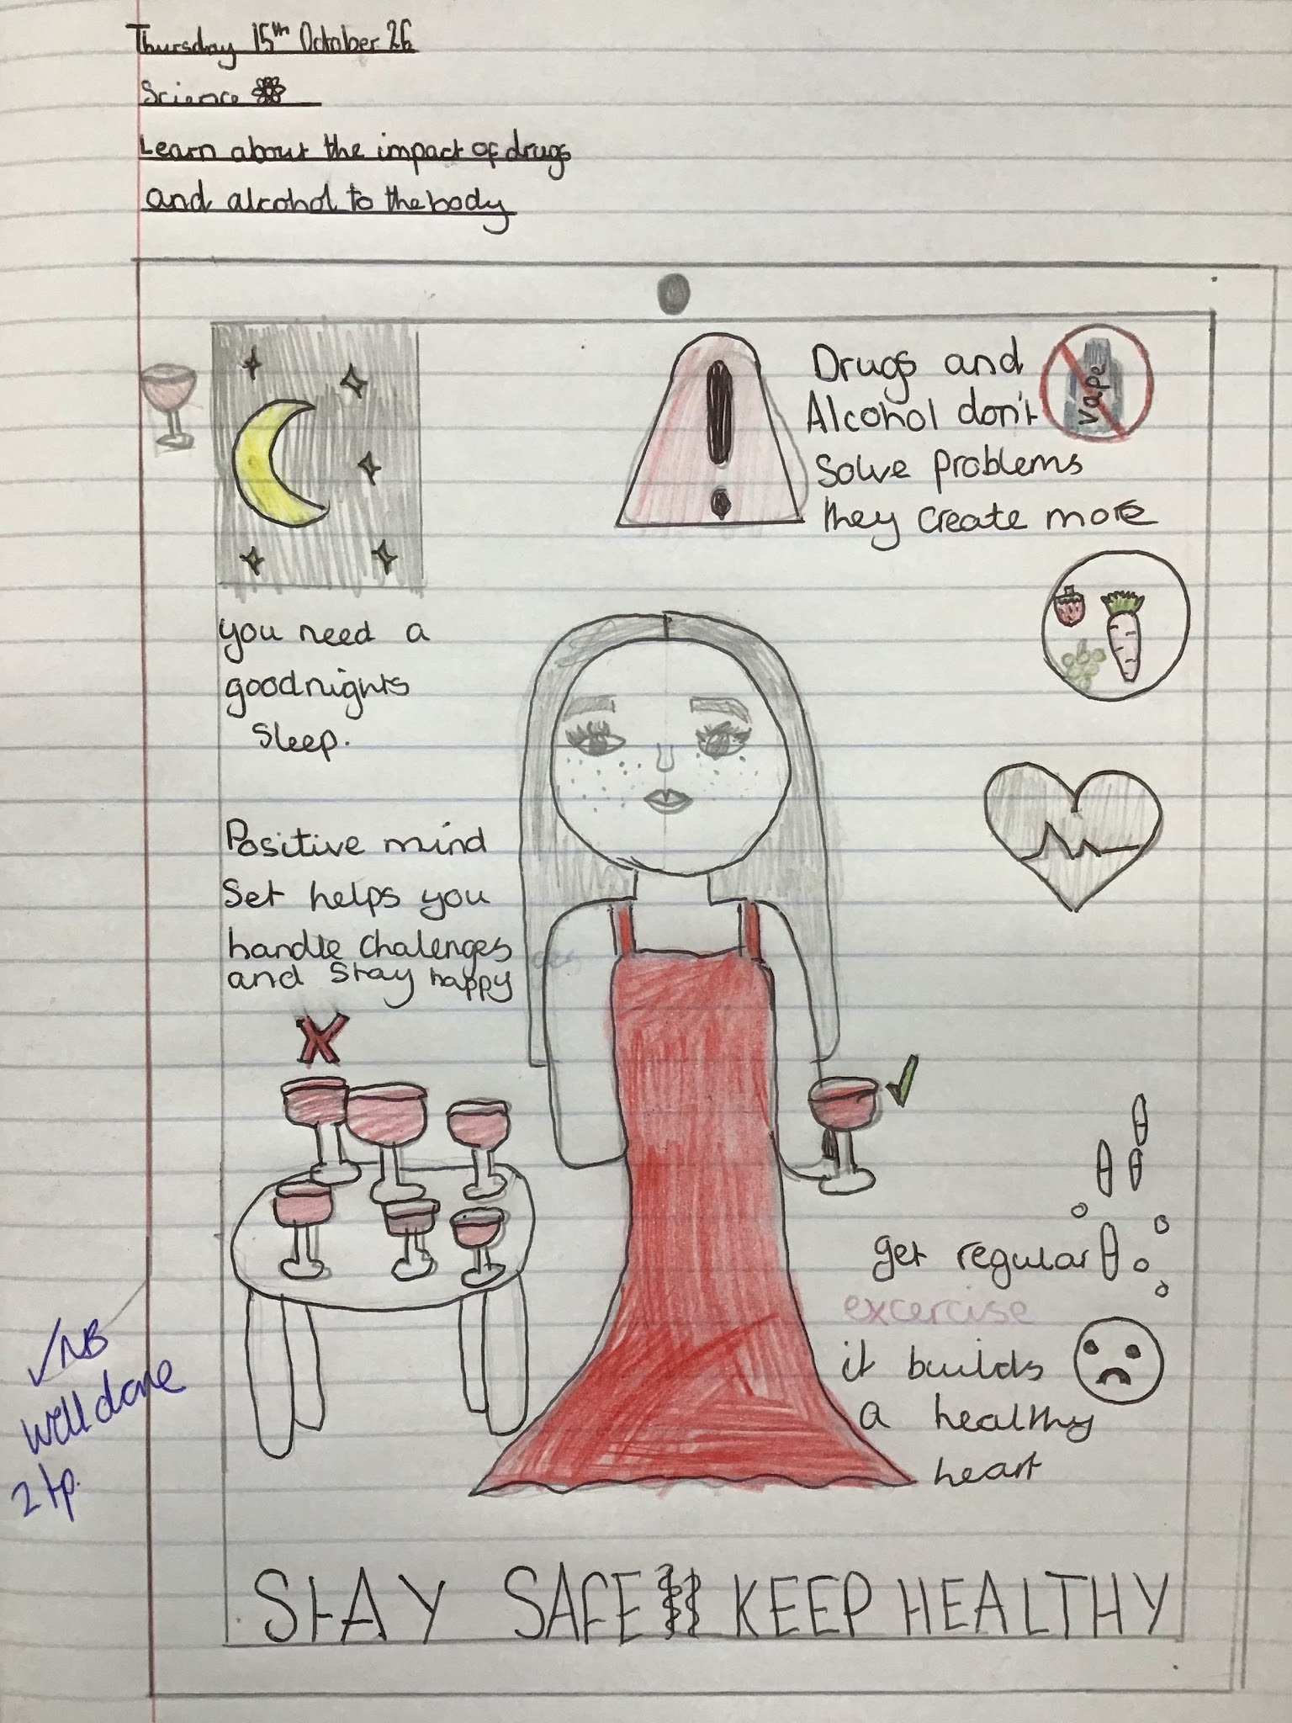
Year 6
Year 6 have been studying the circulatory system and discussing how to stay healthy.
We chose how to present this information following our learning about the effects of different drugs.

Slide 5

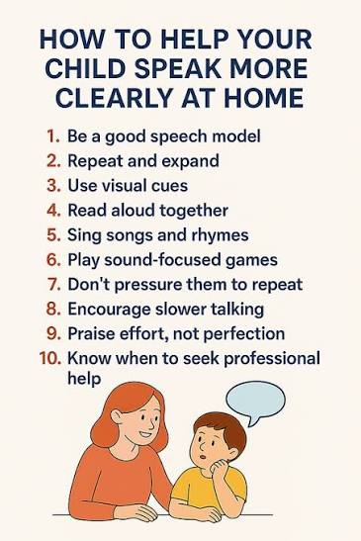
What can you do at home to support learning?
Please remember to check that food you send in to school is NUT FREE.
We have had some items recently, usually in packed lunches that say ‘may contain…’ This is especially worth checking on ‘health bars’ such as flap jack type bars and items containing chocolate.
Great Talking!
Encouraging your child to speak clearly is important. Make sure they do not have an obstructions such as pacifiers, bottles, fingers etc. Encourage them to speak in full sentences. Give them time to respond; pause after asking a question because children often need longer than adults to organise their thoughts and find the words they want.

Slide 6







Word Wizard Winners:
Year 4 - Class 9
Year 5 - Class 11
Year 6 - Class 13
Miss Hunter recommends:
On her thirteenth birthday, a trainee witch who struggles with spells leaves home with her black cat, Jiji, to start an independent life using her flying abilities to make her way in the world and make new friends.
Fred says ‘Well done’ to Mrs Poole’s group who are reading super speedily and learning all their Set 3 sounds!
Mrs Guerin recommends:
Squirrel is convinced someone is stealing the beautiful leaves off the tree. Will they find who the leaf thief is?

Slide 7

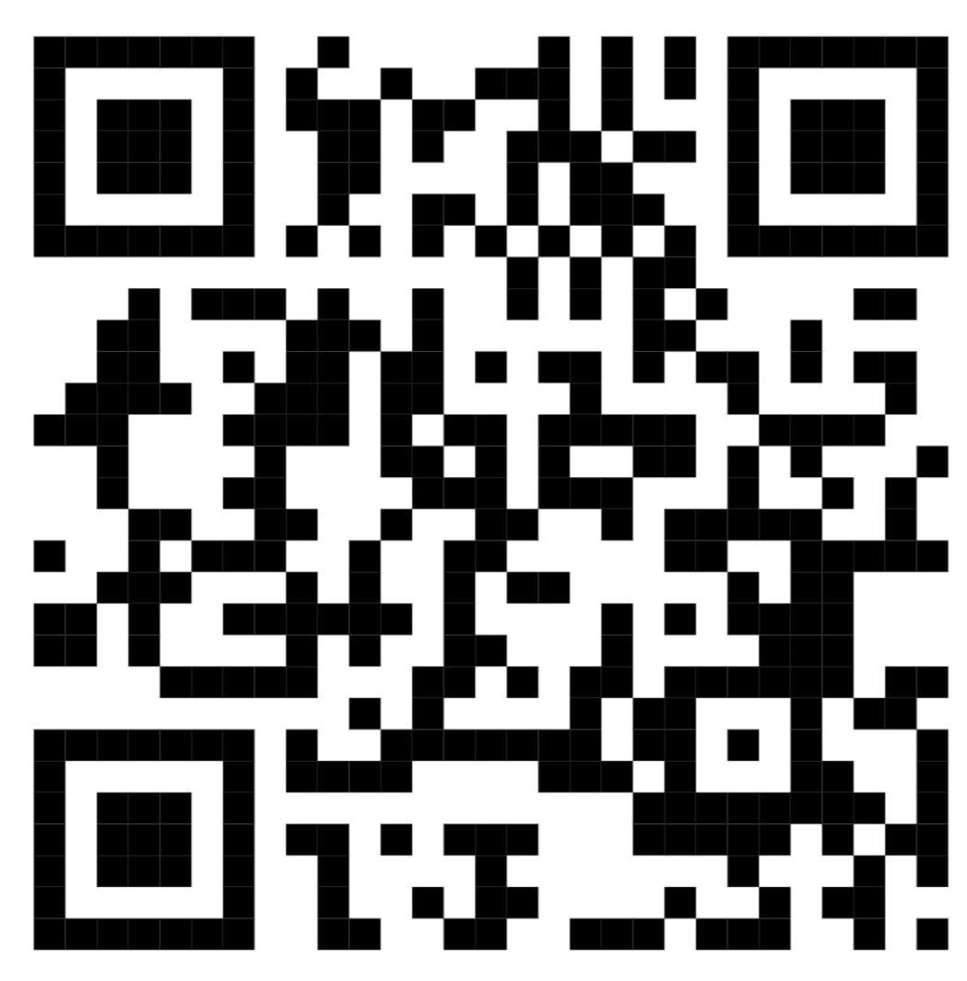


Cavalry Website
Contact us:
Cavalry Primary School
Cavalry Drive
March
Cambridgeshire
PE15 9EQ
office@cavalryprimary.org
Tel: 01354 652814
We are aiming for 97% attendance.
This week, our classes with the highest attendance are…
KS1 - Class 6 97.33%
KS2 - Class 7 97.2%
WELL DONE

