Slide 1



5th December 2025
Colour Monster
The human body
Robot Wars

Slide 2

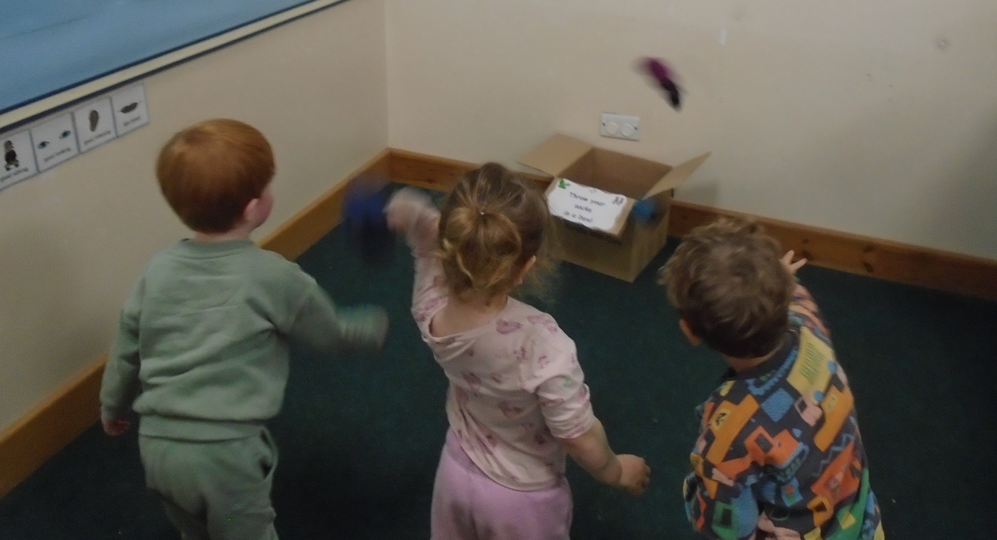
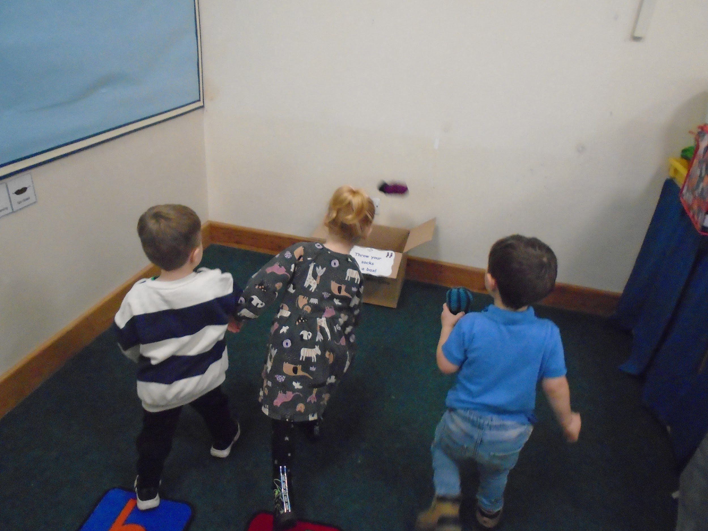
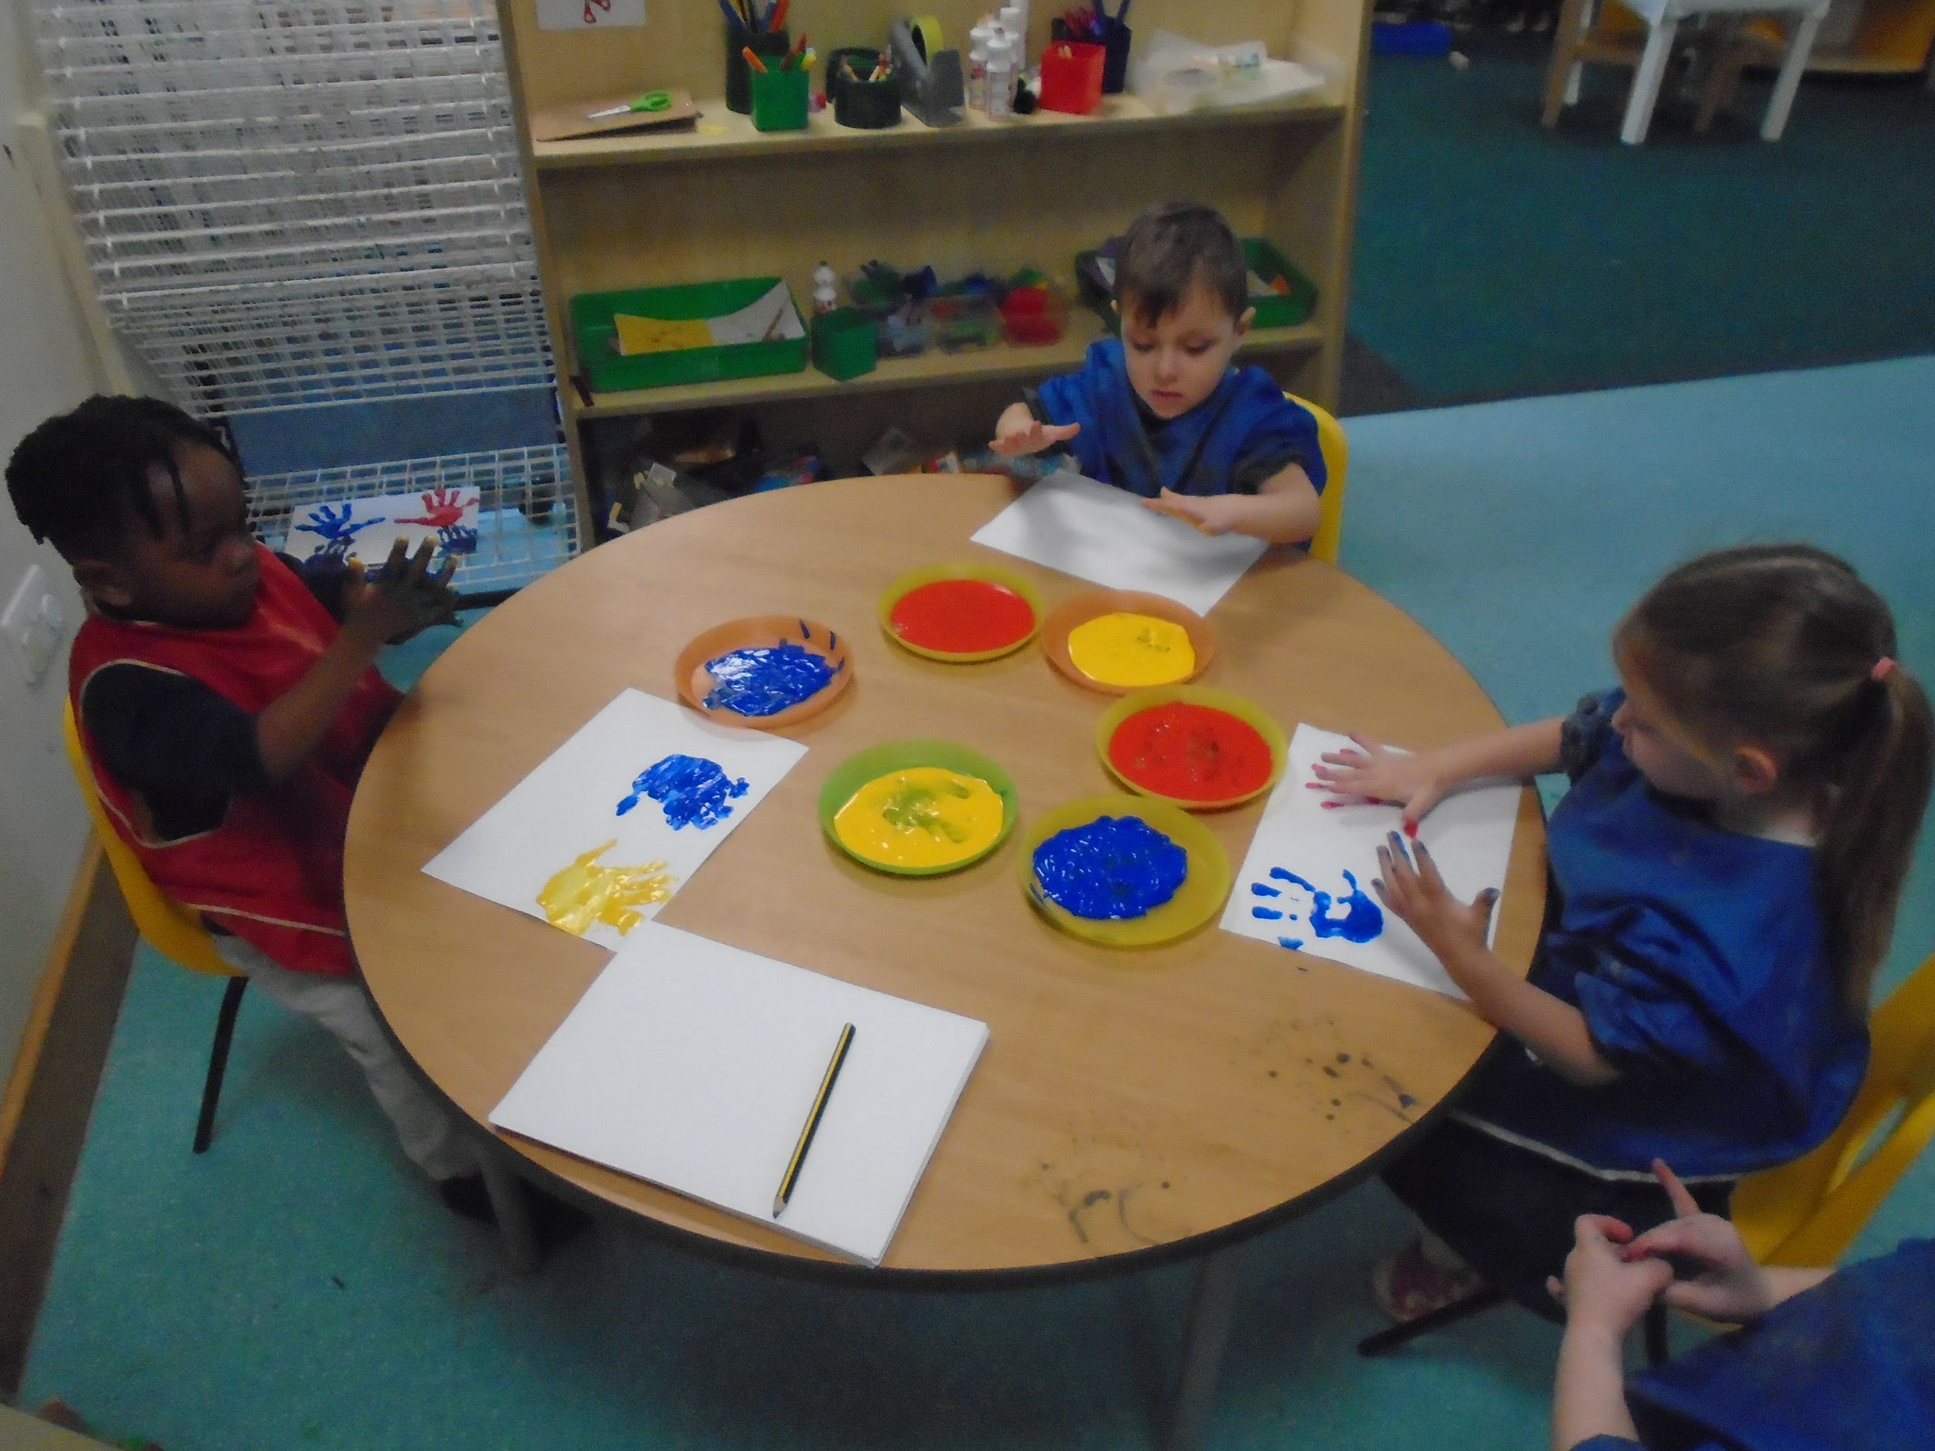
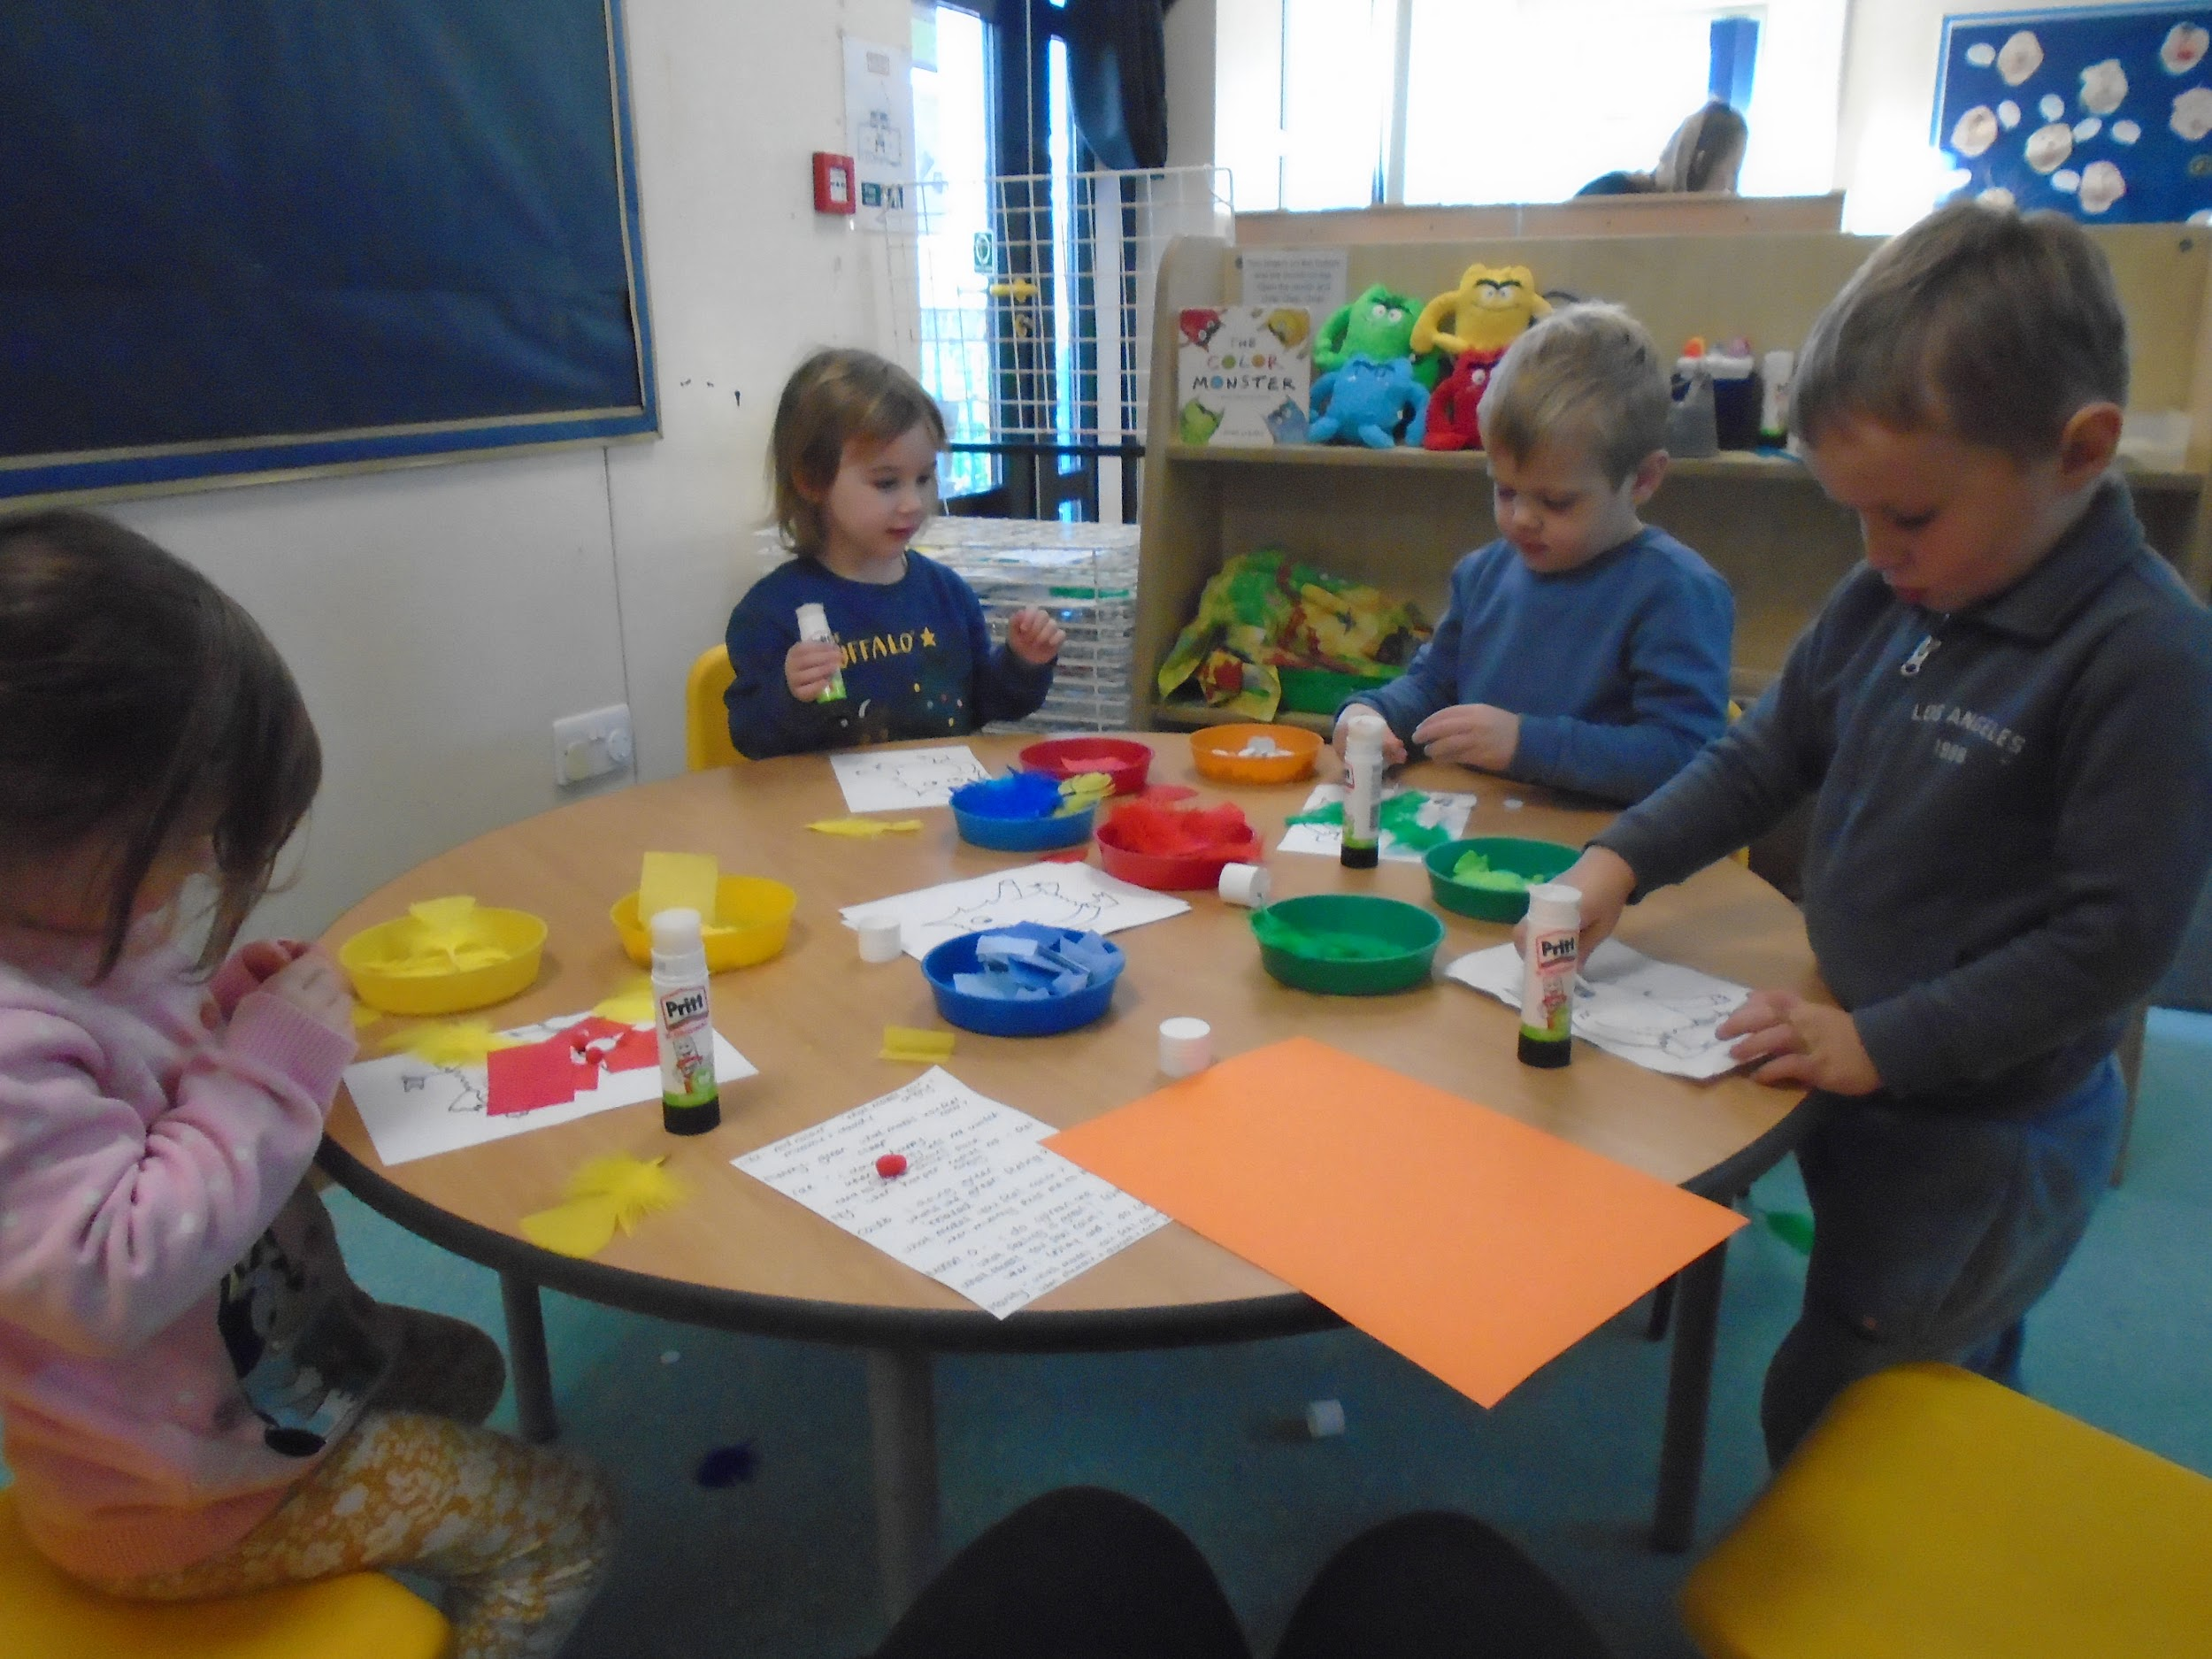
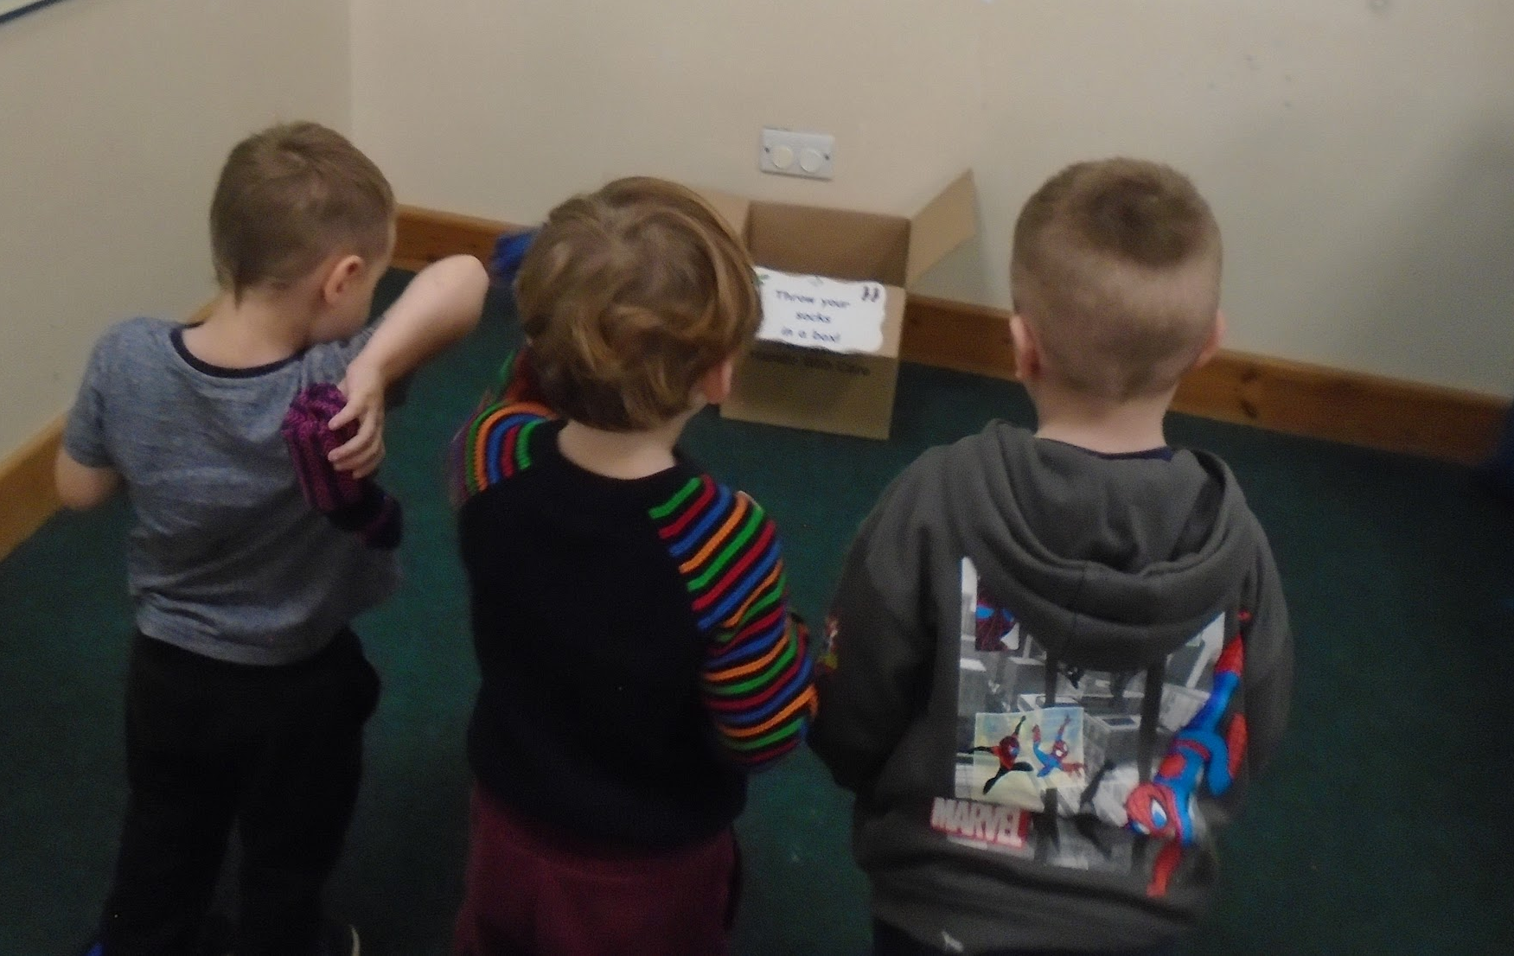
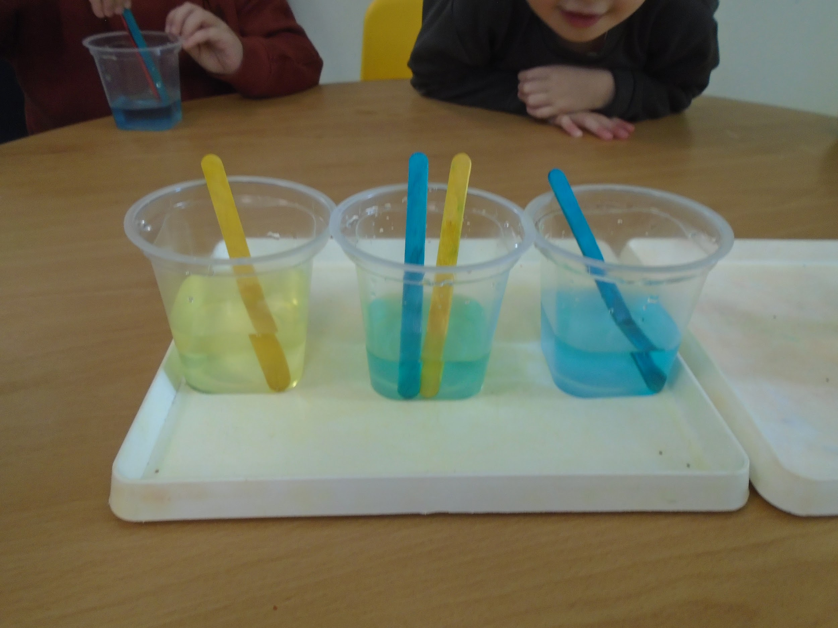
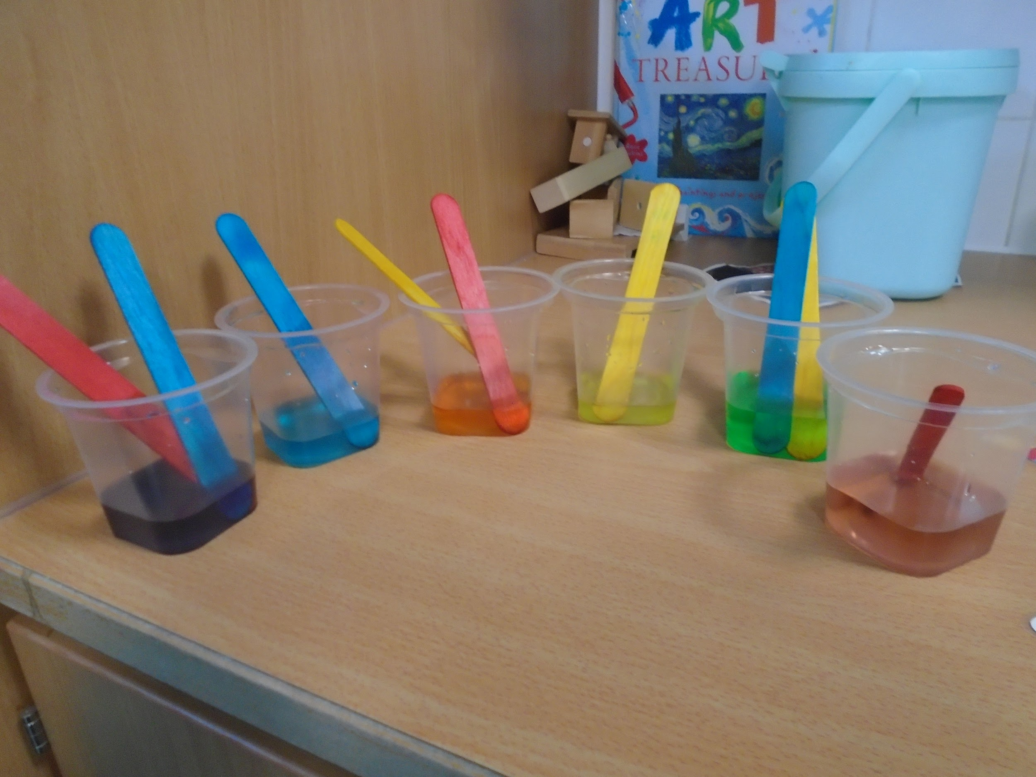
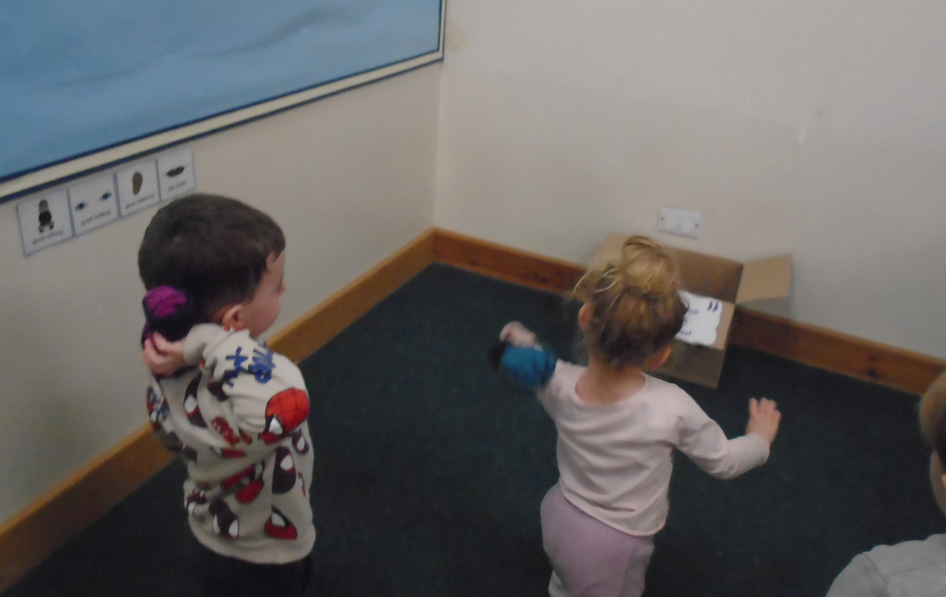
Nursery
We are reading The Colour Monster. This week our focus has been on the feeling of anger and how we can help ourselves find our way back to feeling calm again. We’ve been trying out different ways to self- regulate our emotions like throwing socks in a box!
We are continuing to follow the children’s interests in exploring colour and colour mixing. We’ve been experimenting mixing primary colours with paints on our hands and lollipop sticks in water!

Slide 3
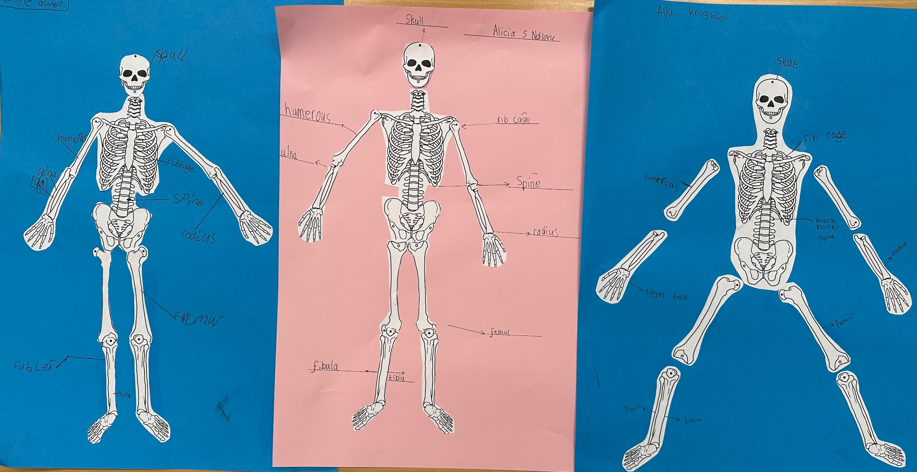
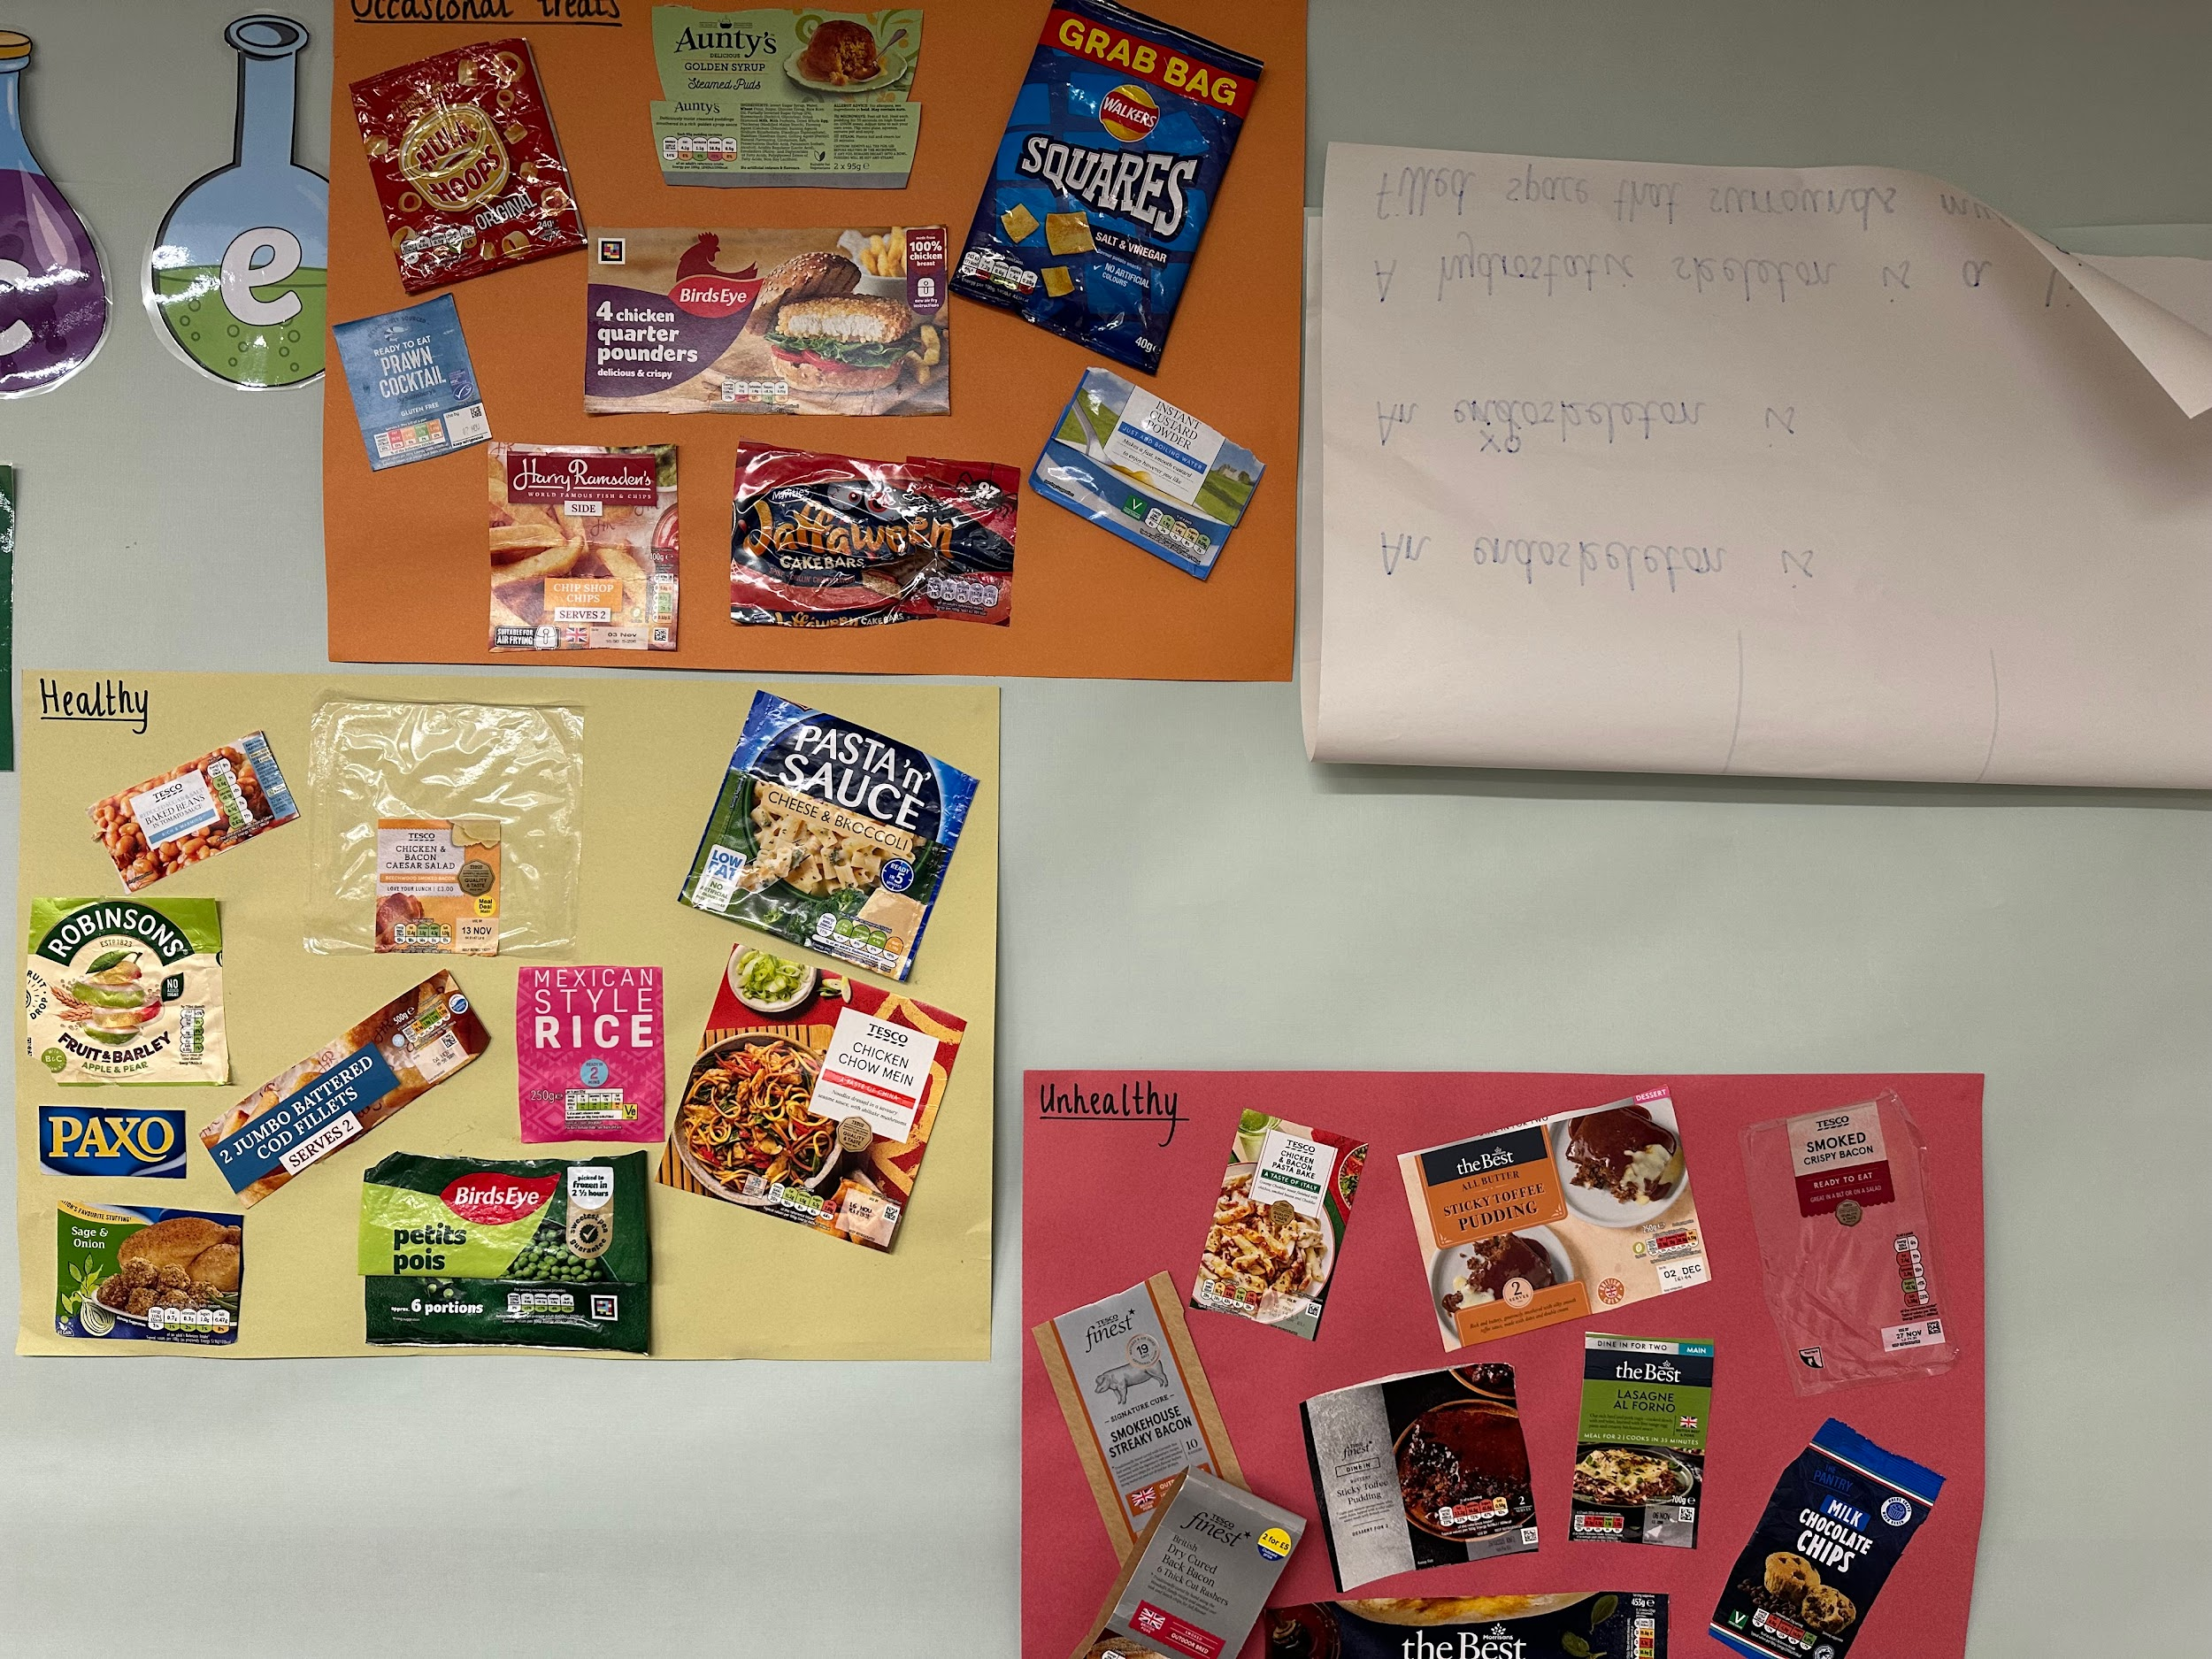
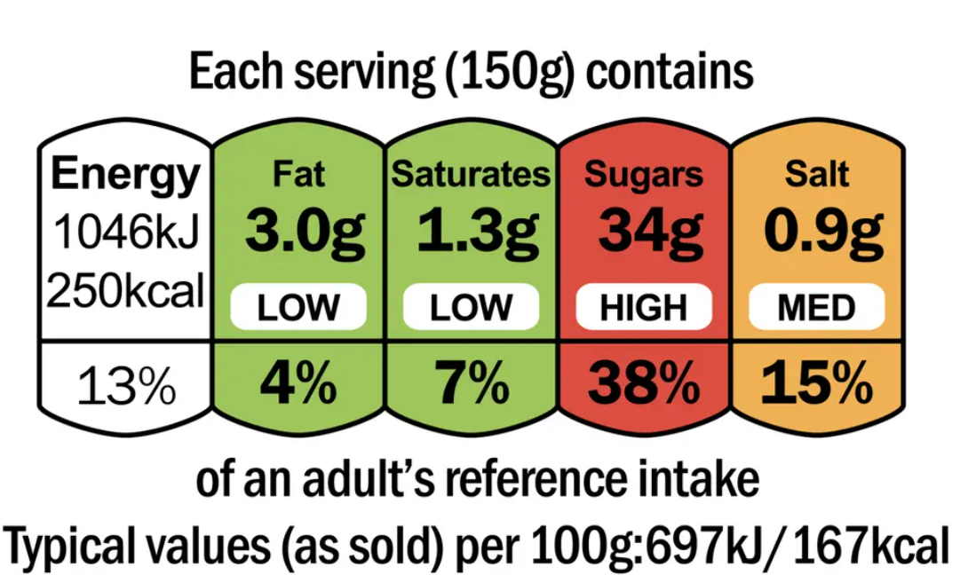
Year 3
In Science, Year 3 have been learning all about the human body (and those of other creatures).
We learnt how to read the nutritional values on food labels and used this information to decide whether different foods were healthy, unhealthy or okay to have as an occasional treat. Unfortunately, most of our favourites were not healthy!
We then started learning about the skeleton, the names of all the different bones and their functions.

Slide 4
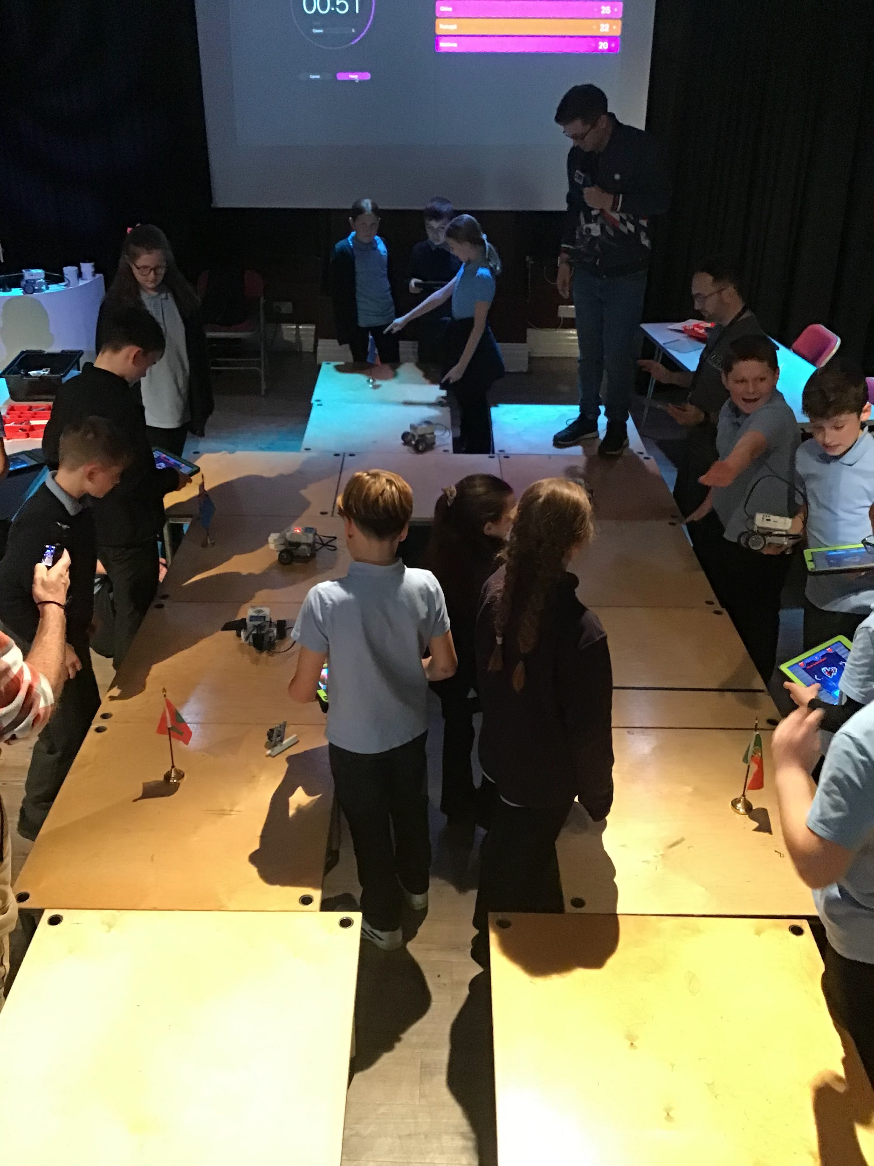
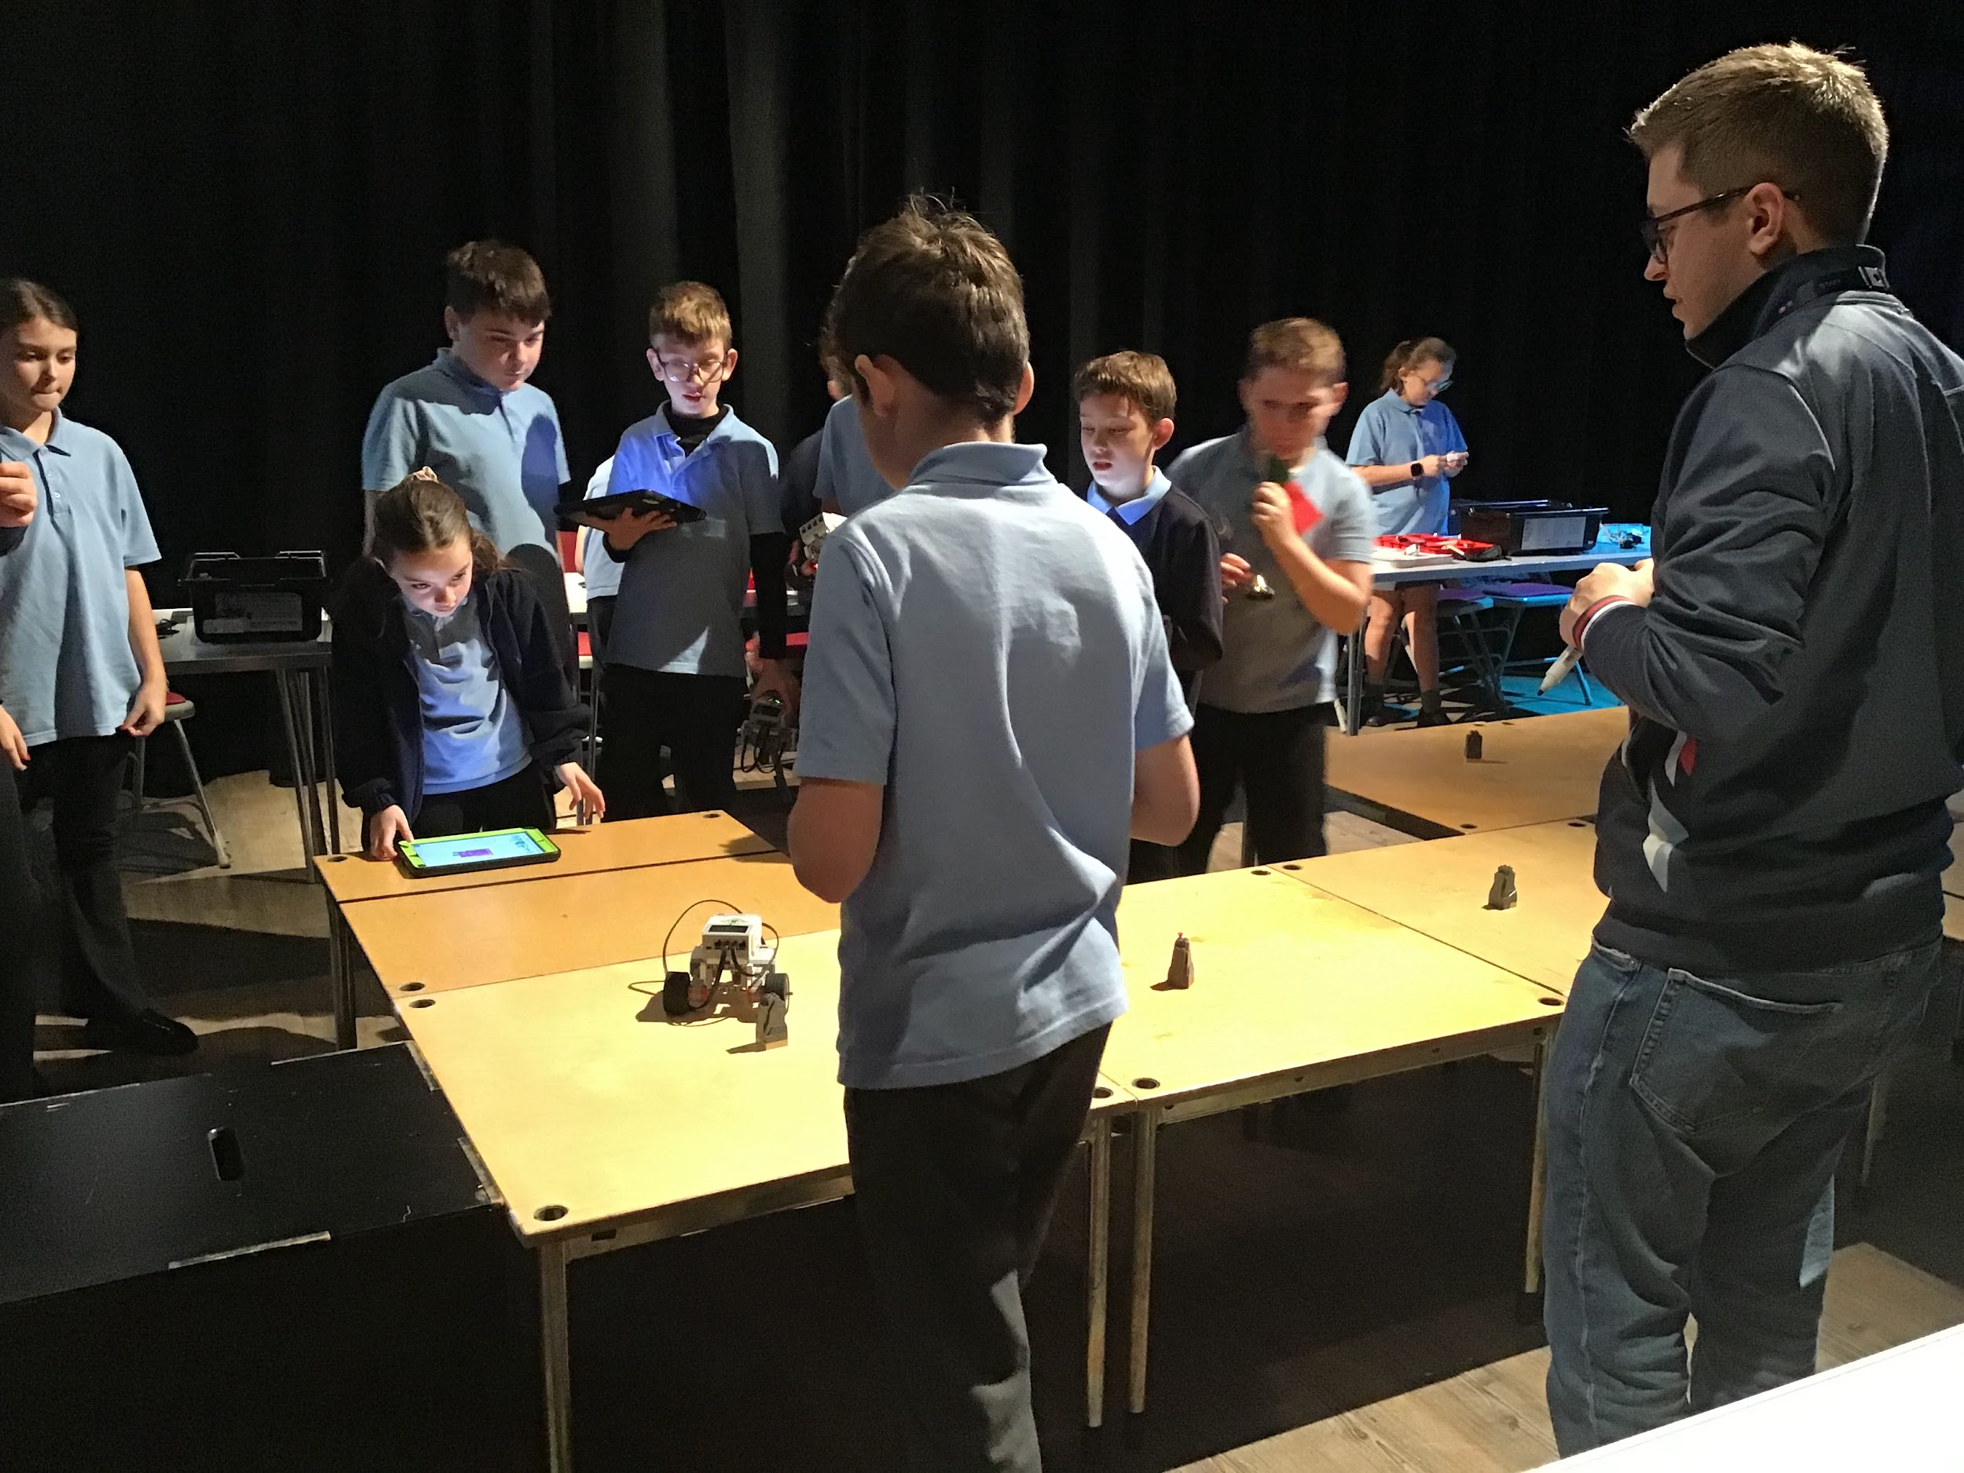
Y
Robot Wars for Year 6
Six teams of engineers and programmers from Year 6 fought out a Lego-based robot tournament in March Town Hall on Tuesday.
The teams from Class 13 and Class 14 were selected for the event, run by TwentyTwenty productions, based on their work in computing over the last term. Challenges included adapting their buggy to complete a task, programming it to complete a course and a final robot wars style “Battle Royale”.

Slide 5


Every class in Cavalry recently received a workshop from Woodgreen and we have now received their Helping Pets in our Community Award! Their Education Officer was really impressed with how our classes interacted and worked throughout the sessions. Well done Cavalry!

Slide 6



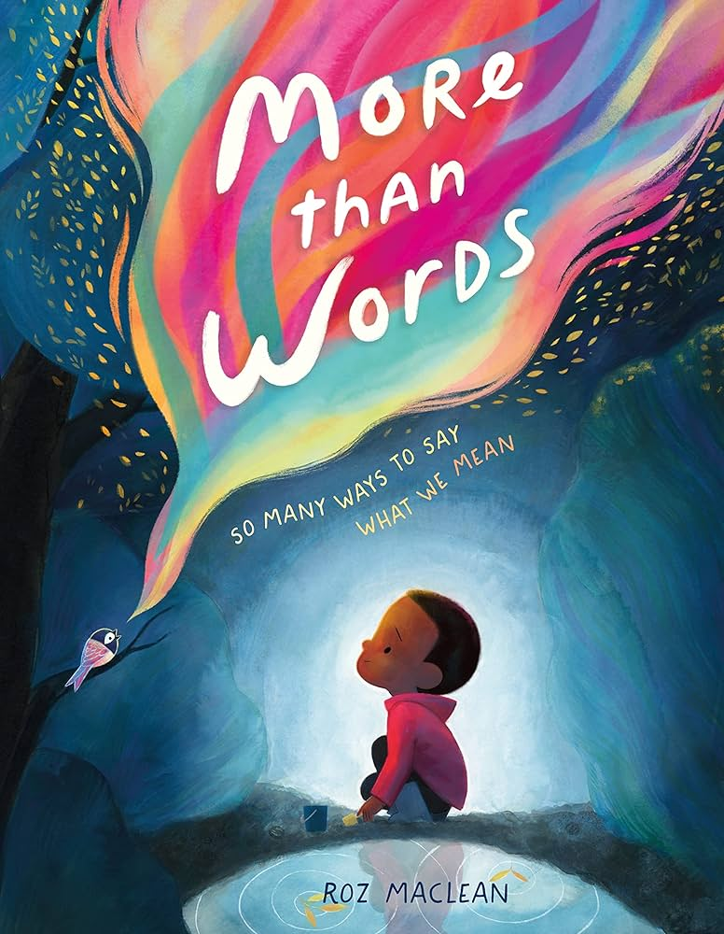



Word Wizard Winners:
Year 3 - Class 7 (11,611)
Year 4 - Class 10 (113,861)
Year 5 - Class 12 (206,364)
Year 6 - Class 13 (560,140)
Mr Harris recommends:
Well done to Miss Udy’s phonics group. They have been working brilliantly on the structure of their sentences and have produced some fabulous sentences!
More Than Words is a touching picture book about the many unique ways we communicate and how we can better listen to and respect these different modes of expression.
Mrs Guerin recommends:
Izzy and friends are excited to find that their school trip involves an overnight train ride. But when they get on board, they're shocked to discover that everything is strange.

Slide 7

Don’t forget Christmas Jumper day on FRIDAY 12th, the same day as our Christmas lunch! Our Friday menu will be available on Thursday instead of the usual roast dinner, because of the swap for Christmas dinner.
We are aiming for 97% attendance.
This week, our classes with the highest attendance are…
KS1 - Class 4 93.79%
KS2 - Class 11 95.48%
WELL DONE

Slide 8



Nursery stay and play 10th Dec @8.50am OR 12.30 St. Peter’s Christmas Tree festival 12-14th Dec at St. Peter’s Church Christmas Carol Concert Fri 12th Dec@9.15am Christmas Jumper & Christmas Dinner Day Reception Nativity 16th & 17th (9:15 - 9:45am) Y1,Y2 & Y3 Production 15th, 16th & 17th (2.30-3.15pm) Nursery Sing Along 17th Dec @11.30 OR 2.45 Y4, Y5, Y6 Production 17th Dec (5.30-6.30pm) & Thur 18th Dec (9.15-10.15am & 2:00-3:00pm Last day of term Friday 19th Dec

Slide 9
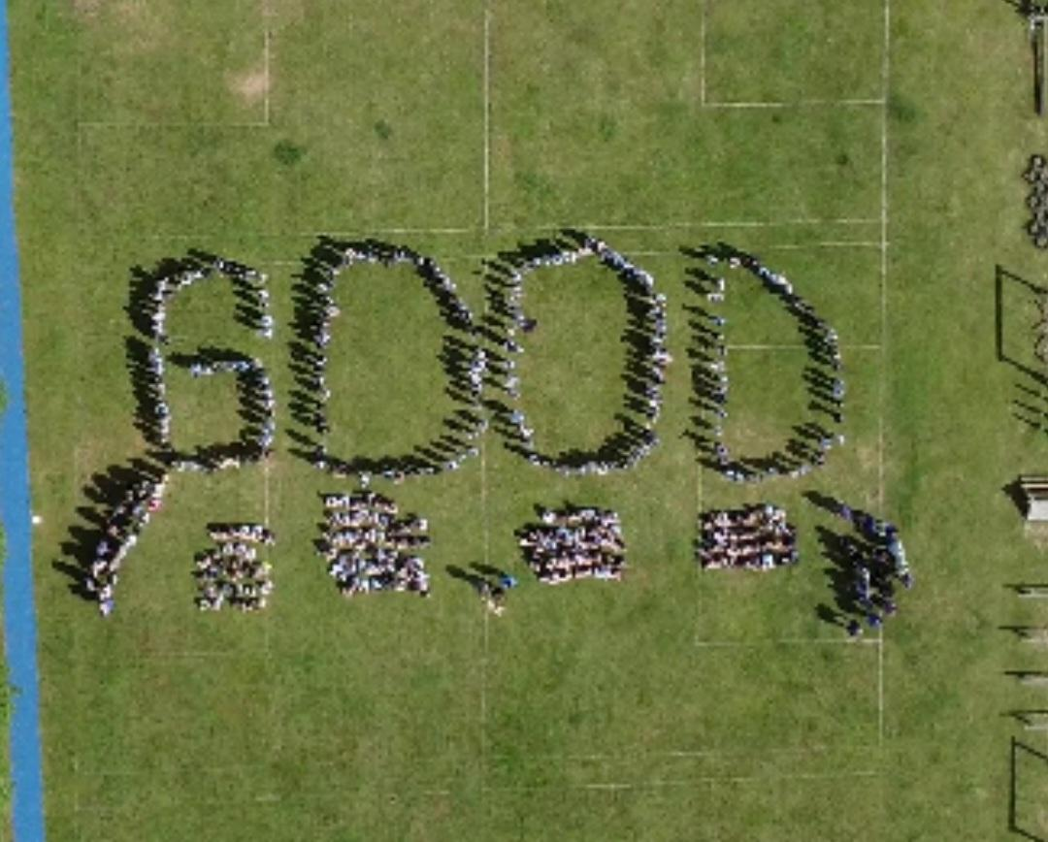

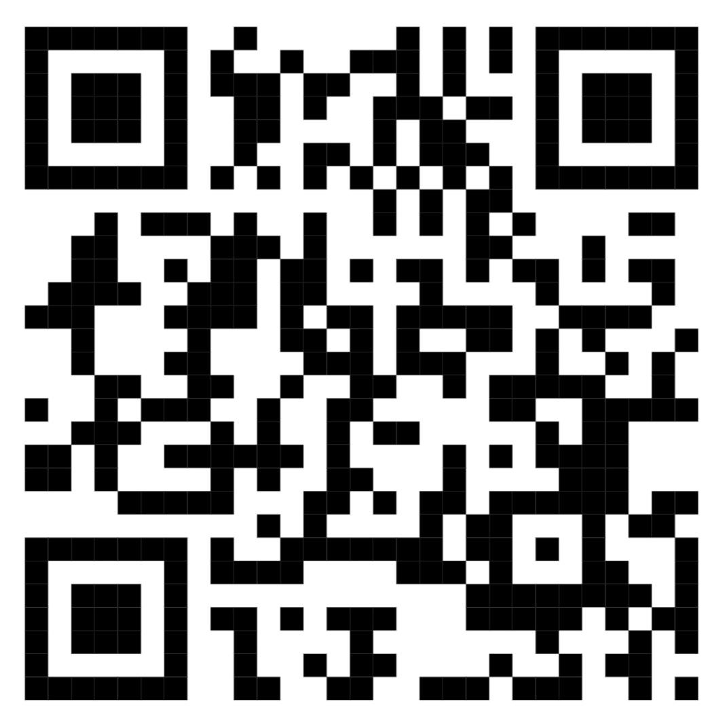
Cavalry Website
Contact us:
Cavalry Primary School Cavalry Drive March Cambridgeshire PE15 9EQ
office@cavalryprimary.org
Tel: 01354 652814

