Slide 1



28th November 2025
Brilliant books
Conductors or insulators

Slide 2

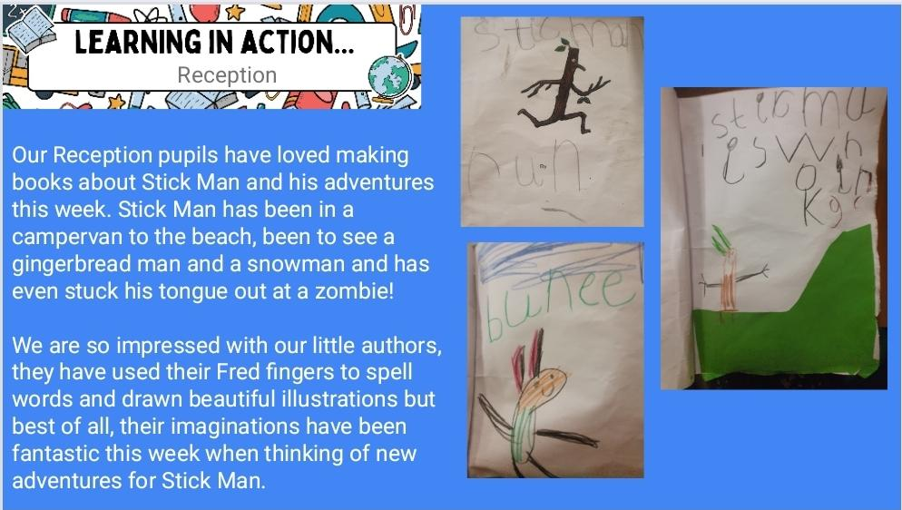
Reception

Slide 3
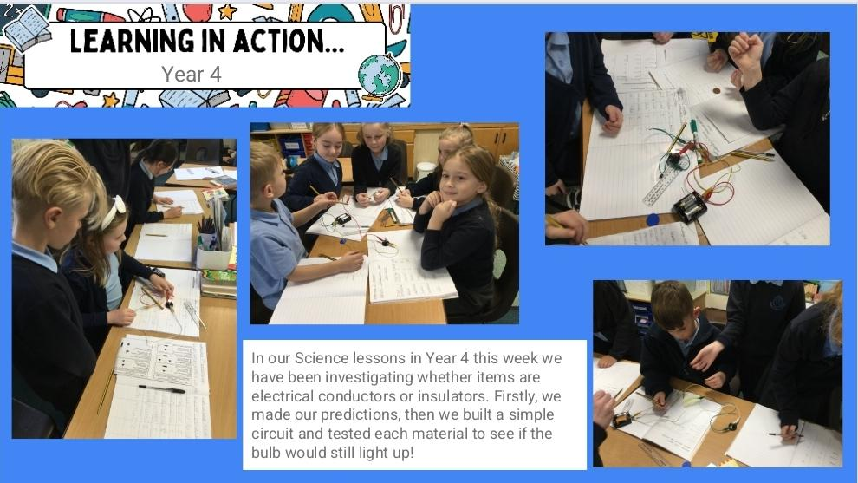
Year 4

Slide 4
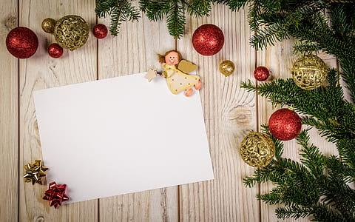
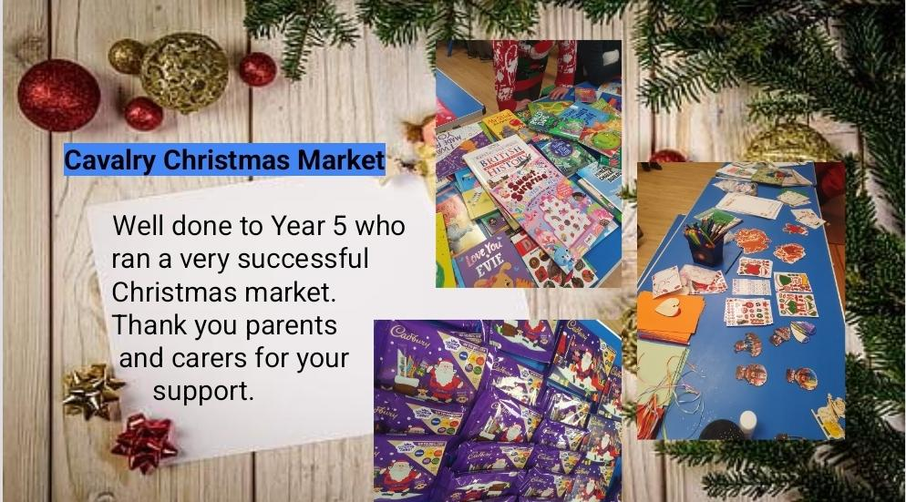

Slide 5







Word Wizard Winners:
Year 3 - Class 8
Year 4 - Class 9
Year 5 - Class 11
Year 6 - Class 13
Mrs Banks recommends:
Stick Man by Julia Donaldson. A heartwarming story about Stick Man’s accidental journey away from home and how he eventually finds his way back in time for Christmas.
Well done to Mrs Wilson’s phonics group who have been on fire with their blending skills this week! They are so speedy building words using the magnets and their Fred talking to read the word has been impressive!
Miss Ellis recommends:
I recently read this with my daughter and we laughed the whole way through! The Twits is a children's story by Roald Dahl about a cruel, grotesquely ugly couple who play nasty tricks on each other.

Slide 6

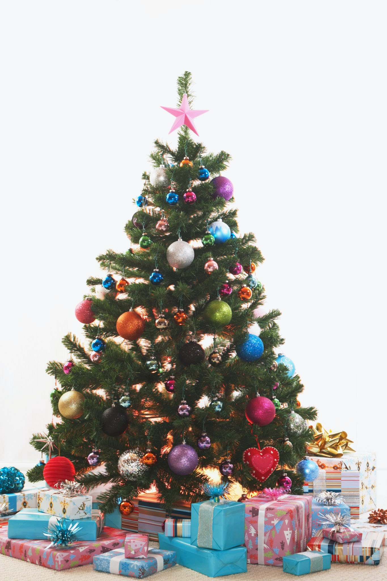
Are you ready for Christmas at Cavalry?
✅ Christmas play tickets ordered?
✅ Christmas lunch ordered?
✅ Made time to visit St. Peter’s Church Christmas Tree Festival?
✅Bought tickets for the Christmas Raffle?
Enormous thanks
to our PTFA
members who
came to school last weekend to put up our many Christmas trees around school!
We are aiming for 97% attendance.
This week, our classes with the highest attendance are…
KS1 - Class 2 96.8%
KS2 - Class 13 97.2%
WELL DONE

Slide 7


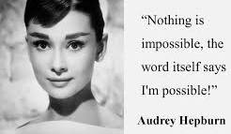
Reception Cavalry Cafe 4th Dec @2pm
Nursery stay and play 10th Dec
@8.50am OR 12.30
St. Peter’s Christmas Tree festival 12-14th Dec
at St. Peter’s Church
Christmas Carol Concert Fri 12th Dec@9.15am
Christmas Jumper & Christmas Dinner Day Reception Nativity 16th & 17th
(9:15 - 9:45am)
Y1,Y2 & Y3 Production 15th, 16th & 17th (2.30-3.15pm)
Nursery Sing Along 17th Dec @11.30 OR 2.45
Y4, Y5, Y6 Production 17th Dec (5.30-6.30pm) & Thur 18th Dec (9.15-10.15am & 2:00-3:00pm
Last day of term Friday 19th Dec

Slide 8
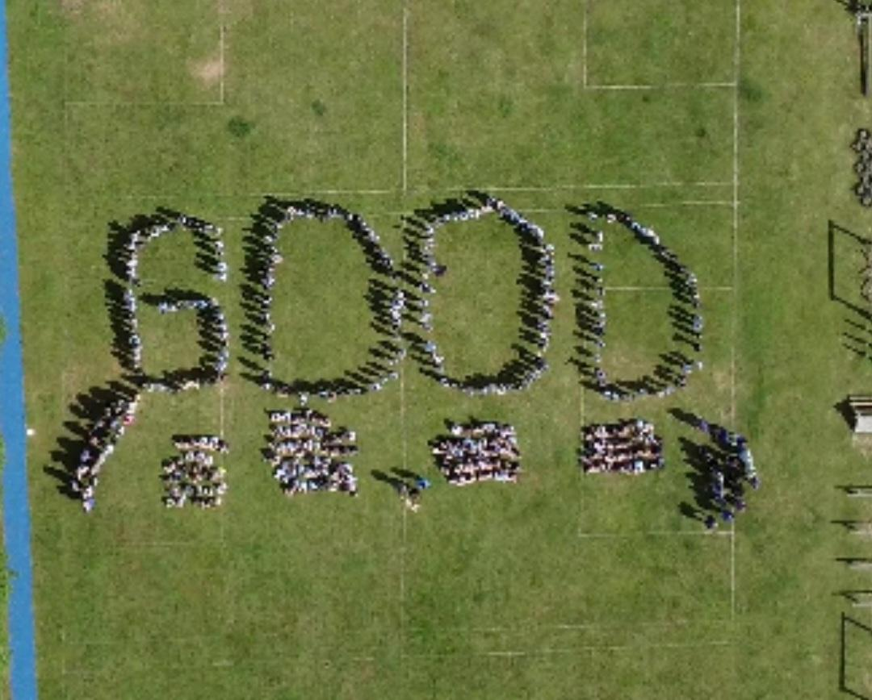


Cavalry Website
Contact us:
Cavalry Primary School
Cavalry Drive
March
Cambridgeshire
PE15 9EQ
office@cavalryprimary.org
Tel: 01354 652814

