Slide 1



21st November 2025
Woodgreen visitors
Science forces

Slide 2

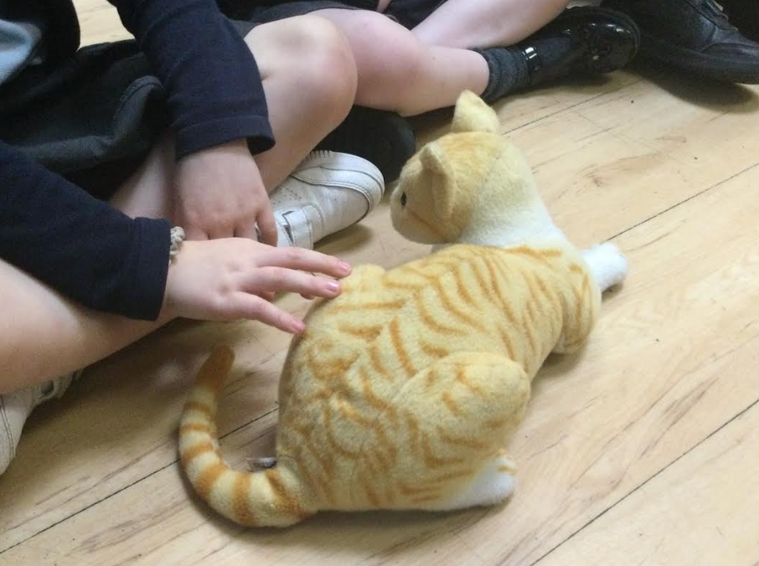
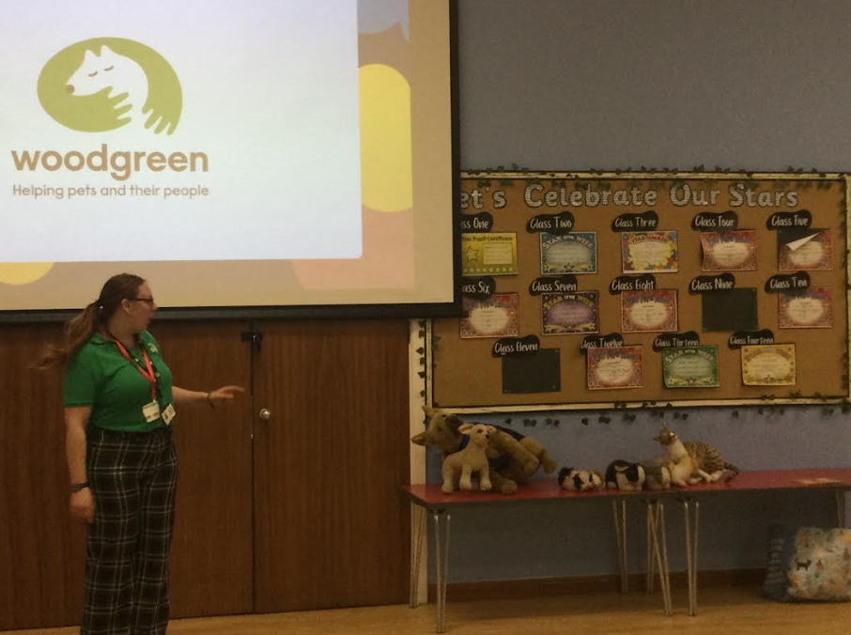
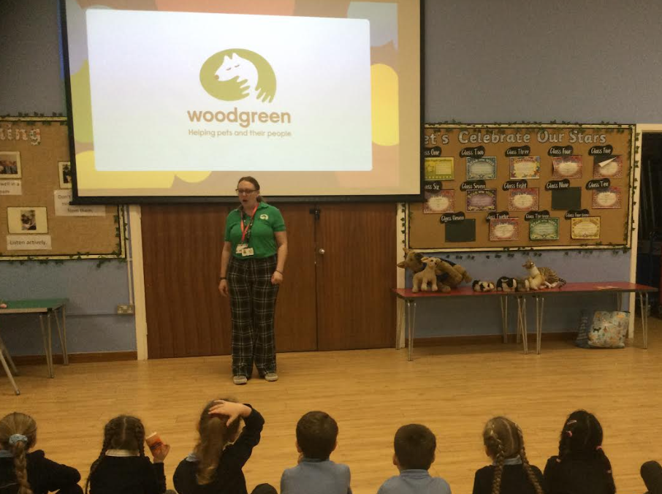
Year 1
Year 1 had the most amazing time when Woodgreen came into visit.
The children spoke all about pets and how to take care of them.
When we were listening about pets and how to take care of them the children were able to cuddle of soft and fluffy versions.
At the end Woodgreen spoke about fireworks and how they make our pets feel safe. A few children went and helped to build a safe bed and home for them.

Slide 3
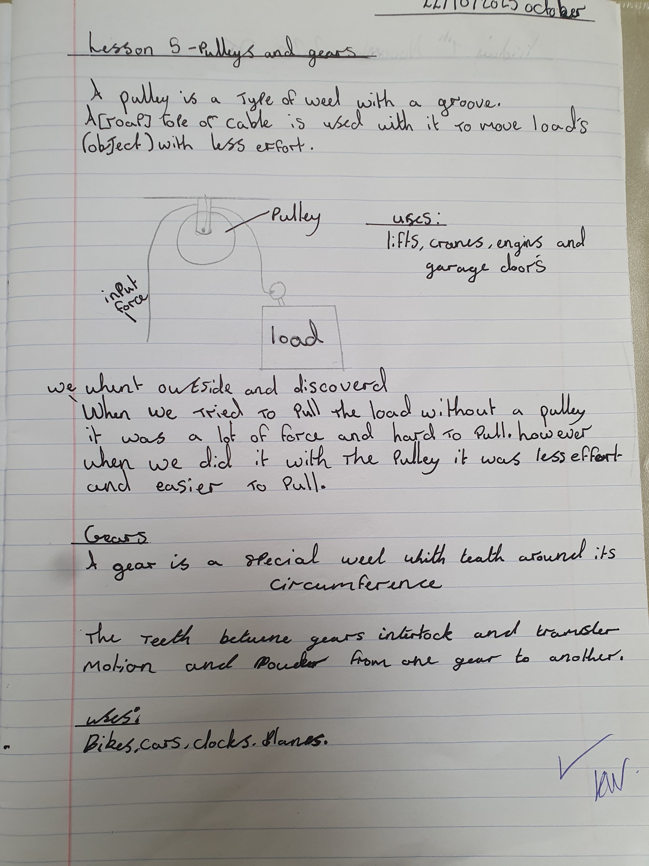
Year 5
Year 5 have enjoyed Science this half term learning about forces.
The children have experimented with pulleys and levers, finding out how they work and building their own.

Slide 4






Word Wizards:
Year 4 - Class 9 (480000)
Year 5 - Class 12 (1,472,653)
Year 6 - Class 13 (389,643)
Miss Deeks recommends:
There’s a snake in my school! By David Walliams. All ages enjoy this story. Its illustrations make the story come to life.
Well done to Mrs Mann’s phonics group who have worked really hard to learn their sounds and fill in the sound gaps they had. They are now recognising most of the single sounds and working hard to blend them to read words!
Mrs Owen recommends:

Slide 5

Don't forget to buy your tickets for our Christmas Market next Friday. This will be a cashless event and tickets need to be ordered and paid for on Parentpay prior to the market.
We are aiming for 97% attendance.
This week, our classes with the highest attendance are…
KS1 - Class 2 98%
KS2 - Class 13 99.31%
WELL DONE

Slide 6



EYFS open morning 10-11am Thurs 27 Nov
Christmas Market Friday 28th November
Reception Cavalry Cafe 4th Dec @2pm
Nursery stay and play 10th Dec
@8.50am OR 12.30
St. Peter’s Christmas Tree festival 12-14th Dec
at St. Peter’s Church
Christmas Carol Concert Fri 12th Dec@9.15am
Christmas Jumper & Christmas Dinner Day Reception Nativity 16th & 17th
(9:15 - 9:45am)
Y1,Y2 & Y3 Production 15th, 16th & 17th (2.30-3.15pm)
Nursery Sing Along 17th Dec @11.30 OR 2.45
Y4, Y5, Y6 Production 17th Dec (5.30-6.30pm) & Thur 18th Dec (9.15-10.15am & 2:00-3:00pm
Last day of term Friday 19th Dec

Slide 7
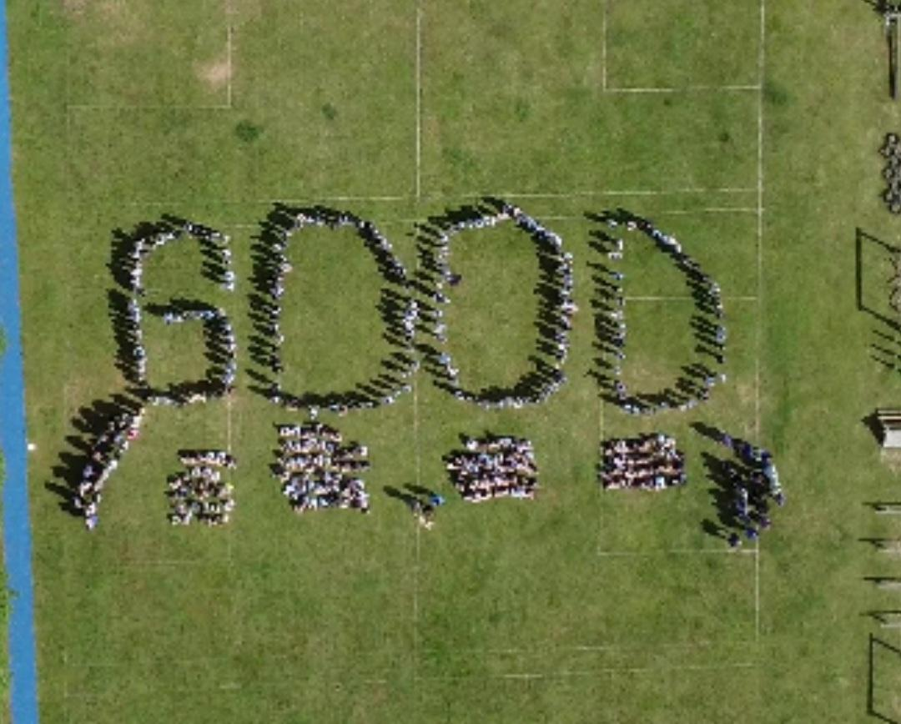


Cavalry Website
Contact us:
Cavalry Primary School
Cavalry Drive
March
Cambridgeshire
PE15 9EQ
office@cavalryprimary.org
Tel: 01354 652814

