Slide 1



14th November 2025
Habitat helpers
Rainforest reports

Slide 2

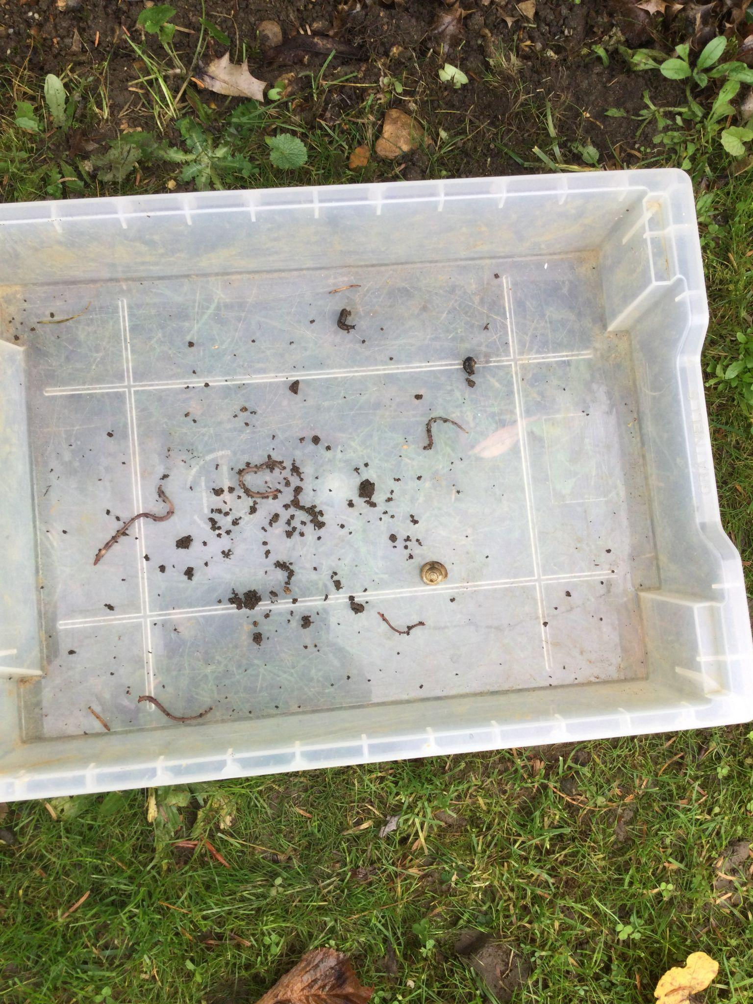
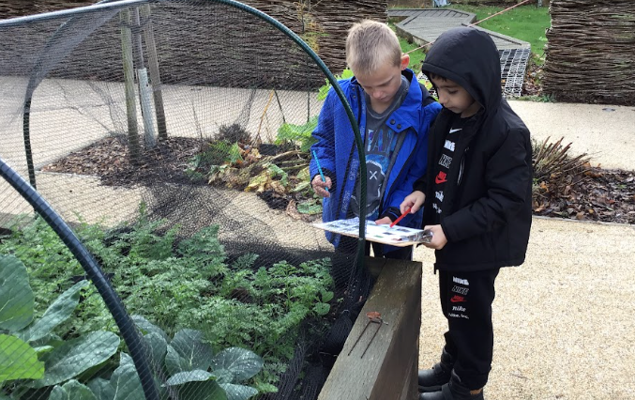
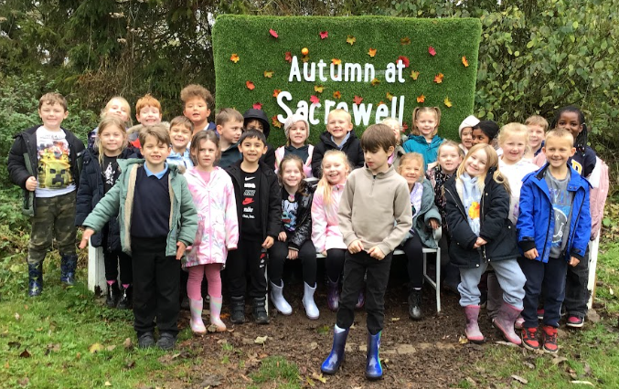
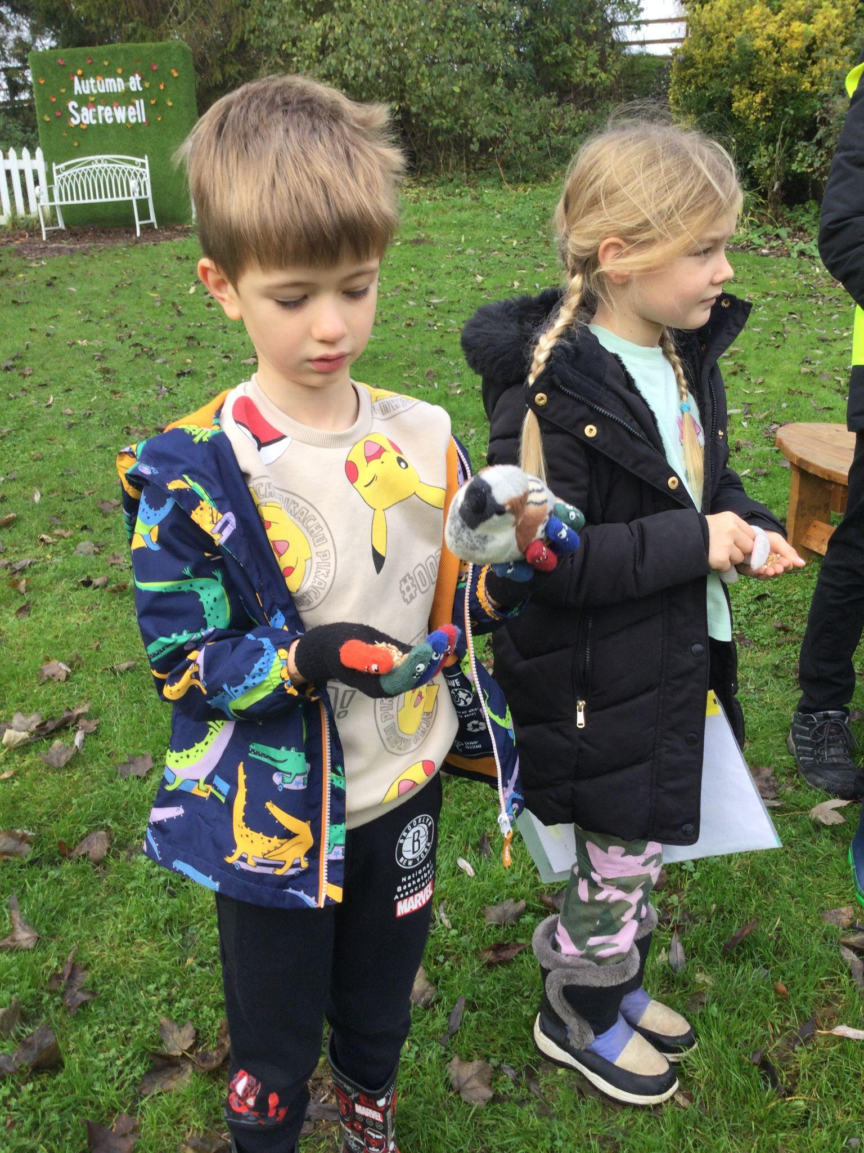
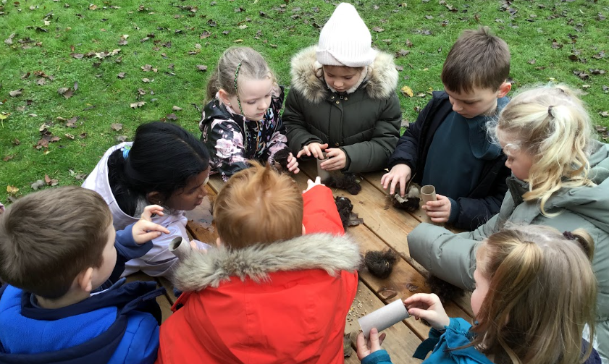
Year 2 had a fantastic day at Sacrewell Farm! We identified lots of different vegetables that are growing in the garden at this time of year.
We then planted our own seeds which we are hoping to plant in our outdoor area in the spring.
We also investigated mini habitats and created our own habitat helpers to take home. These were made from real sheep’s wool, leaves and some bird seed.
Year 2

Slide 3
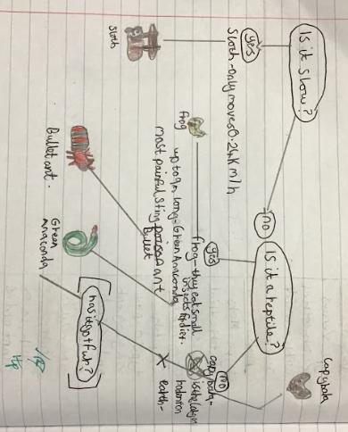
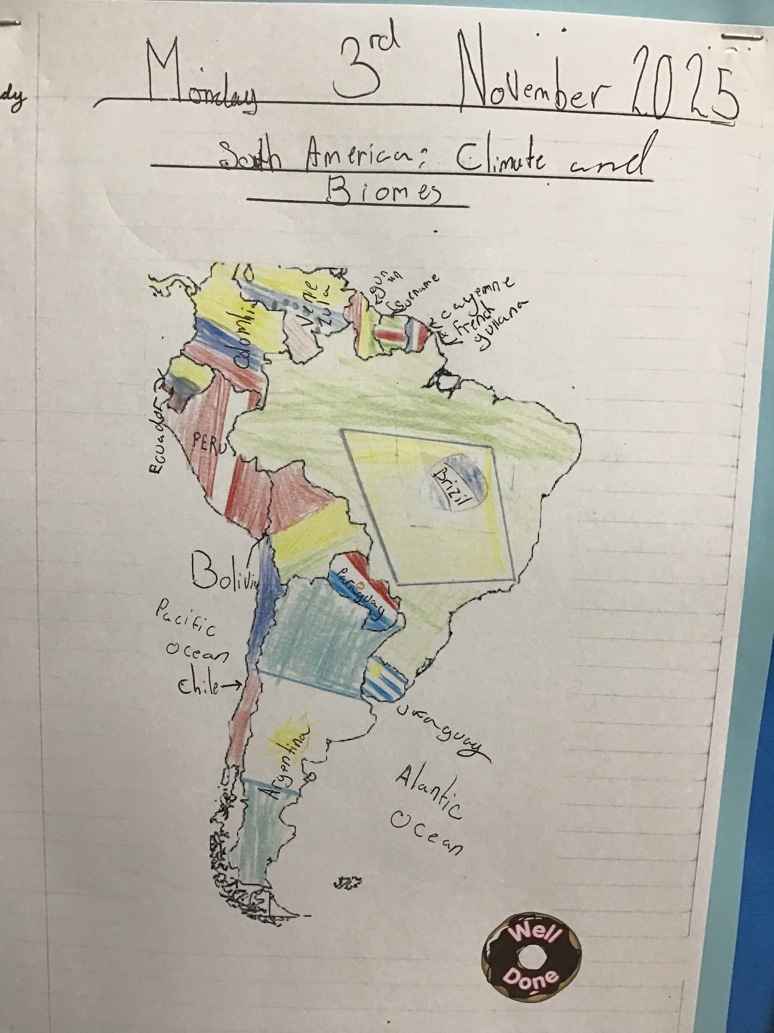
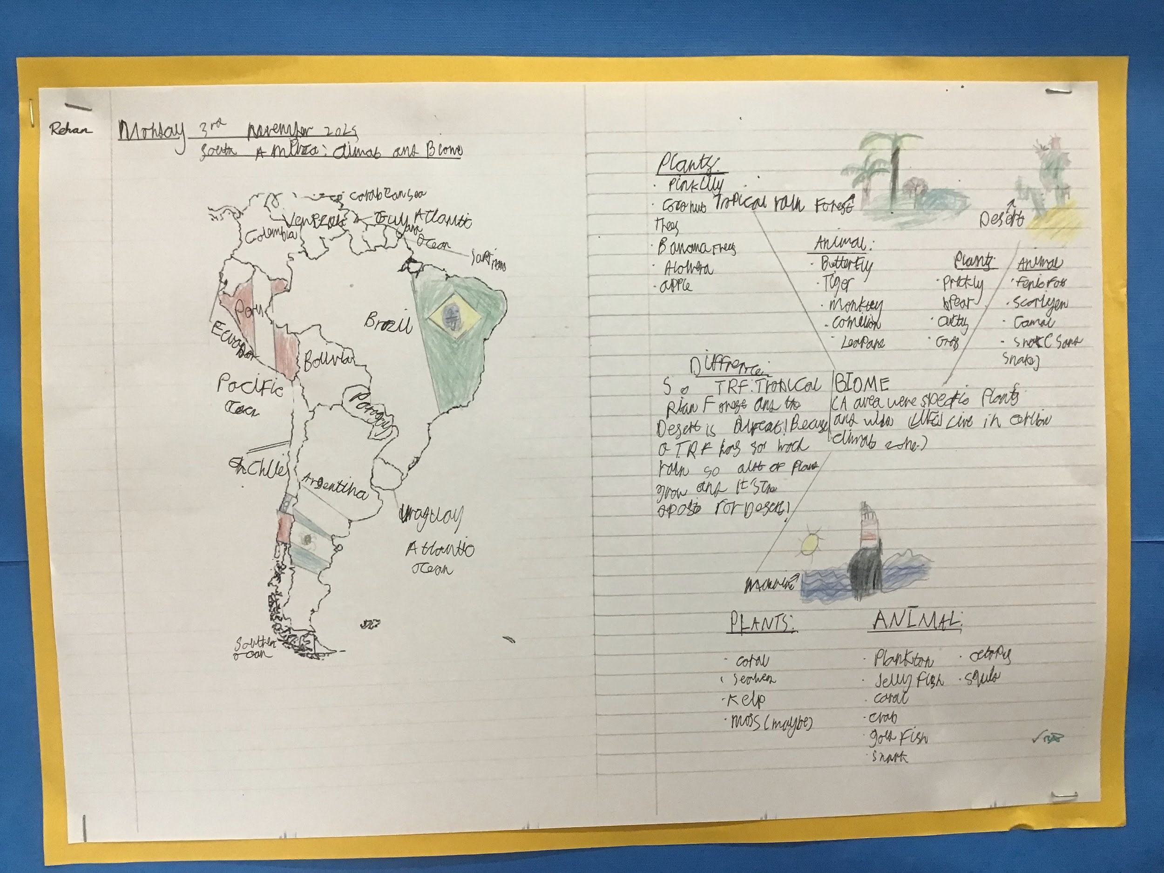
This half term’s geography work is concentrating on Brazil and the tropical rainforests. We are looking at the classification of animals within the rainforest as part of our science, with the intention to write a non-chronological report on some of those animals later in English.
Year 6

Slide 4







Word Wizards:
Year 4 - Class 10 (249,389)
Year 5 - Class 11 (356,354)
Year 6 - Class 13 (527,042)
Mrs Witts recommends:
Well done to Mrs Bank’s phonics group who have worked really hard with their blending skills and who were able to complete their phonics game by blending the sounds to read the word and match it to a picture.
A whale takes a child on a journey to discover the magic of the sea. On their adventures, they witness the effects of pollution on other creatures.
How can we work together stop this happening?
Mr Brown recommends:
A Series of Unfortunate Events - The Bad Beginning. A book that truly got me hooked into a whole series when I was at primary school.

Slide 5

We are aiming for 97% attendance.
This week, our classes with the highest attendance are…
KS1 - Class 2 96.36%
KS2 - Class 13 97.59%
WELL DONE

Slide 6



Year 6 meeting Mon 17th Nov 3.30 or 5.30 Flu Vaccinations Weds 19th November Non uniform for Christmas Market Friday 21st November EYFS open morning 10-11am Thurs 27 Nov Christmas Market Friday 28th November Christmas Carol Concert Fri 12th Dec@9.15am Christmas Jumper & Christmas Dinner Day Reception Nativity 16th & 17th (9:15 - 9:45am) Y1,Y2 & Y3 Production 15th, 16th & 17th (2.30-3.15pm) Y4, Y5, Y6 Production 17th Dec (5.30-6.30pm) & Thur 18th Dec (9.15-10.15am & 2:00-3:00pm Last day of term Friday 19th Dec

Slide 7
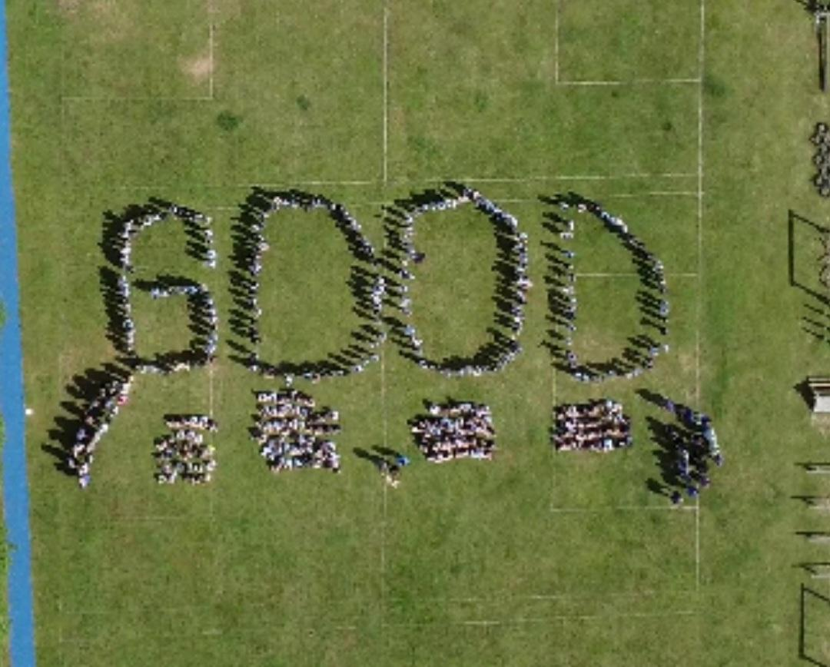


Cavalry Website
Contact us:
Cavalry Primary School Cavalry Drive March Cambridgeshire PE15 9EQ
office@cavalryprimary.org
Tel: 01354 652814

