Slide 1

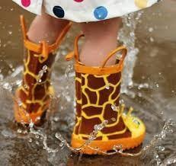
Newsletter 22/10/26
The week after half term at a glance…
PTFA Meeting
Monday 2nd
5.15pm - 6.15pm
Please come to the main school door. ALL WELCOME
FIRST SWIMMING session is on
Thursday 5th
Don’t forget your swimming kit!
Nursery Sponsored Welly Waddle
Wednesday 4th
9am - 9.45am
Residents of Aria Court will join us at Cavalry
Thursday 5th
Please bring a small tupperware if you can, you’ll have treats to take home.
Whole school
Year 3
Nursery
The Green Team

Slide 2
Up and coming events…
Whole school
PTFA Meeting Monday 2nd November 5.15pm in school | Come along, find out what the PTFA will be doing next to support Cavalry. All Welcome!
School Book Fair Week beg 9th November | Parents and children will be given time to browse the books and place an order.
Anti Bullying Week Monday 16th-Friday 20th Nov | Special events will take place during the week based around the importance of kindness and anti bullying.
Children in Need Friday 20th November | A letter with more information about our Children in Need event will be sent out soon.

Slide 3

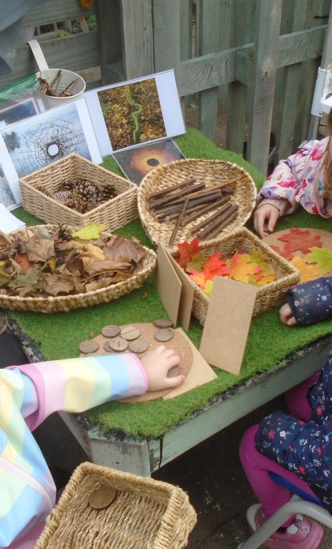
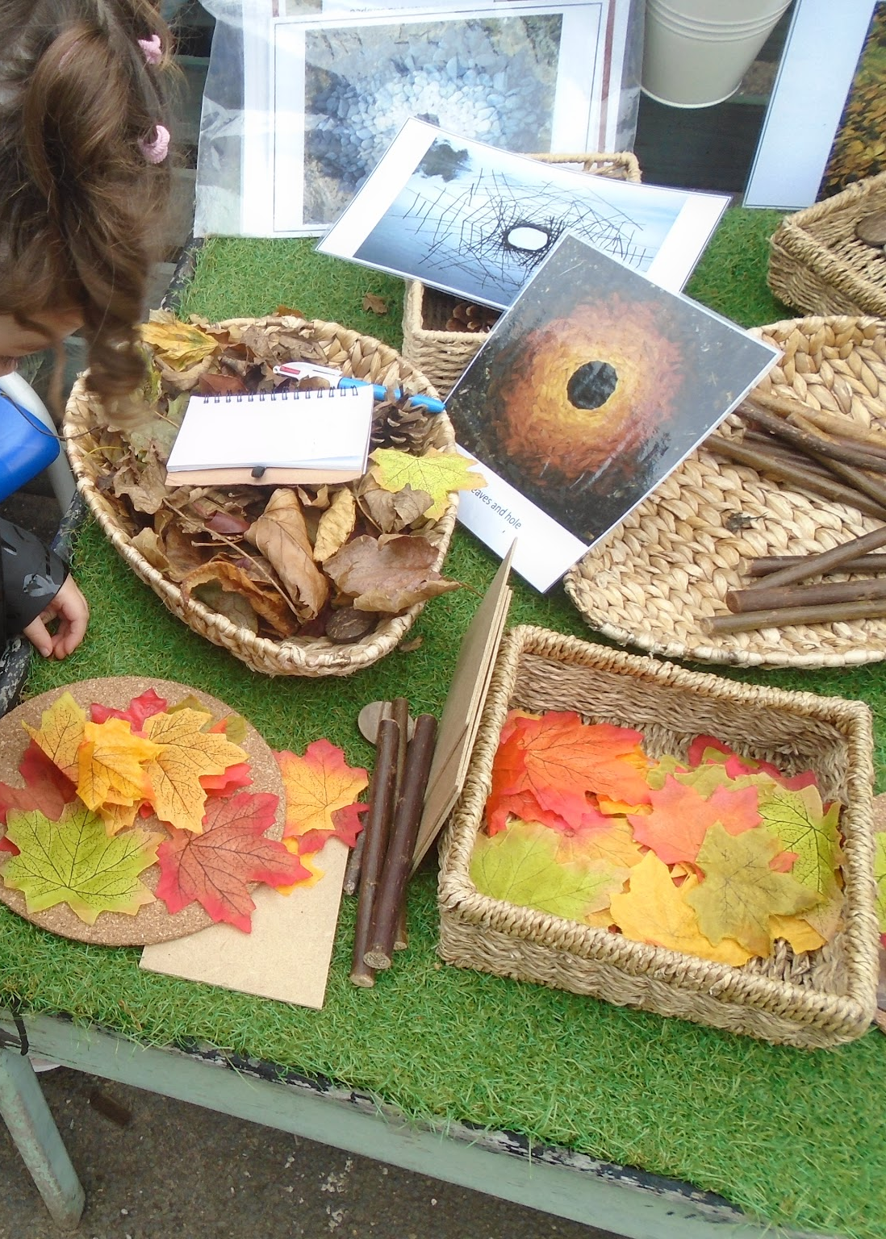
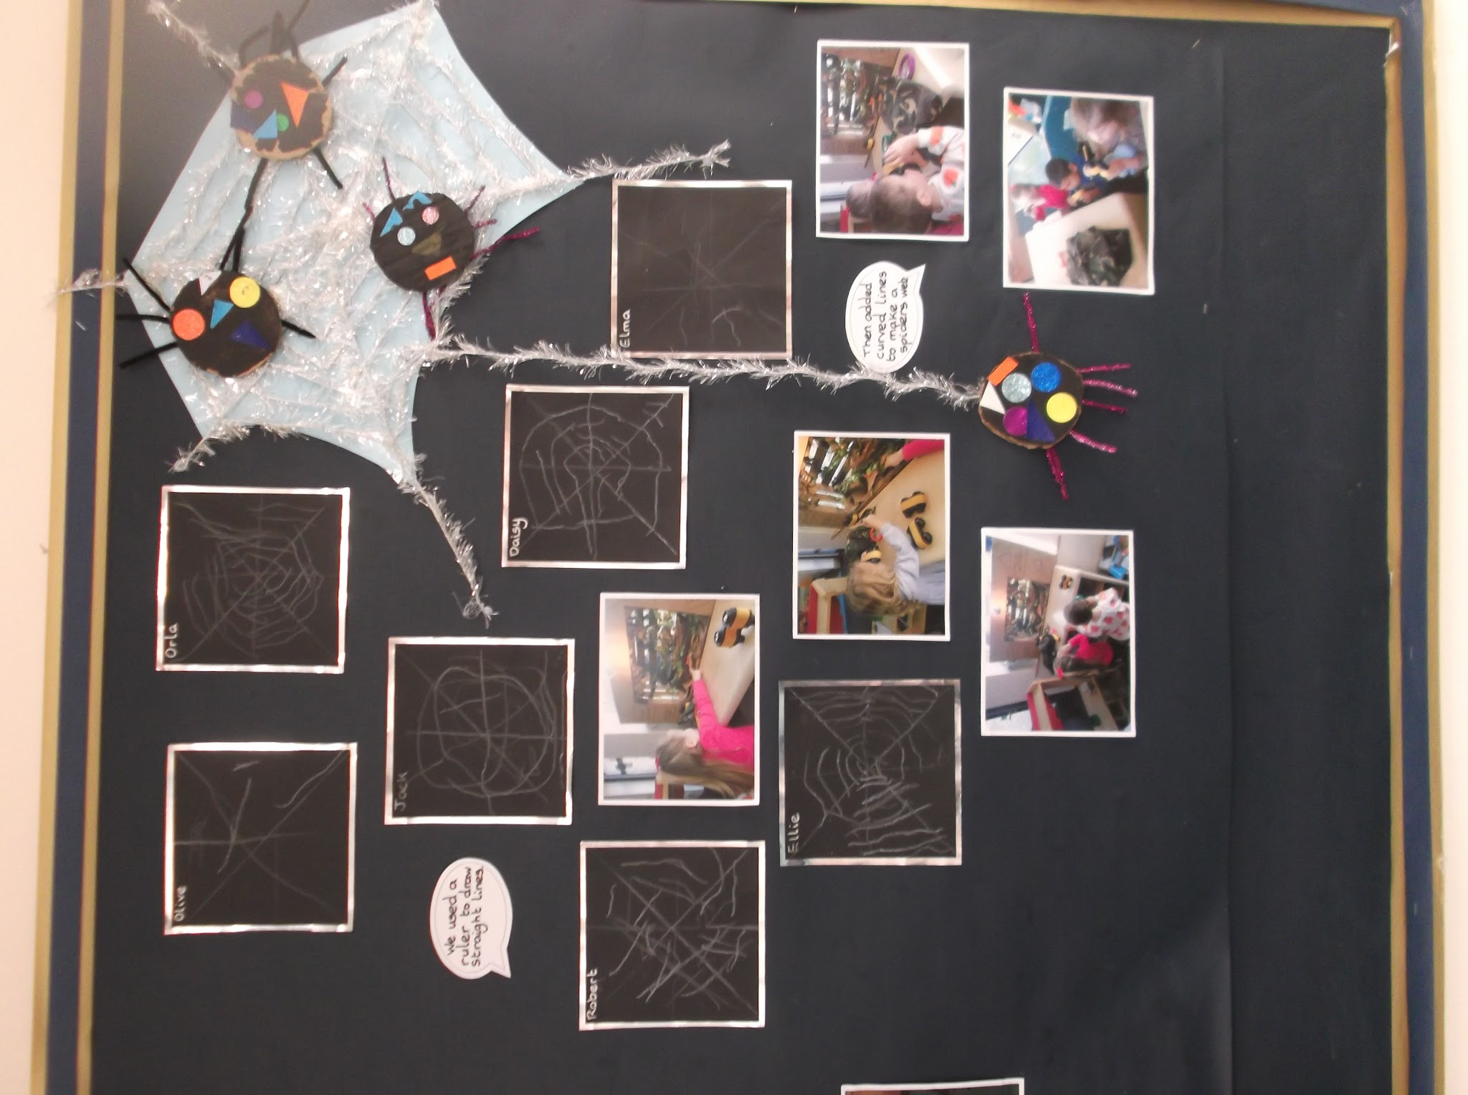
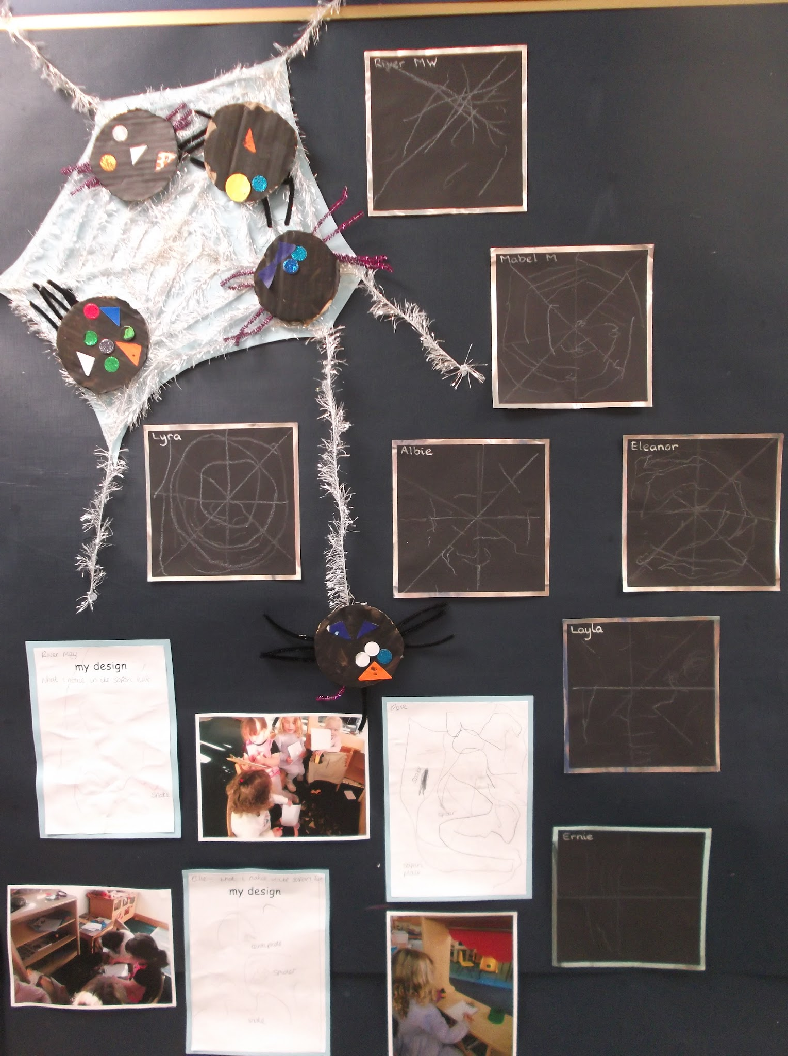
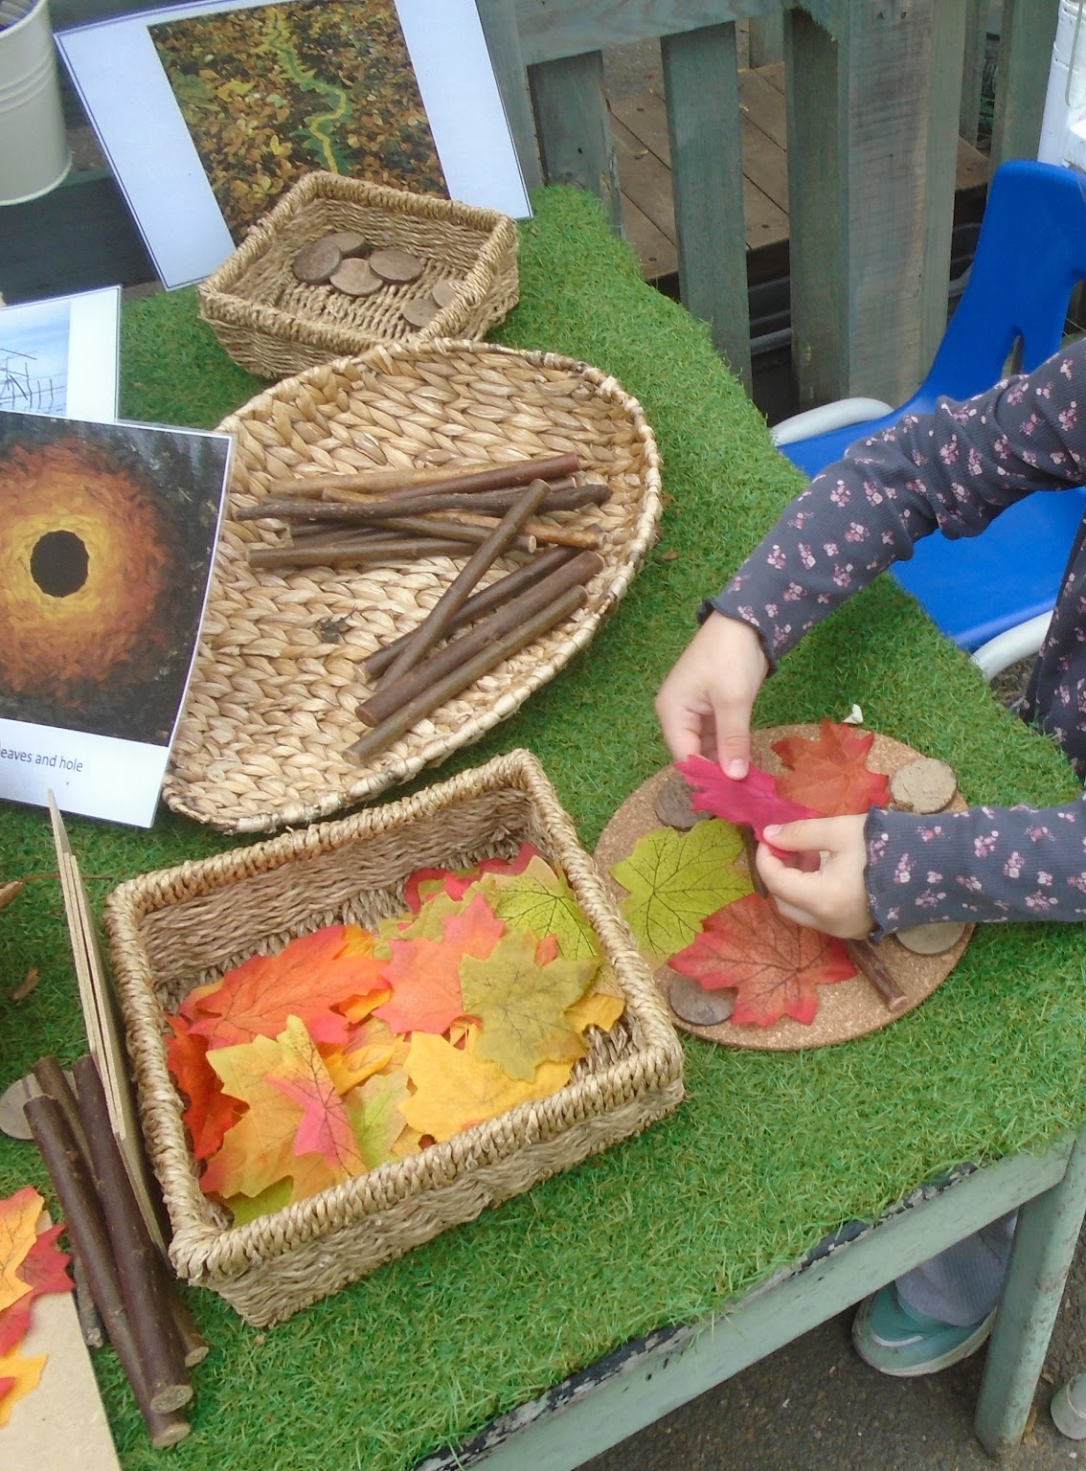
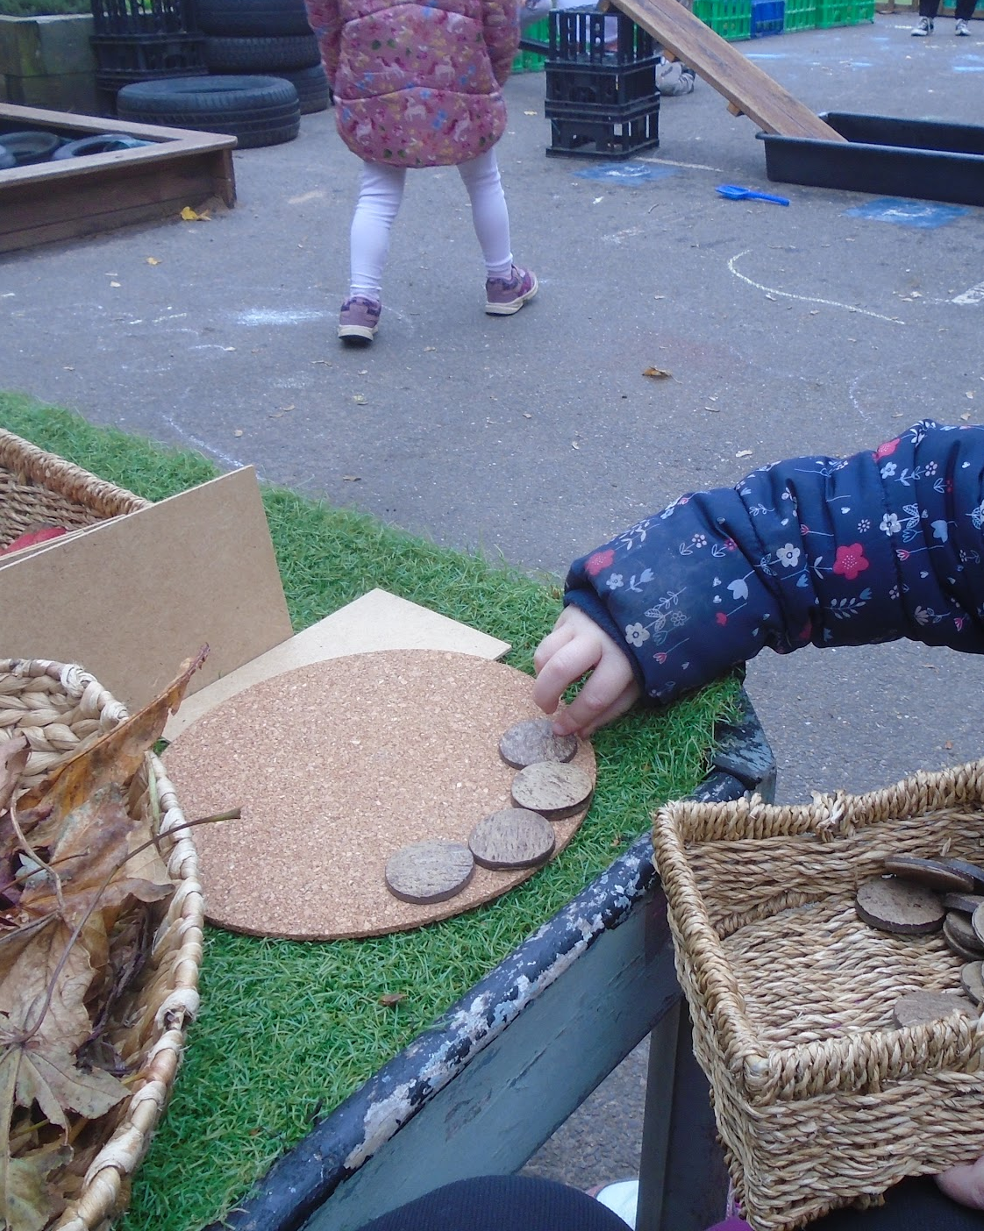
Nursery
We are reading Anansi the Spider. The children have been learning how to use a ruler to draw straight lines then curved lines to create a spider’s web.
Outside we have been looking at the work of Andy Goldsworthy before creating our own autumn inspired transient art.

Slide 4
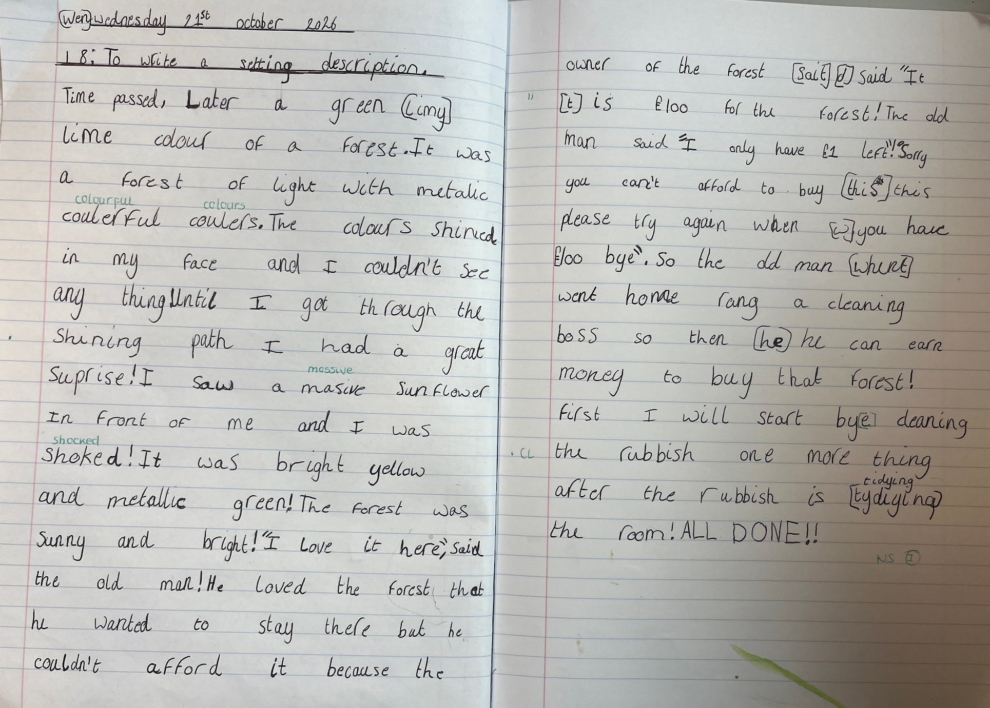
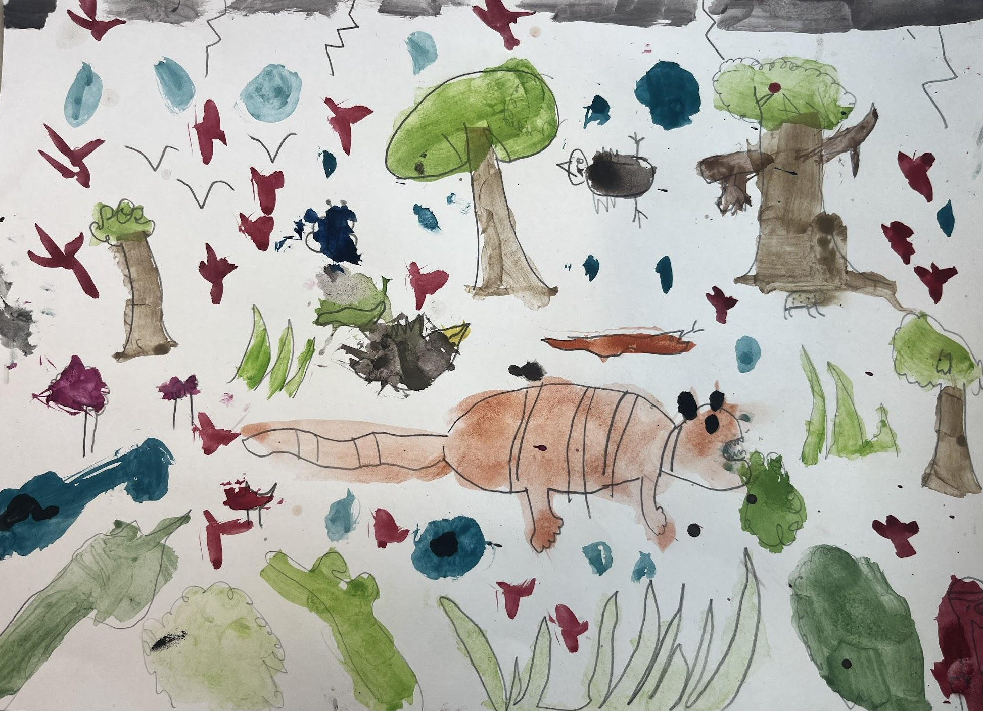
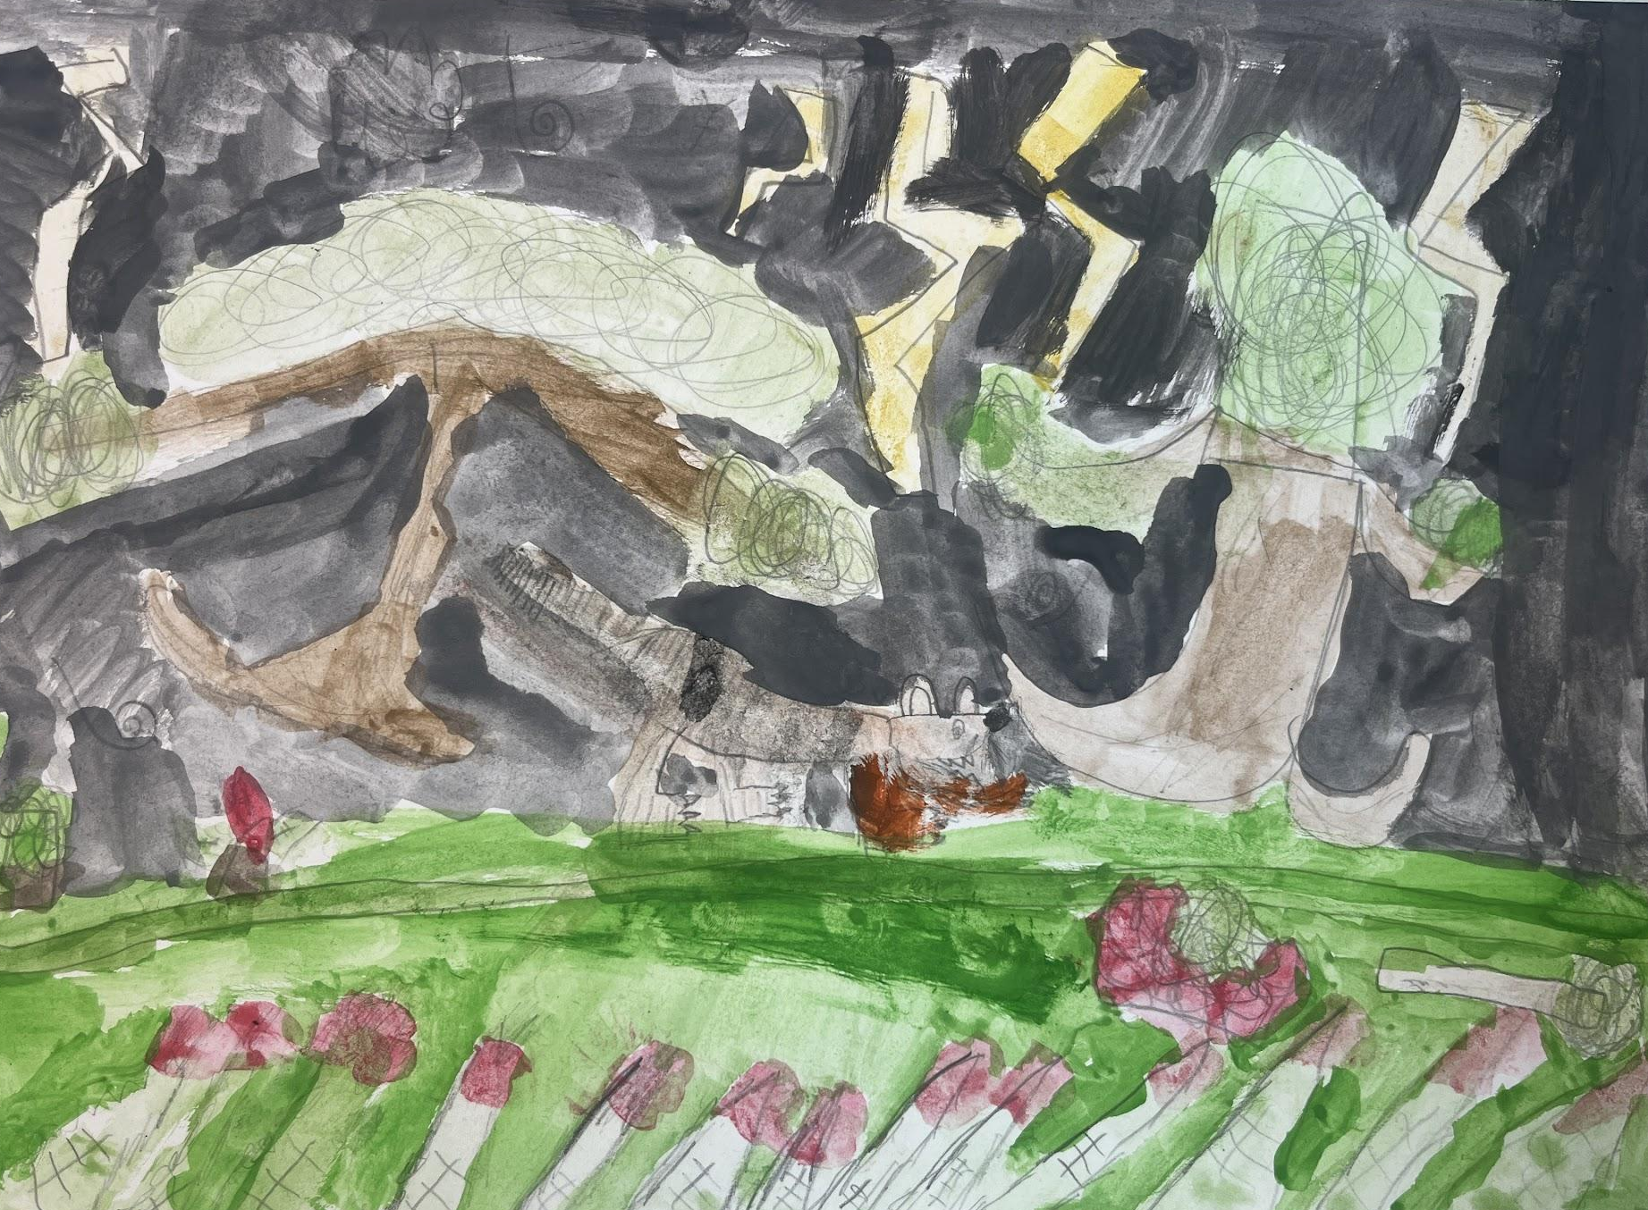
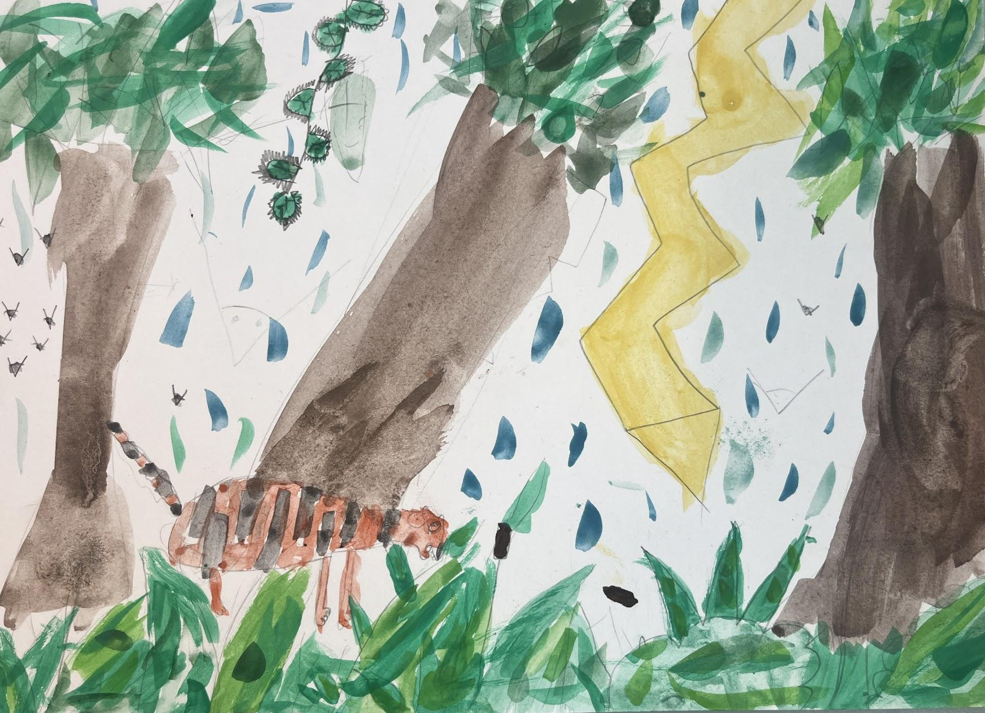
Year 3
In English, Year 3 have been reading a lovely story called ‘The Tin Forest’ by Helen Ward. We have been writing setting descriptions based on the beautiful illustrations in the book; we then went on to paint our own versions of ‘Tiger in a Tropical Storm’ by Henri Rousseau.

Slide 5
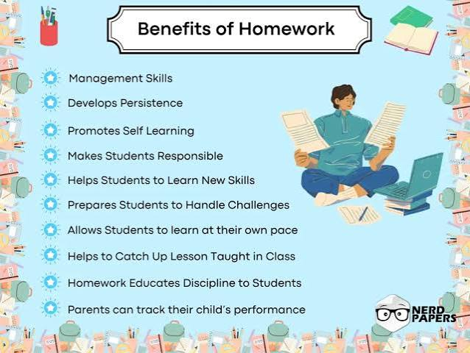
What can you do at home to support learning?
Great Talking!
Please make sure your child continues to read during the holiday, complete their
TTRS and Century
🌟 What Difference Does Reading Make to a Child’s Language Skills?
Vocabulary Explosion Children’s books contain 50% more rare or rare-context words than everyday adult conversation or TV shows. Daily reading rapidly expands the words your child knows and uses.
Stronger Reading & Writing Fundamentals Hearing fluent reading helps children recognize sentence structure, grammar, and punctuation patterns naturally, making their own speaking, writing and independent reading much stronger.
Deeper Comprehension & Critical Thinking Discussing stories together teaches children to predict outcomes, understand cause-and-effect, and analyze characters' choices.

Slide 6






Word Wizard Winners:
Year 4 - Class 9 78,640
Year 5 - Class 11 369,345
Year 6 - Class 13 675, 784
Mrs Monk recommends Danny the Champion of the World by Roald Dahl is a warm, funny, and surprisingly tender adventure about a nine-year-old boy who lives alone with his father in a gypsy caravan behind their filling station — and who discovers that his beloved, seemingly perfect father has a magnificent secret.
Fred says ‘Well done’ to all of KS1 - you have done amazing phonics this half term and made super progress with your sounds and reading - keep it up!
Miss Udy recommends
Be Kind by Pat Zietlow Miller
It is a picture book about a young girl who ponders what "kindness" really means after her classmate, Tanisha, spills grape juice on her dress. It shows that kindness doesn't require grand gestures.

Slide 7
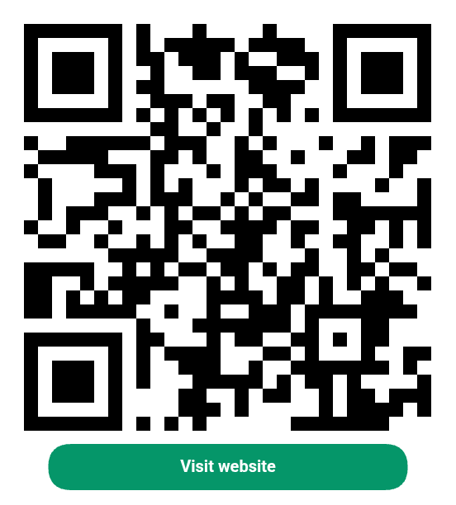
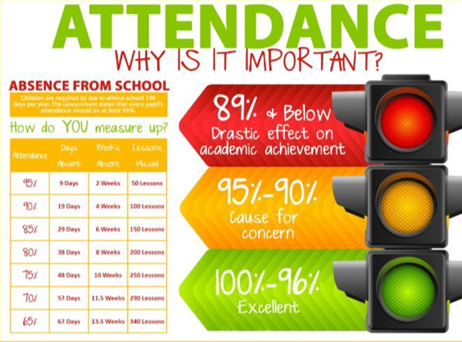
We are aiming for 97% attendance.
This week, our classes with the highest attendance are…
KS1 - Class 4 96.64%
KS2 - Class 7 96.55%
WELL DONE
Spotlight on attendance
School Attendance Information for Parents and Carers
After October half term, our formal attendance monitoring will commence. With Winter just around the corner, we will do our best to mitigate the spread of germs by continuing to encourage regular hand washing and ventilating the classrooms during break and lunchtimes.
Although, we appreciate that younger children are often unwell, regular attendance is so incredibly important for your child’s learning journey!
These early years are all about building amazing foundations, from reading magical stories and writing exciting tales to understanding the secrets of numbers. Since they learn things step by step, being there every day helps them not miss a single beat or fall behind. But it’s not just about lessons! Coming to school consistently helps your child make new friends, learn how to share and work together, and build healthy daily routines. It gives them a sense of belonging, making them feel happy, confident, and excited to learn,
As always, your continued support is appreciated.

Slide 8
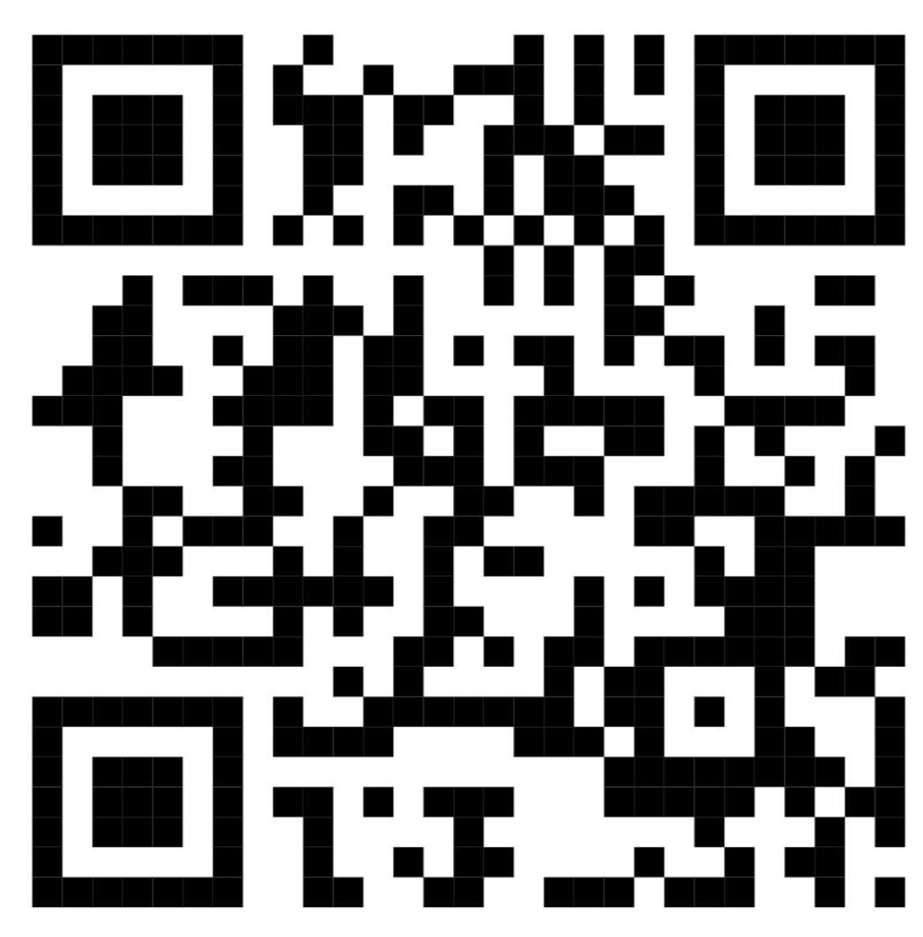

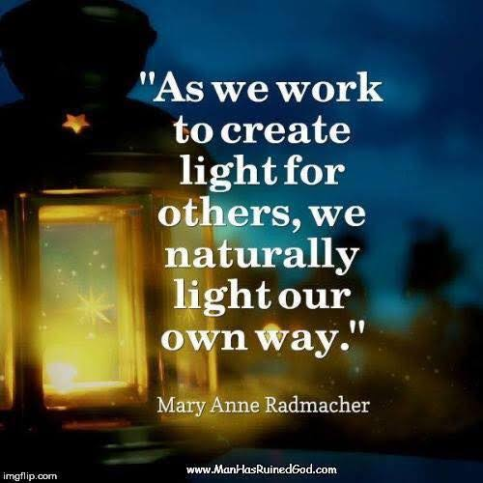
Cavalry Website
Have a great half term, stay safe and see you on Monday 2nd November!
Contact us:
Cavalry Primary School
Cavalry Drive
March
Cambridgeshire
PE15 9EQ
office@cavalryprimary.org
Tel: 01354 652814

