Slide 1




12th December 2025
Counting down to Christmas special!
An igloo in the hall…
Carol concert…
Christmas tree competition…

Slide 2
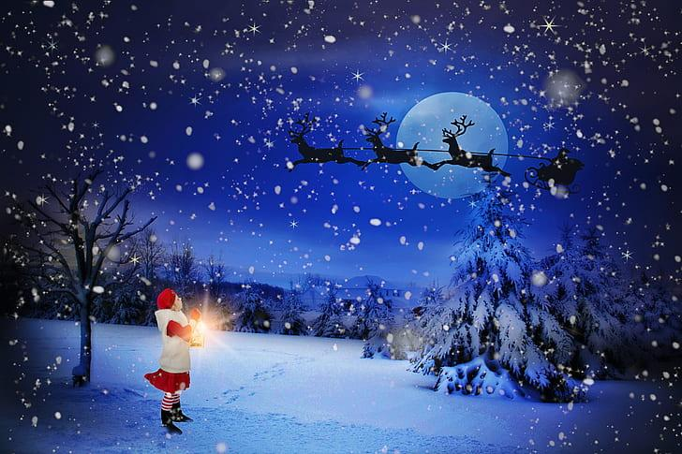
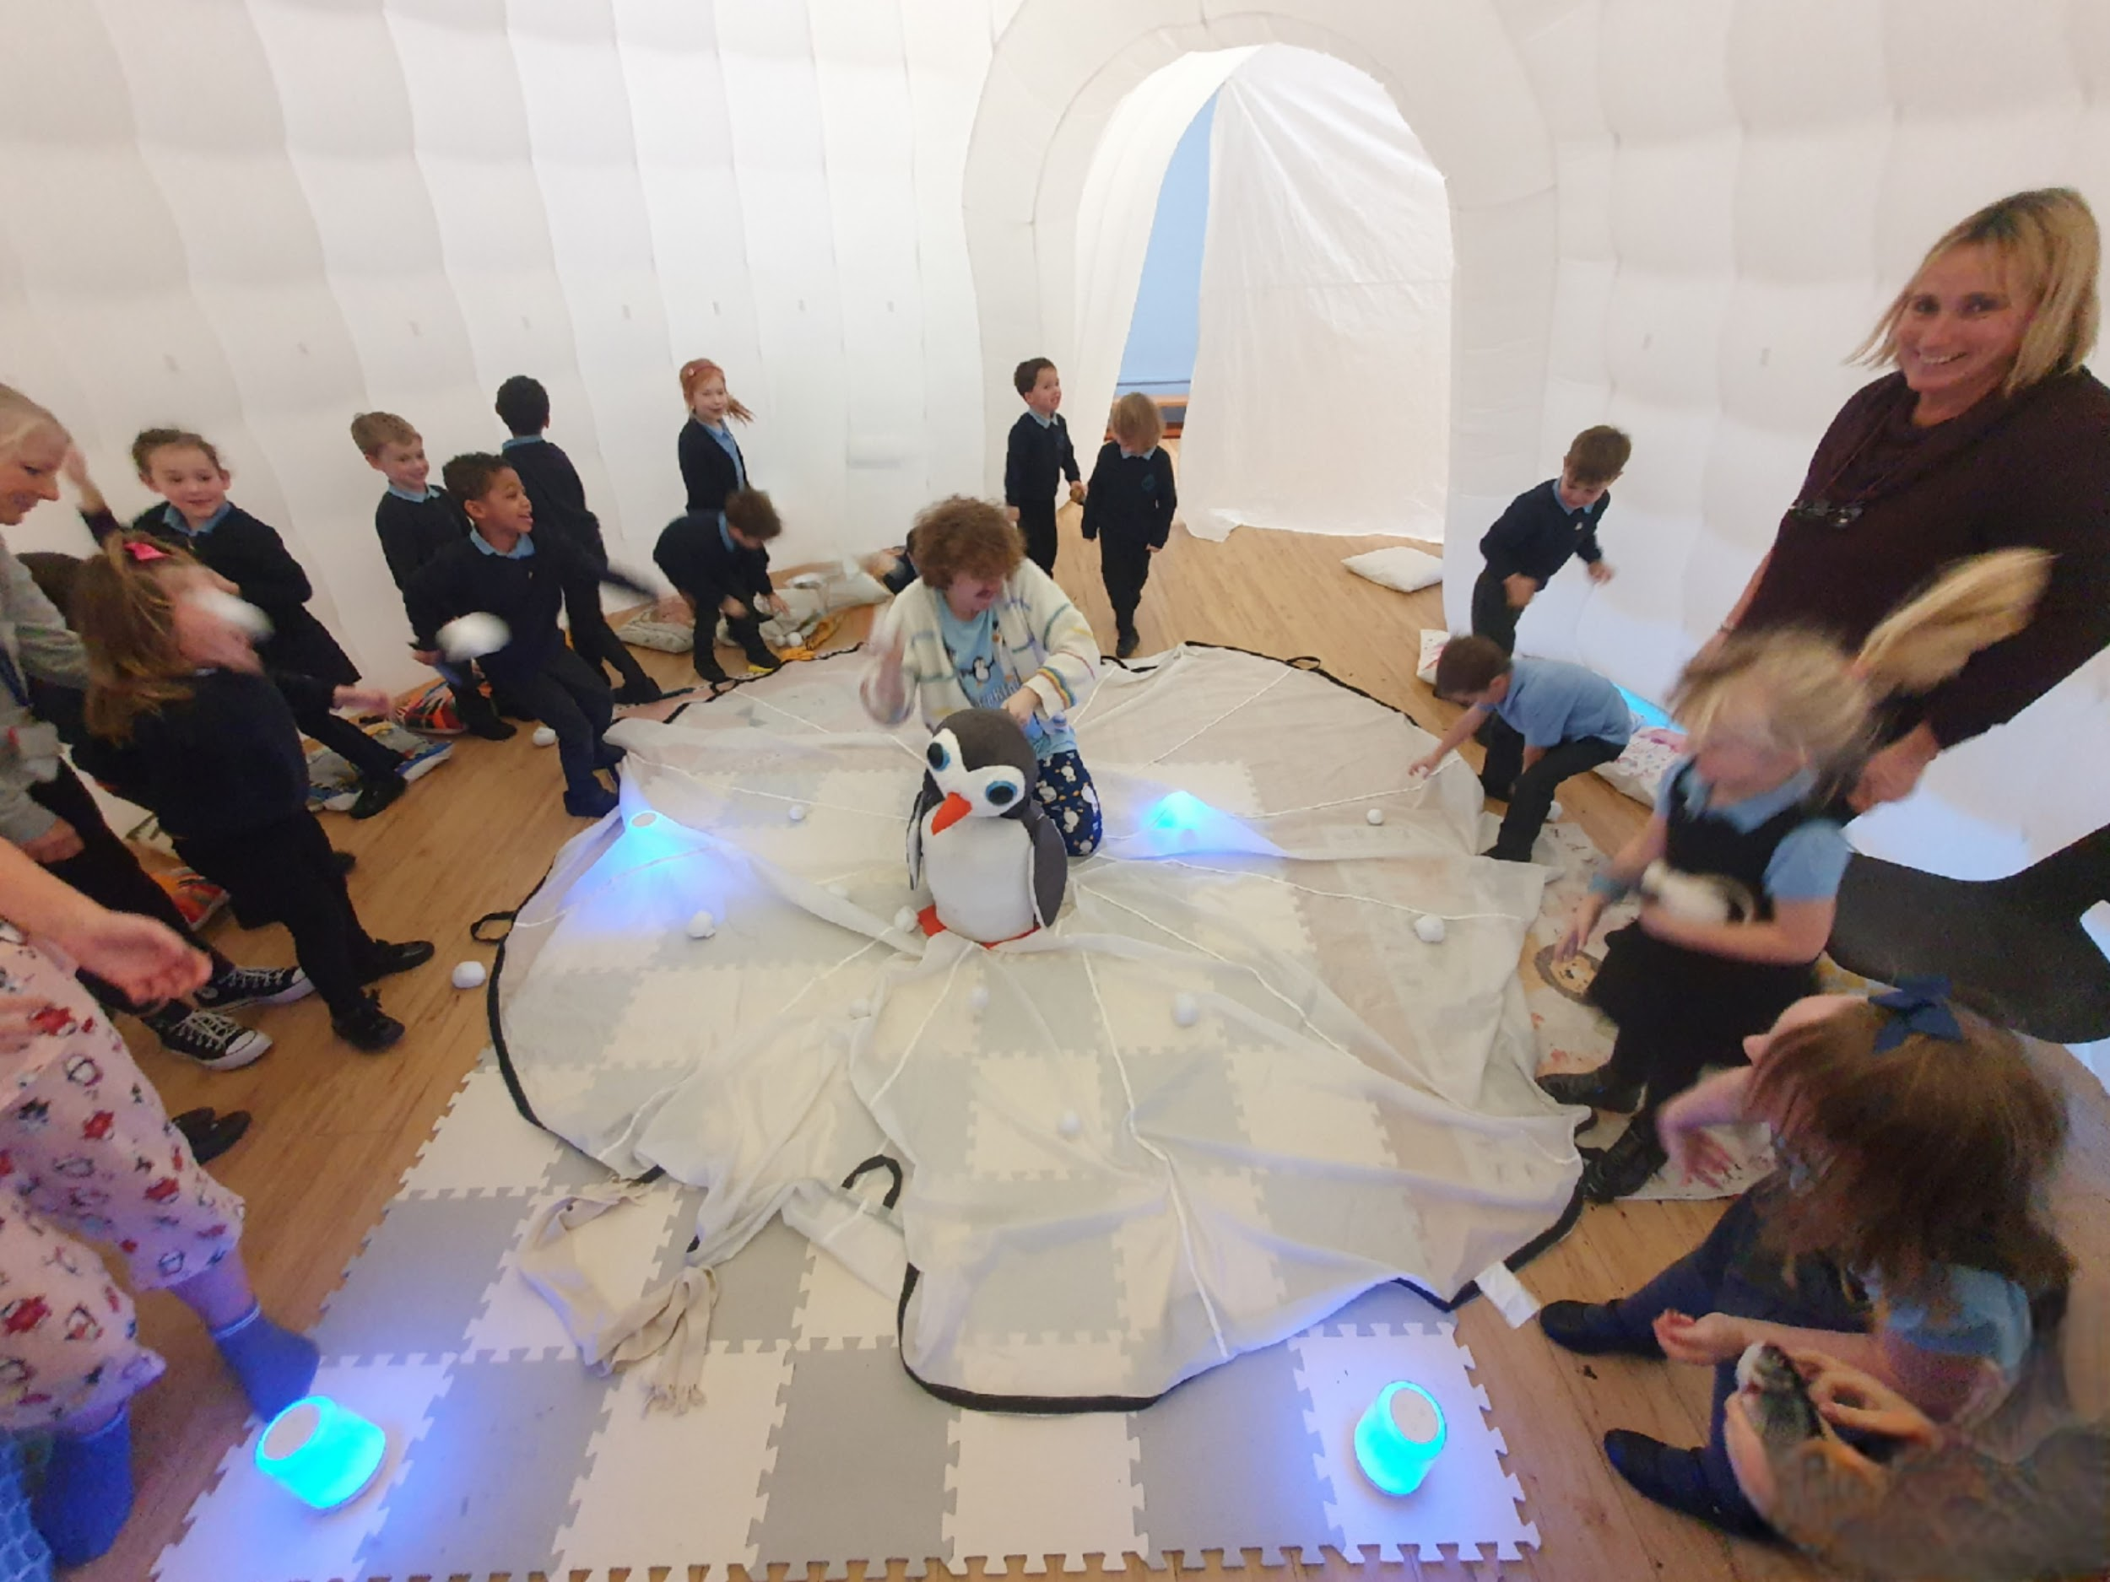
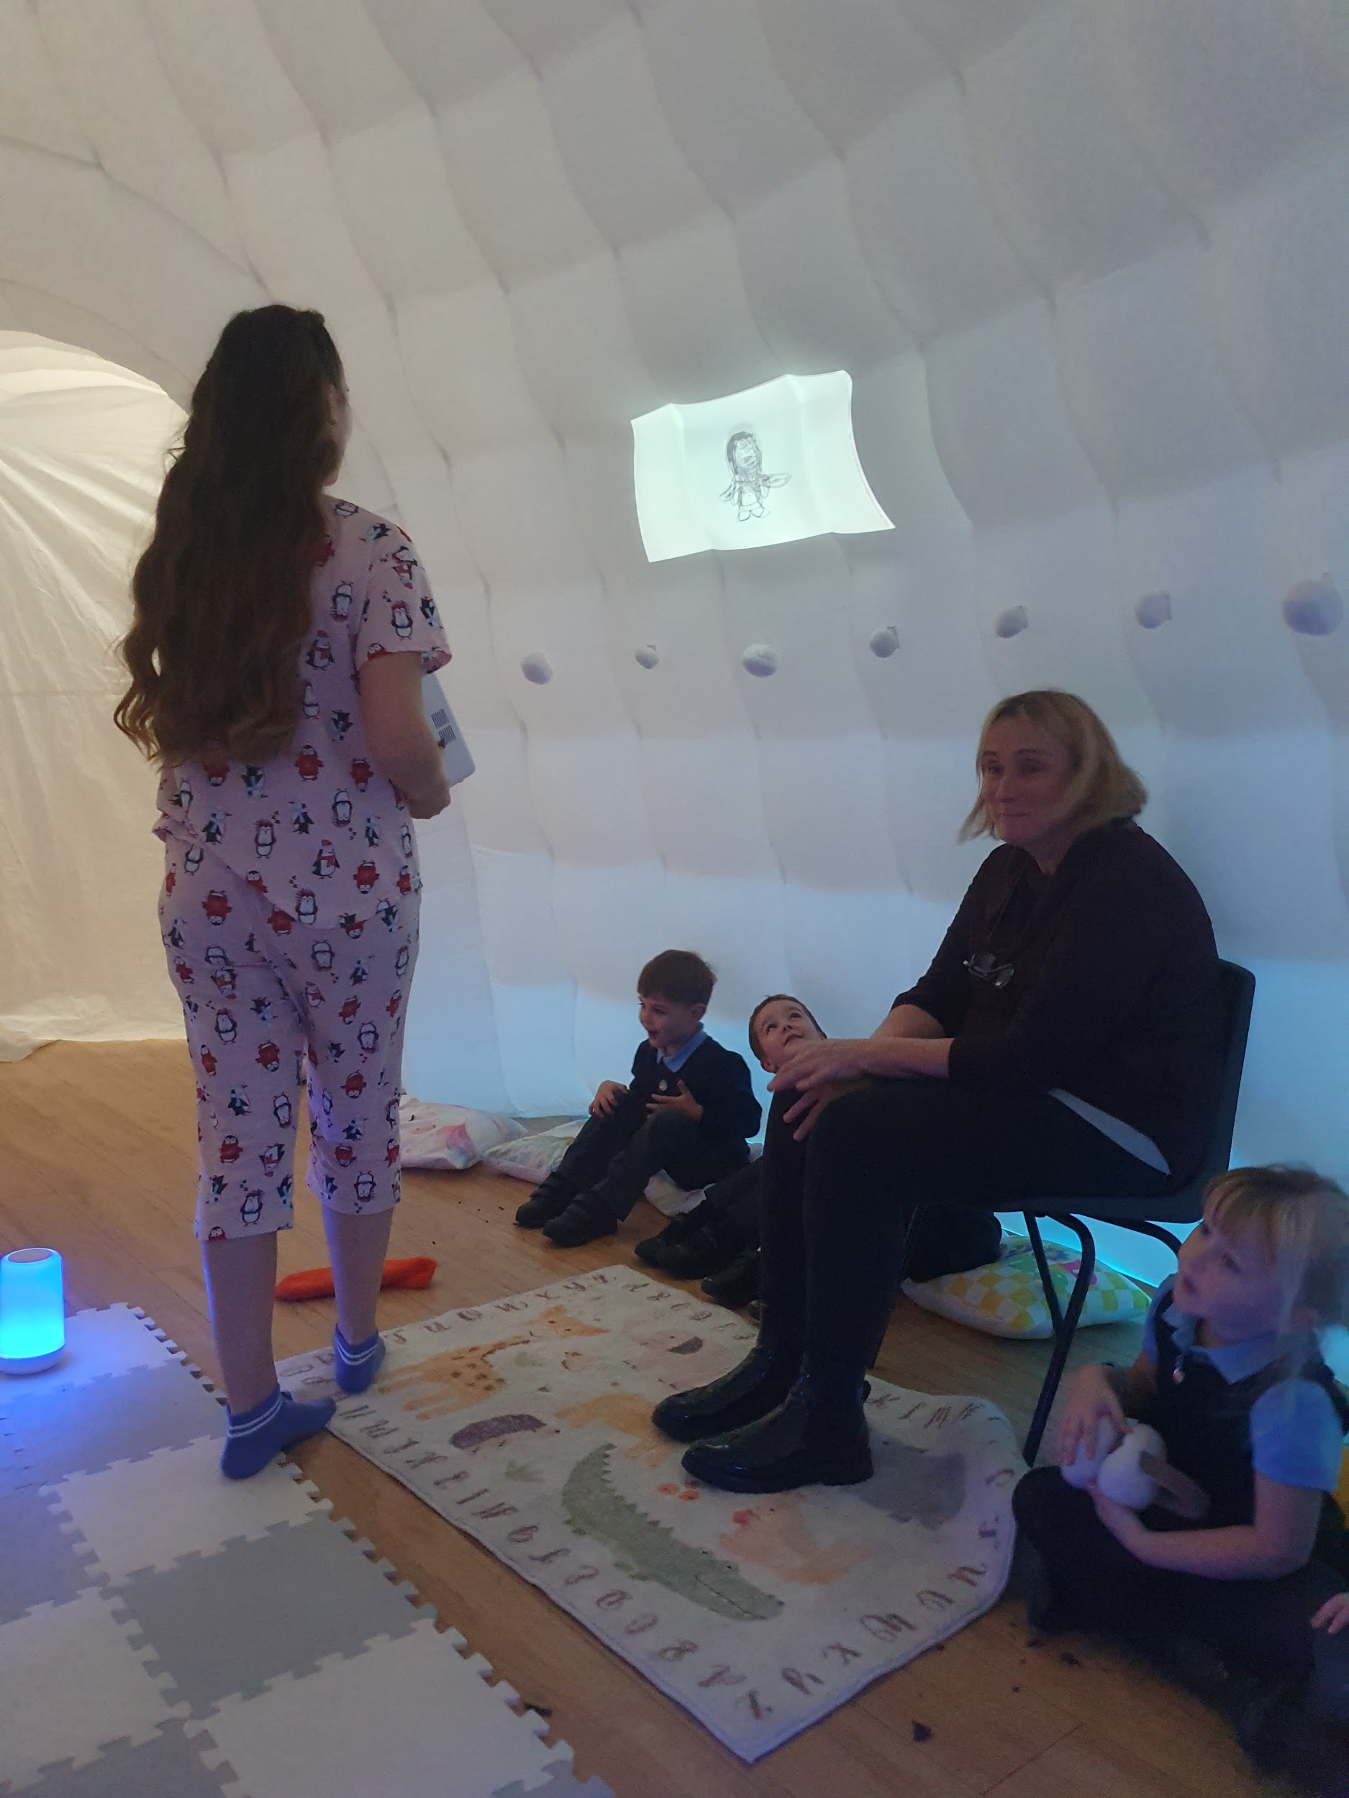
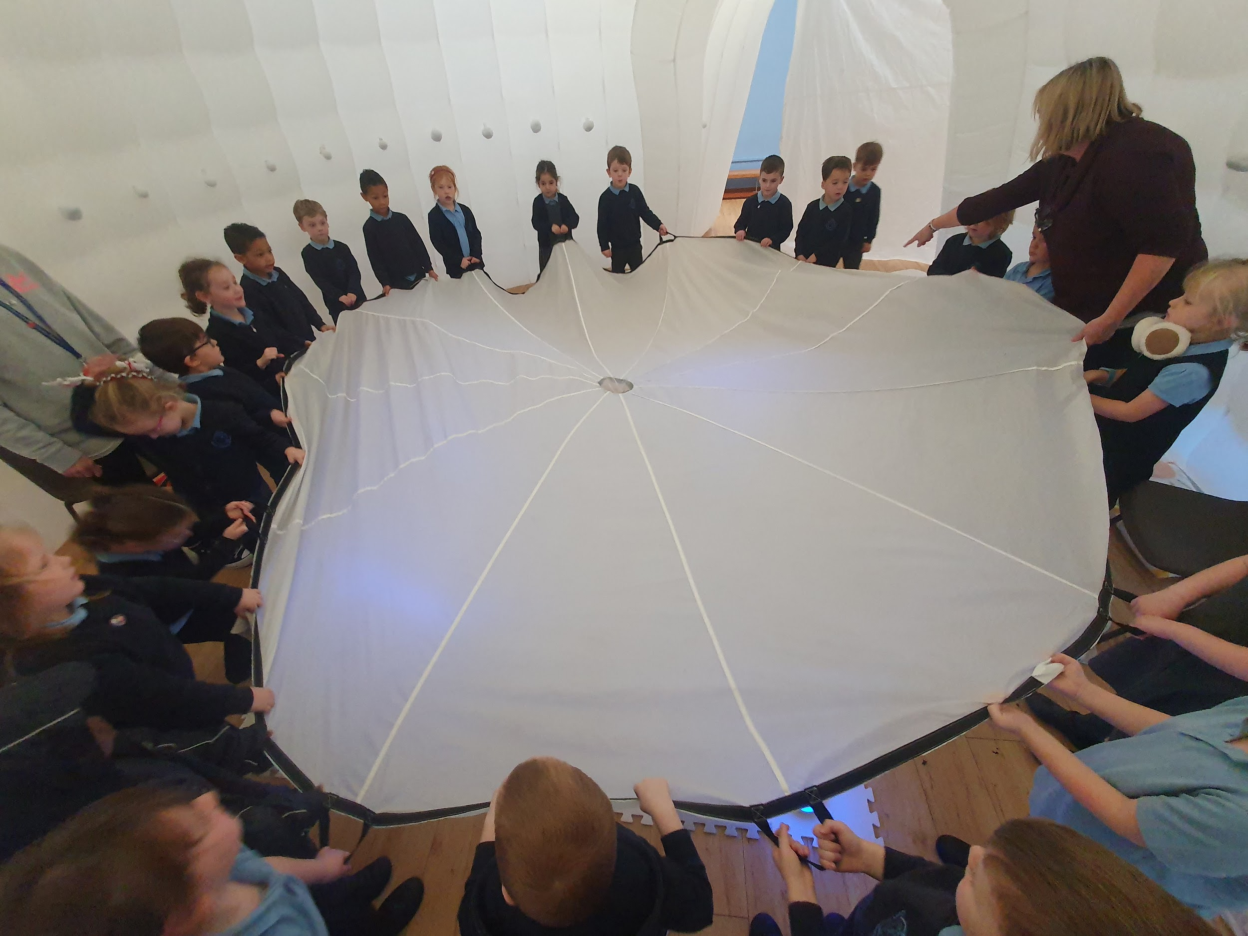
This week we welcomed The Jam Jar Theatre Company who shared their performance ‘Penguins’ with Reception, Year 1 and Year 2. We met a young girl, Issy, who invited us into her ‘duvet den’, where she evaded bedtime and took us with her as she traveled the world using the power of imagination, following in the footsteps of her idol David Attenborough. We met the wildlife she is determined to help… PENGUINS! She was joined by her brother who helped to tell the story too. We learnt many facts about penguins and climate change - specifically the way global warming reduces the huge ice sheets that are home to wildlife in Antarctica - and the human efforts being made in response to the issue. Thank you, Jam Jar Theatre!

Slide 3
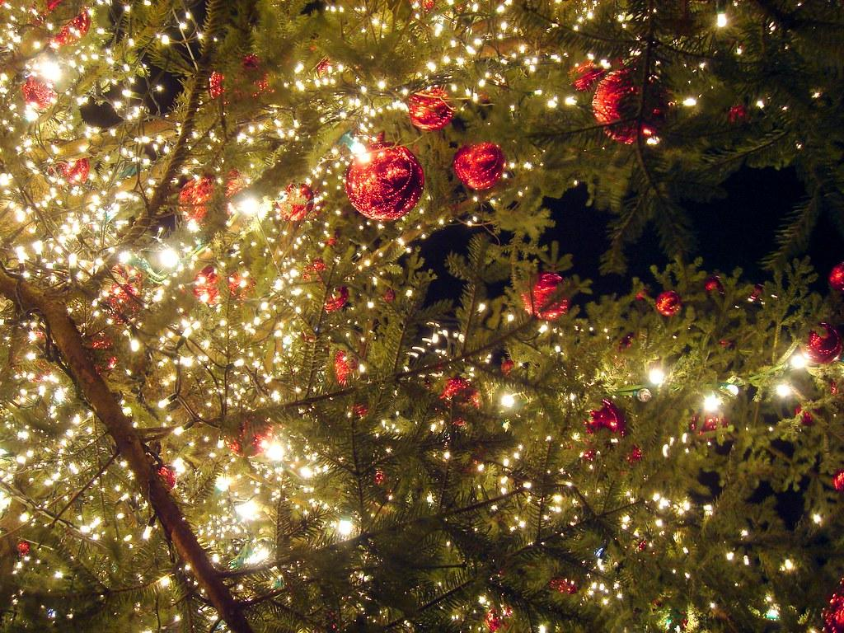
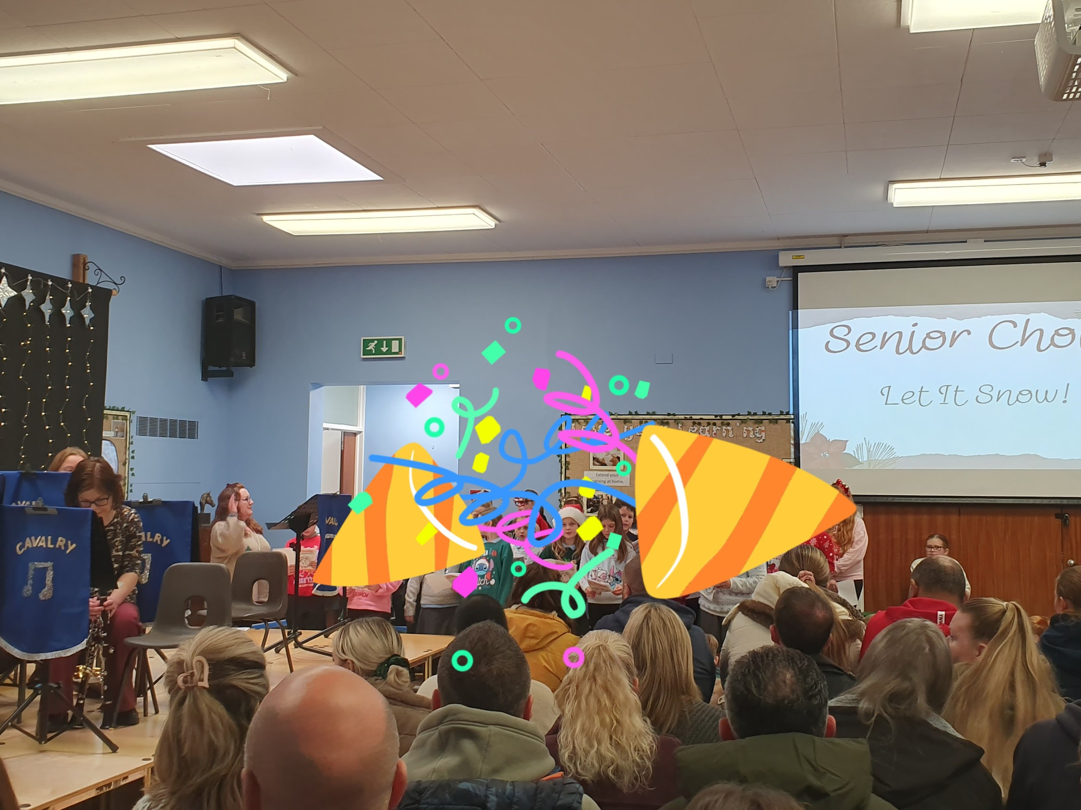
Carol Concert
On Friday the 12th, we enjoyed our lovely School Carol Concert, filled with festive cheer and outstanding performances. Our talented Junior and Senior Choirs delighted the audience with beautiful festive songs, followed by wonderful performances from the Junior and Senior Bands.
We were also treated to impressive solos, duets, and group pieces from our woodwind and brass instrumentalists, who performed a mix of classic Christmas carols and magical film music.
The morning was a truly joyful celebration of music and community, and we are incredibly grateful to Mr Wilson, Mrs Wheeler, and our lovely Mrs Edwards for their magical musical support in making the Carol Service so special.

Slide 4


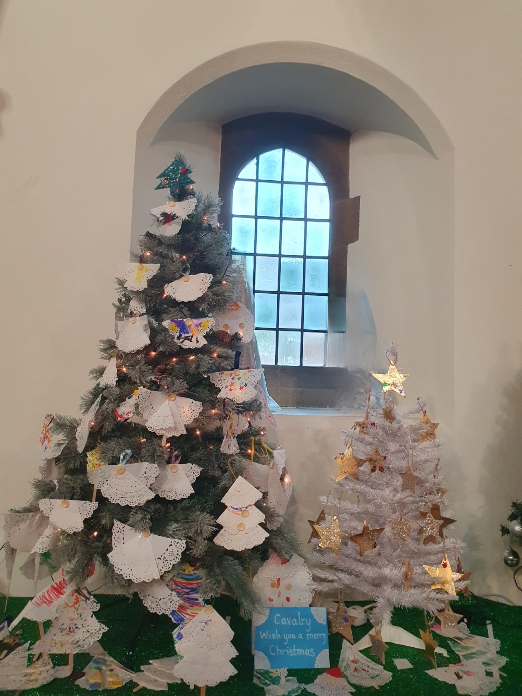
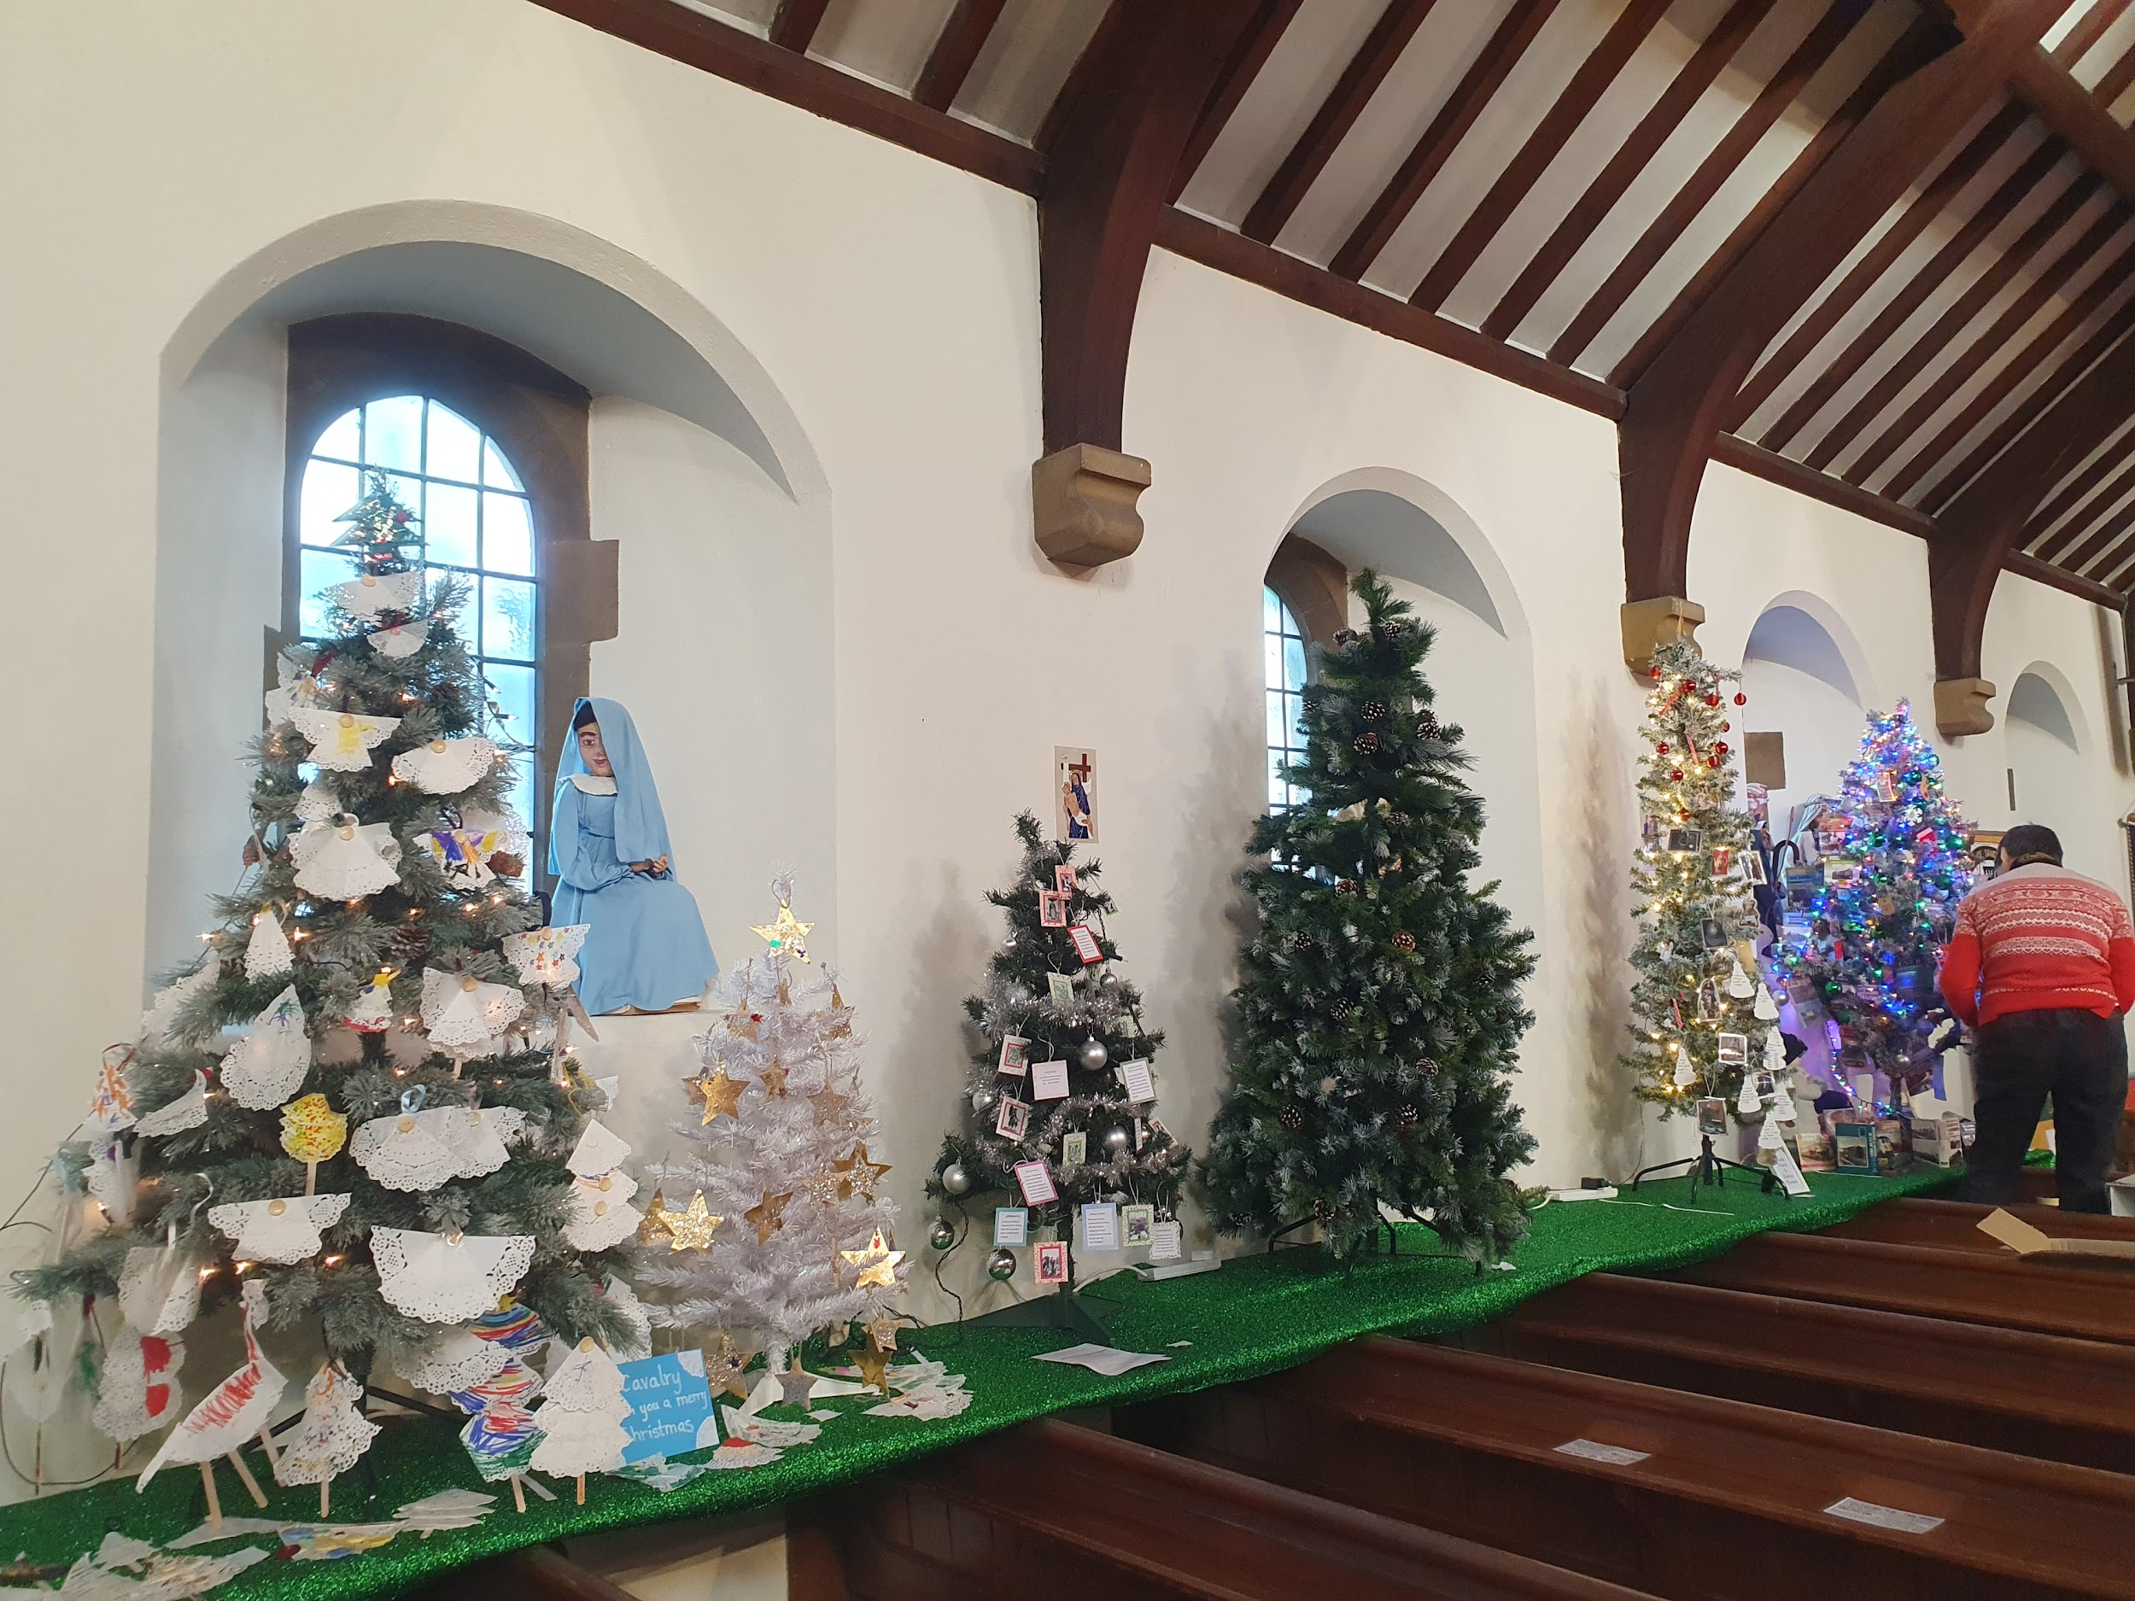
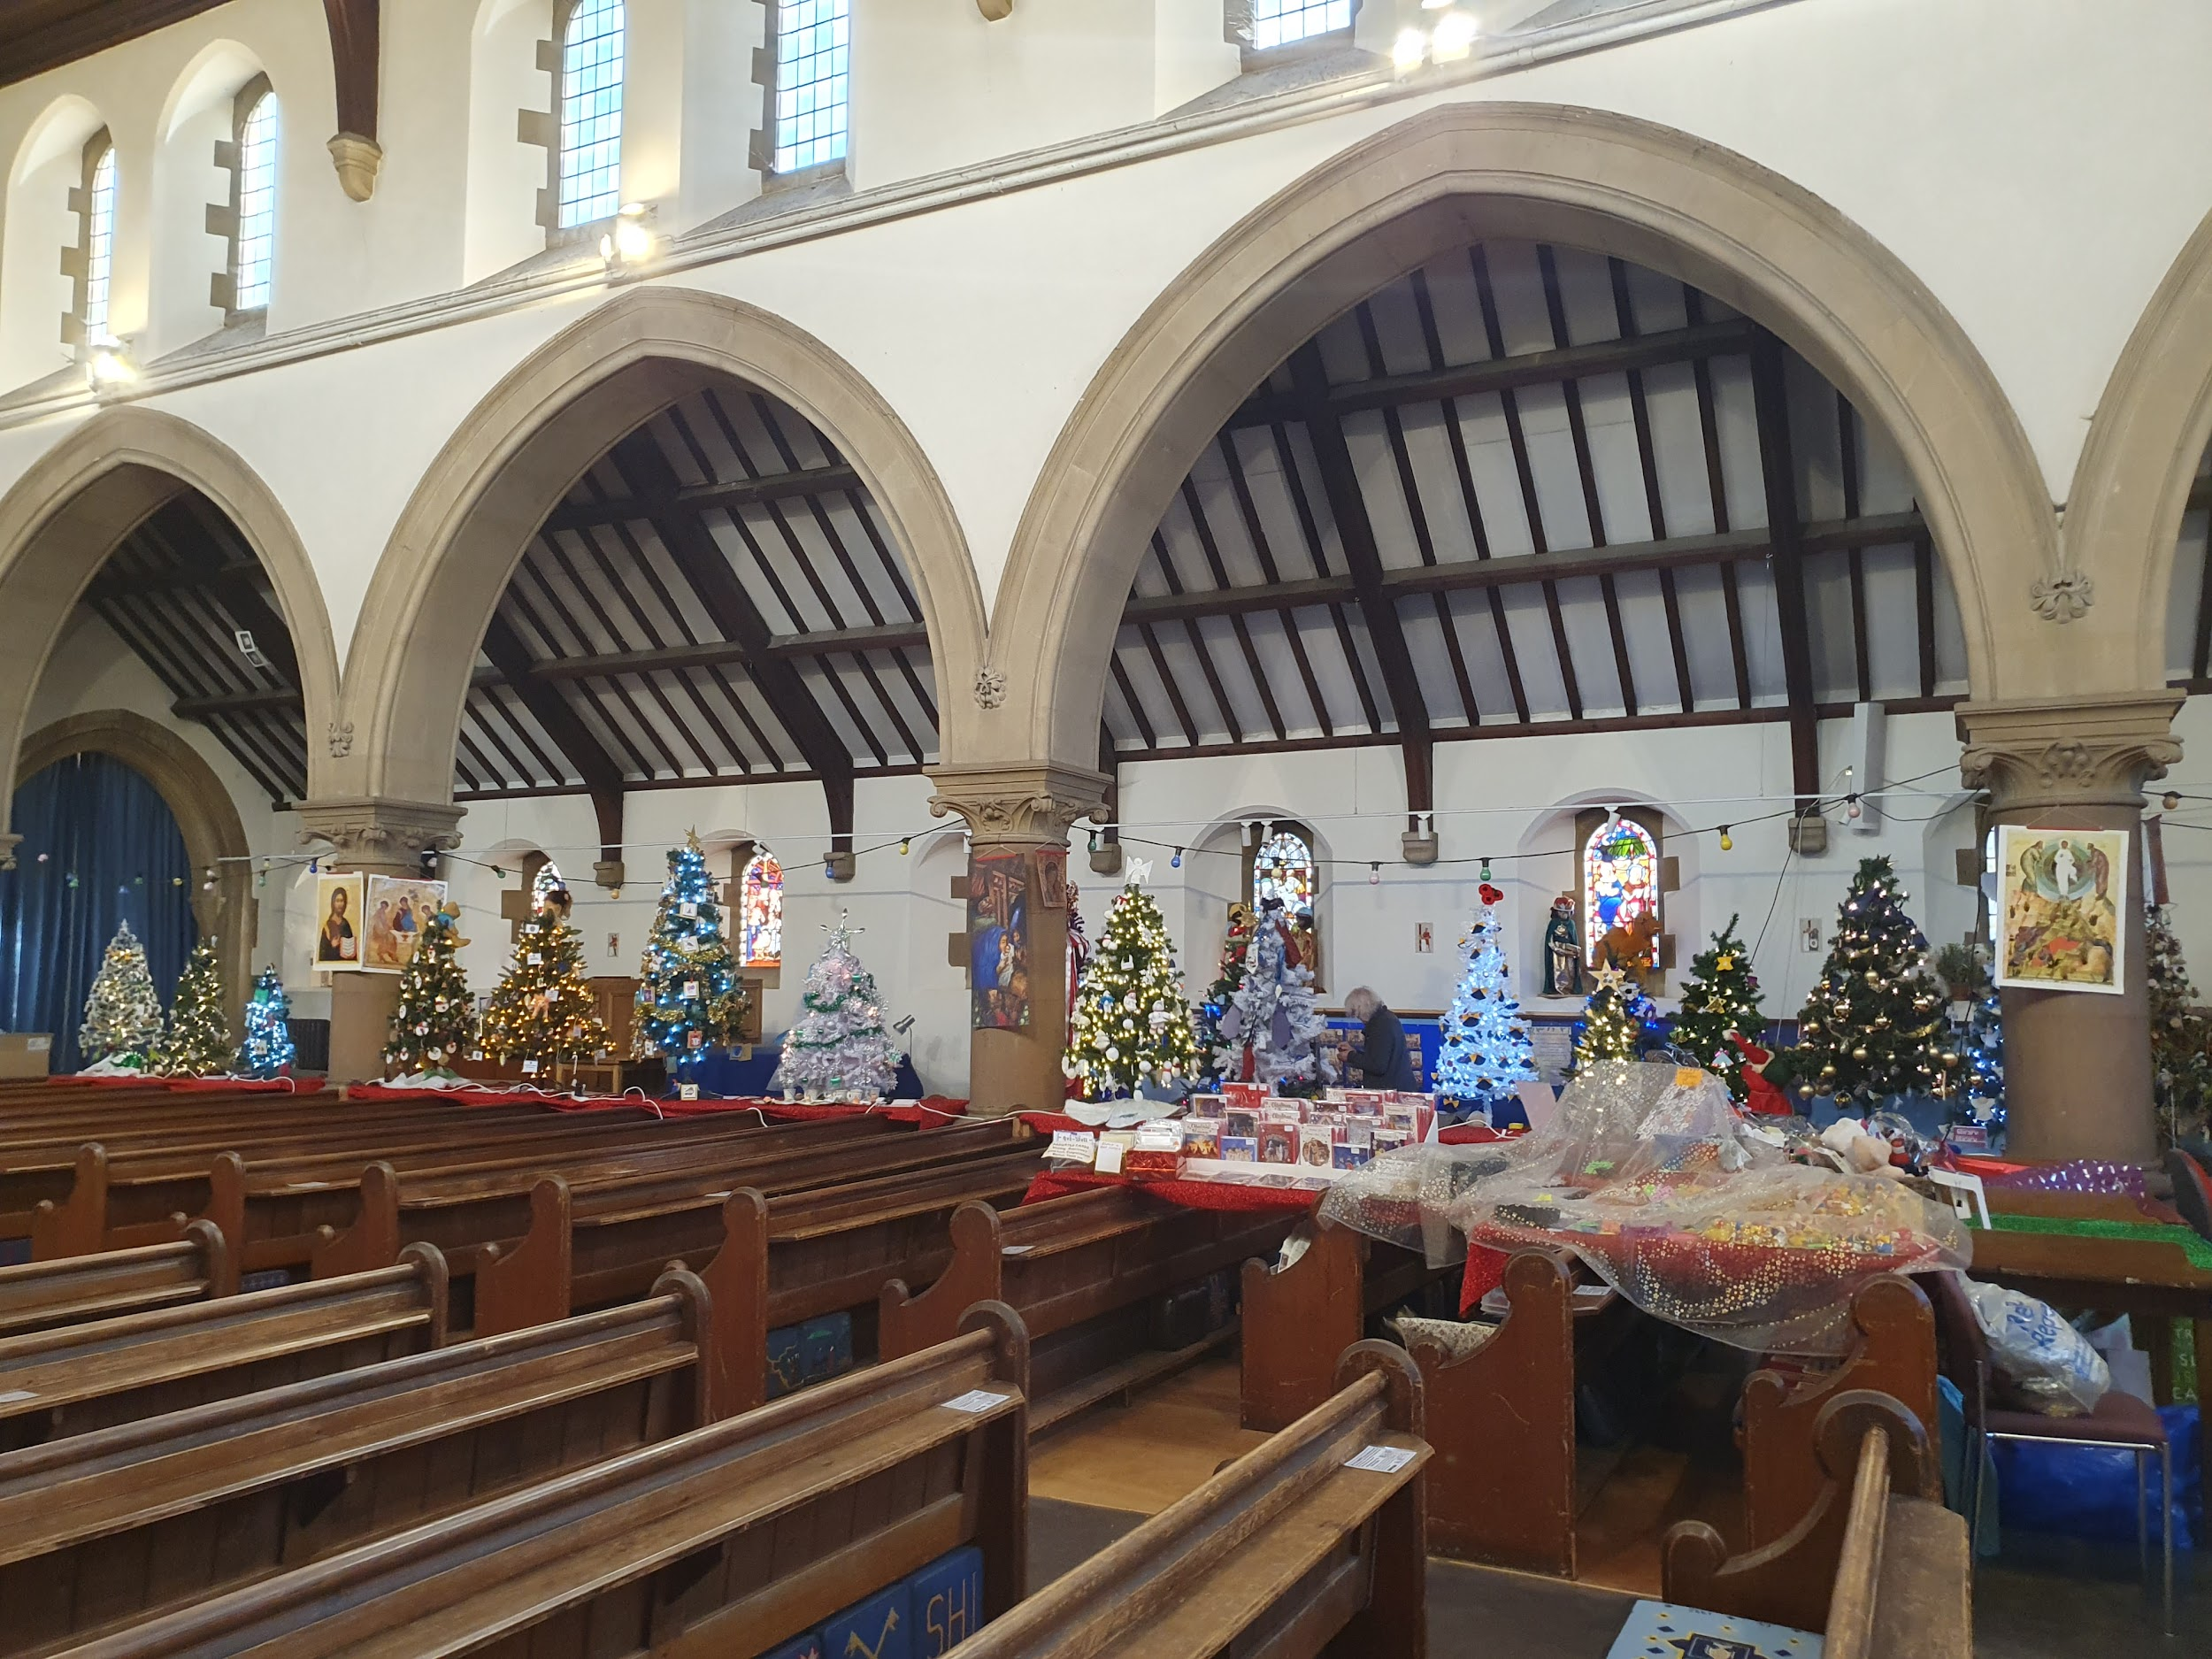
This weekend is the Christmas Tree Festival at St. Peter’s Church, March. We have entries from Cavalry in the competition, so why not go along, enjoy the festival and hopefully, put a vote in for one of our trees!

Slide 5





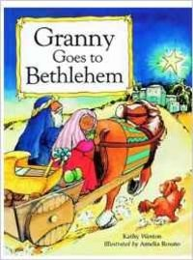

Word Wizard Winners:
Year 3 - Class 8 - 17,586
Year 4 - Class 10 - 270,990
Year 5 - Class 11 - 477,810
Year 6 - Class 14 - 553,086
Mrs Wilson recommends Granny Goes to Bethlehem by Kathy Weston. The night Jesus is born, many visitors arrive at the stable and Jesus's Granny and Grandad arrived too. And Jesus's Granny wasn't at all pleased to find her grandson stuck in a smelly old stable with all these animals. And she wasn't keen on all these strange visitors either. Imagine someone giving a lamb as a gift to a baby!
Well done to Miss Jones’ group. This week they have all written FANTASTIC ‘Big Writes’ based on ‘Playdate’.
Miss Jones recommends:
We would love to recommend Clump the Lump of Coal by Eleanor Best. Miss Jones had the pleasure of sharing this delightful story with Class One, and it had everyone laughing out loud as they practised the funny faces they might pull if Clump appeared in their stocking on Christmas morning! Our favourite moment in the story is when Clump proudly says, “My difference makes me special and brings others so much joy.” This heart-warming book teaches a wonderful message about celebrating our differences and finding happiness in being unique.
Mrs Wilson thinks Jesus’ Granny is from Yorkshire so you have to read the speech in a Yorkshire accent!

Slide 6

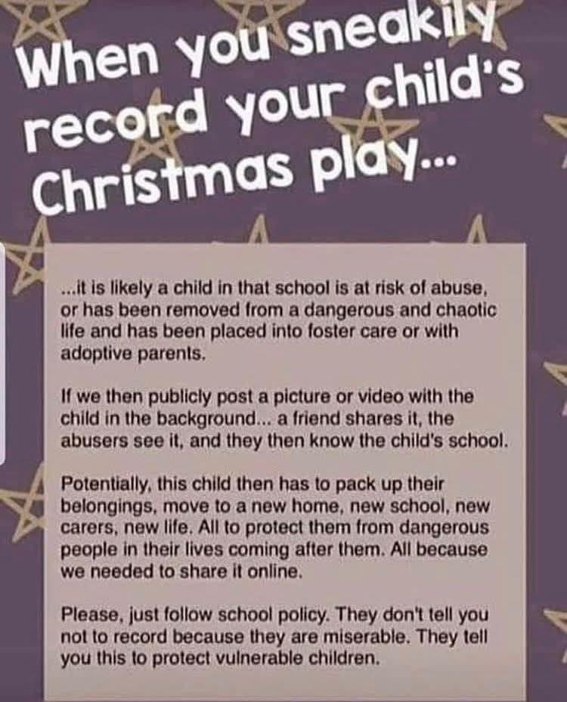
A polite reminder ahead of next week’s performances, that the filming and photography of our performances is strictly prohibited. This is to protect vulnerable pupils.
Instead, we have taken a photograph of your child that you will receive. We hope you enjoy the shows!
We are aiming for 97% attendance.
This week, our classes with the highest attendance are…
KS1 - Class 5 95%
KS2 - Class 11 98.92%
WELL DONE

Slide 7


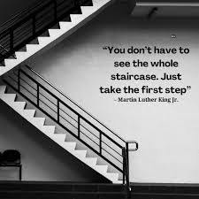
Reception Nativity 16th & 17th (9:15 - 9:45am) Y1,Y2 & Y3 Production 15th, 16th & 17th (2.30-3.15pm) Nursery Sing Along 17th Dec @11.30 OR 2.45 Y4, Y5, Y6 Production 17th Dec (5.30-6.30pm) & Thur 18th Dec (9.15-10.15am & 2:00-3:00pm Last day of term Friday 19th Dec
Training Days Mon 5th January 2026
Back to School Tuesday 6th January

Slide 8
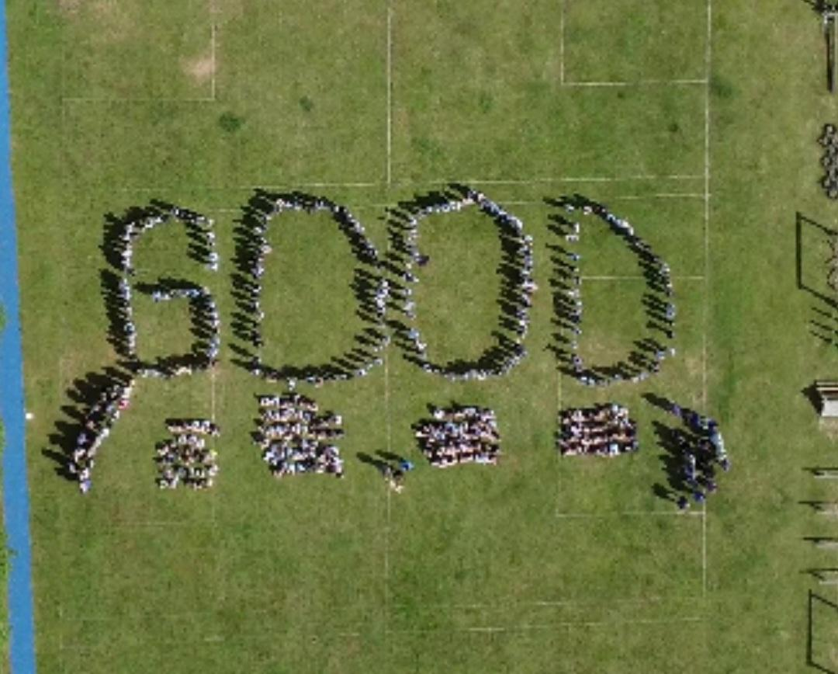
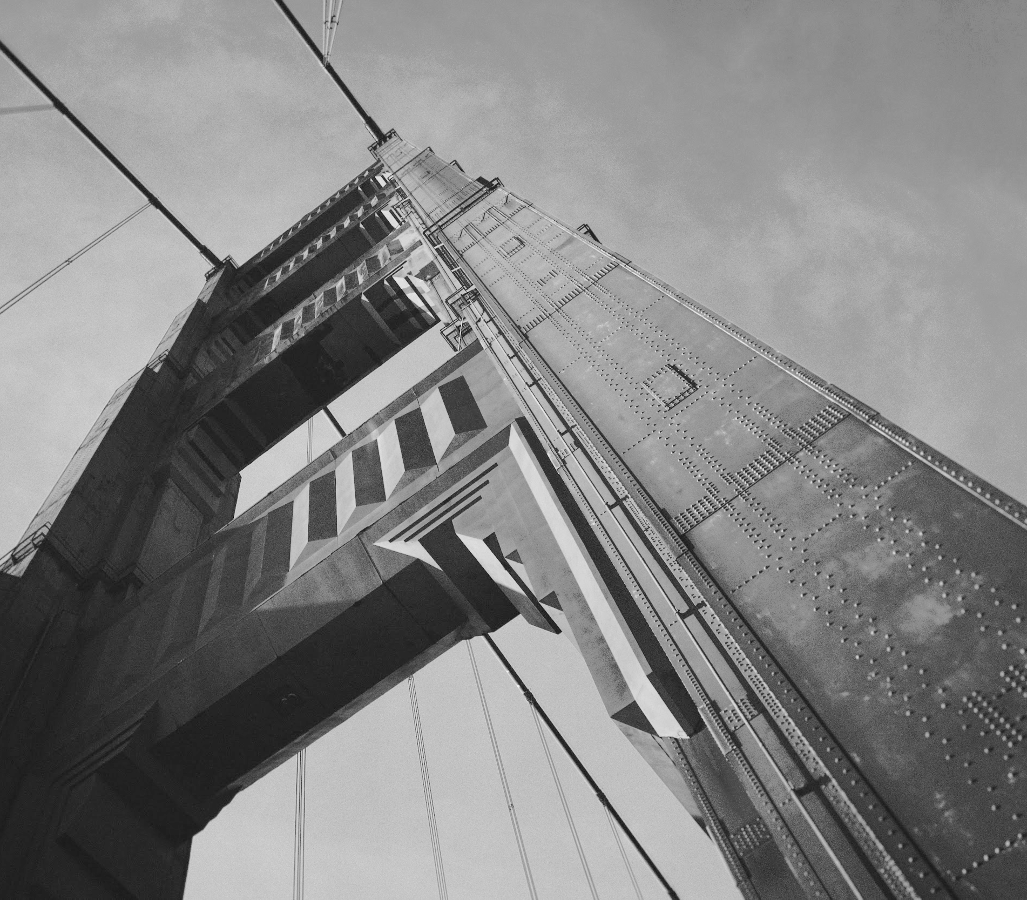
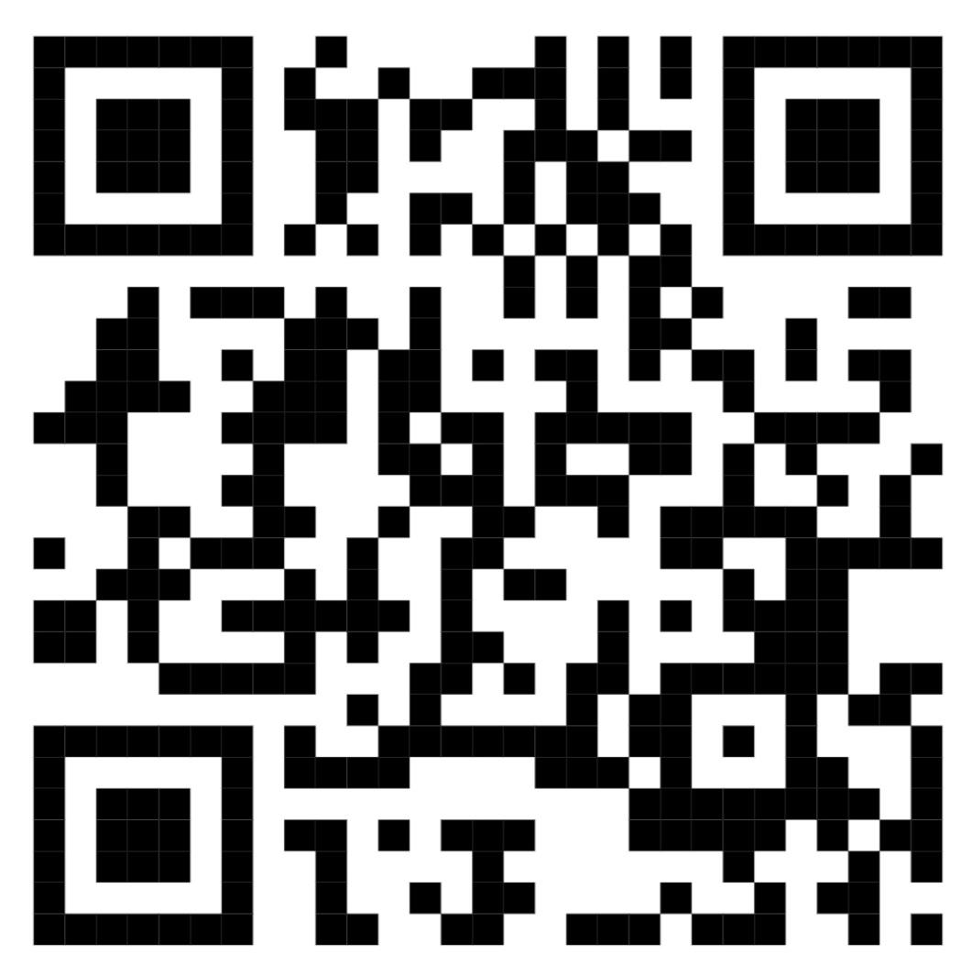
Cavalry Website
Contact us:
Cavalry Primary School Cavalry Drive March Cambridgeshire PE15 9EQ
office@cavalryprimary.org
Tel: 01354 652814

